Slide 1
March 22, 2020

Slide 2
Ongoing Needs
Sunday Prep
Office work
Cleaning upstairs
Building & yard maintenance

Slide 3
Small Groups
Freedom Session
Sundays @ 4:30 @ Parkdale
Women’s
Tuesdays @ 3pm @ Main’s
Men’s
Tuesdays @ 11:30, Wednesdays @ 1:00

Slide 4
Psalm 91
¹ Whoever dwells in the shelter of the Most High will rest in the shadow of the Almighty.
² I will say of the Lord, “He is my refuge and my fortress, my God, in whom I trust.”

Slide 5
⁹ If you say, “The Lord is my refuge,” and you make the Most High your dwelling, ¹⁰ no harm will overtake you, no disaster will come near your tent.
¹¹ For he will command his angels concerning you to guard you in all your ways; ¹² they will lift you up in their hands, so that you will not strike your foot against a stone.

Slide 6
¹⁴ “Because he loves me,” says the Lord, “I will rescue him; I will protect him, for he acknowledges my name.
¹⁵ He will call on me, and I will answer him; I will be with him in trouble, I will deliver him and honor him. ¹⁶ With long life I will satisfy him and show him my salvation.”

Slide 7
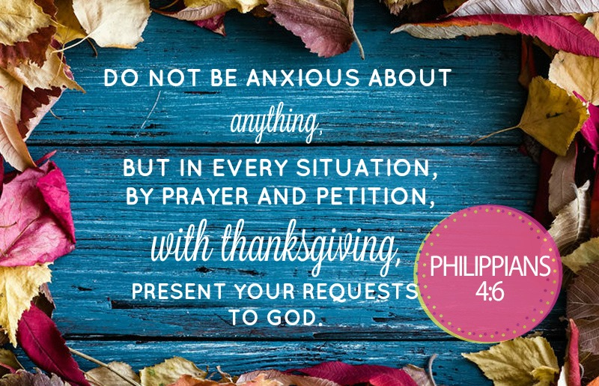

Slide 8
Offering
Online giving available on website:
Parkdalechurch.ca

Slide 9
Kids’ Minute: Sunday school for age 12 and under

Slide 10
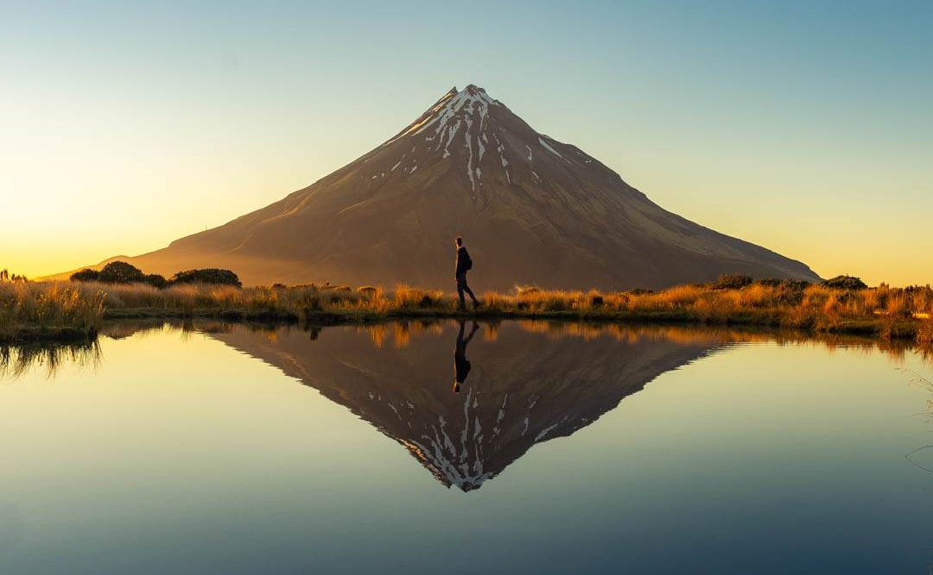
The Gospel of Luke
Parables with a New Perspective

Slide 11
An Ideal Investment
Luke 16:1-13

Slide 12
Discussion
Instability
Have you recently lost anything dear to you? What has changed as a result?
What do you think and feel about what is happening, and where this is all going?

Slide 13
Discussion
The Future
What happened to the manager? What do you think of his response?
What does Jesus compare this situation to? What does it tell us about God, ourselves, and our lives?
What does it mean to be a “shrewd manager” today?

Slide 14
Discussion
Management
What do you have now, that will not last into eternity?
What do you have that lasts forever?
Are there opportunities to use temporary things to invest in what is eternal?

Slide 15
Discussion
Hope
What do you fear losing, more than anything else?
According to Jesus, what is it really worth, and what is it for?
What would it look like to hope in God, above all else?

