Slide 1
June 21, 2020

Slide 2
1 John 3
¹ See what great love the Father has lavished on us, that we should be called children of God! And that is what we are! The reason the world does not know us is that it did not know him.
² Dear friends, now we are children of God, and what we will be has not yet been made known. But we know that when Christ appears, we shall be like him, for we shall see him as he is.
³ All who have this hope in him purify themselves, just as he is pure.

Slide 3
Good, Good, Father
https://www.youtube.com/watch?v=lfeZw1ZB_2g

Slide 4
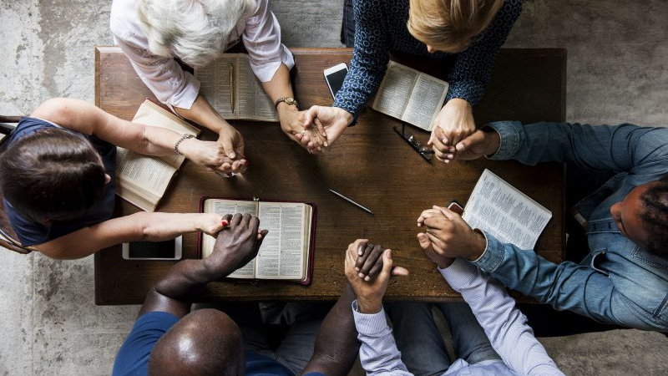
Acts: Becoming the Church
Weekly small groups
Sundays @ Parkdale & Zoom
Outdoor gatherings

Slide 5
Online Connections
Bible Studies on Zoom/in person
Women on Tuesdays; Men on Wednesdays
Sunday Resources
Bulletins, Kids’ activities, Sermons – parkdalechurch.ca
Sermon videos on YouTube channel – Parkdale EFC
Giving Opportunities
In-person, on website, or e-transfer to parkdalechurch@shaw.ca

Slide 6
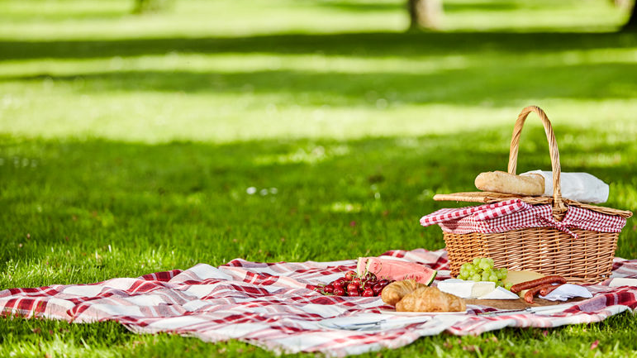
Sunday, July 5
Sunday service with Communion
Outdoor picnic afterward (bring own food)
COBS bread available!

Slide 7
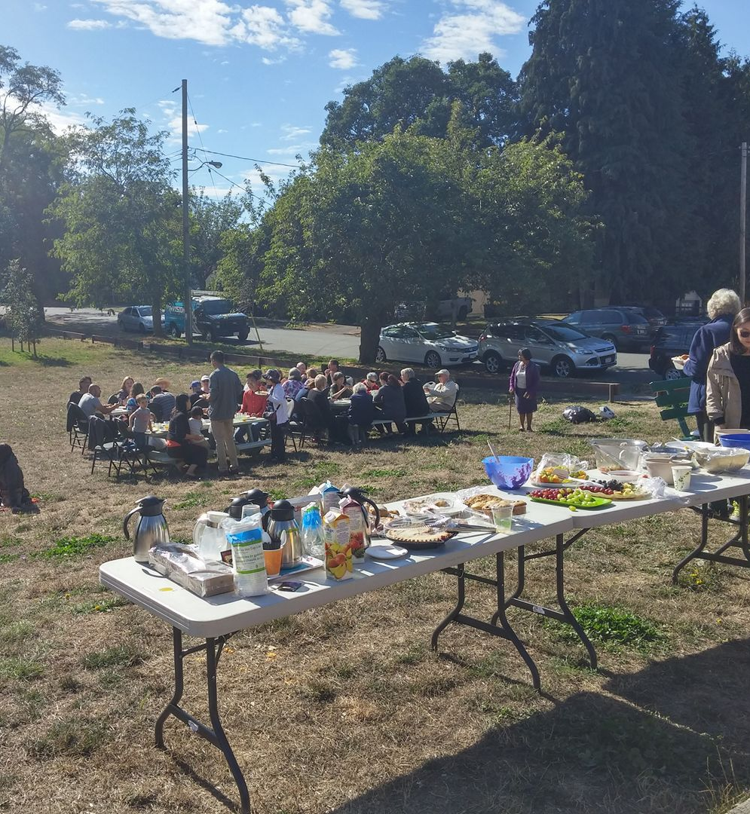
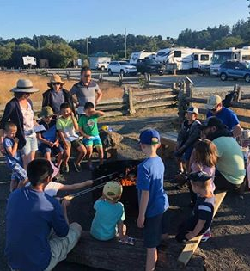

Slide 8
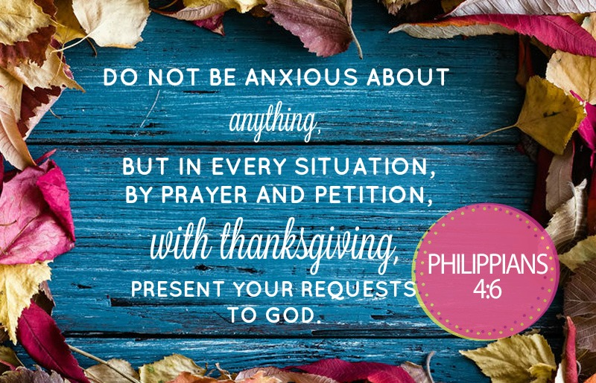

Slide 9
Kids’ Minute: Find the activity sheet on the website!

Slide 10
1 John 4
¹⁶ God is love. Whoever lives in love lives in God, and God in them.
¹⁷ This is how love is made complete among us so that we will have confidence on the day of judgment: In this world we are like Jesus.
¹⁸ There is no fear in love. But perfect love drives out fear, because fear has to do with punishment. The one who fears is not made perfect in love.
¹⁹ We love because he first loved us.

Slide 11
Whom Shall I Fear?
https://www.youtube.com/watch?v=qOkImV2cJDg

Slide 12
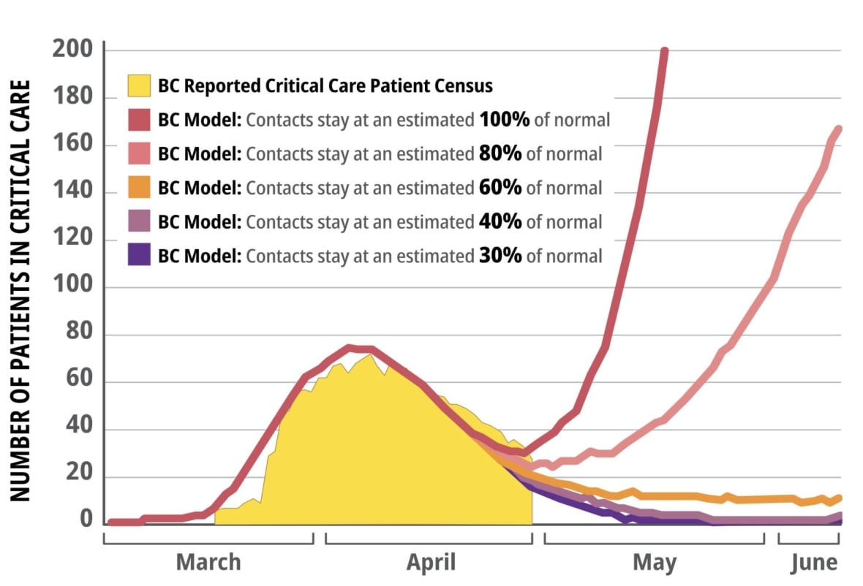
Modeling from April 17, announced May 4

Slide 13
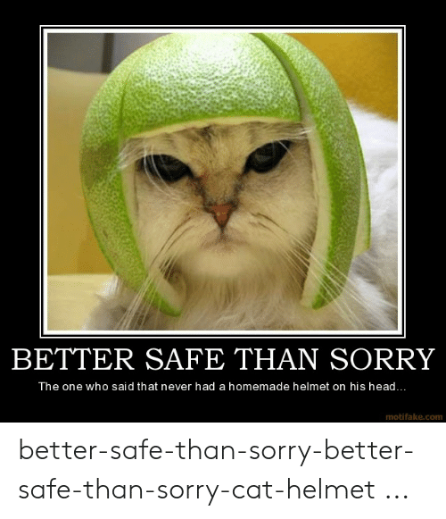

Slide 14
Breakout Question
How have you experienced fear?
How has it affected you?
When is fear helpful, and when is it harmful?

Slide 15
Acts 5:12-16
¹² The apostles performed many signs and wonders among the people. And all the believers used to meet together in Solomon’s Colonnade. ¹³ No one else dared join them, even though they were highly regarded by the people.
¹⁴ Nevertheless, more and more men and women believed in the Lord and were added to their number. ¹⁵ As a result, people brought the sick into the streets and laid them on beds and mats so that at least Peter’s shadow might fall on some of them as he passed by. ¹⁶ Crowds gathered also from the towns around Jerusalem, bringing their sick and those tormented by impure spirits, and all of them were healed.

Slide 16
Acts 5:17-20
¹⁷ Then the high priest and all his associates, who were members of the party of the Sadducees, were filled with jealousy. ¹⁸ They arrested the apostles and put them in the public jail.
¹⁹ But during the night an angel of the Lord opened the doors of the jail and brought them out. ²⁰ “Go, stand in the temple courts,” he said, “and tell the people all about this new life.”

Slide 17
Acts 5

Slide 18
Acts 5:21-24
²¹ At daybreak they entered the temple courts, as they had been told, and began to teach the people. When the high priest and his associates arrived, they called together the Sanhedrin—the full assembly of the elders of Israel—and sent to the jail for the apostles.
²² But on arriving at the jail, the officers did not find them there. So they went back and reported, ²³ “We found the jail securely locked, with the guards standing at the doors; but when we opened them, we found no one inside.” ²⁴ On hearing this report, the captain of the temple guard and the chief priests were at a loss, wondering what this might lead to.

Slide 19
Acts 5:21-24
²⁵ Then someone came and said, “Look! The men you put in jail are standing in the temple courts teaching the people.” ²⁶ At that, the captain went with his officers and brought the apostles. They did not use force, because they feared that the people would stone them.
²⁷ The apostles were brought in and made to appear before the Sanhedrin to be questioned by the high priest. ²⁸ “We gave you strict orders not to teach in this name,” he said. “Yet you have filled Jerusalem with your teaching and are determined to make us guilty of this man’s blood.”

Slide 20
Acts 5:29-32
²⁹ Peter and the other apostles replied: “We must obey God rather than human beings!
³⁰ The God of our ancestors raised Jesus from the dead—whom you killed by hanging him on a cross. ³¹ God exalted him to his own right hand as Prince and Savior that he might bring Israel to repentance and forgive their sins.
³² We are witnesses of these things, and so is the Holy Spirit, whom God has given to those who obey him.”

Slide 21
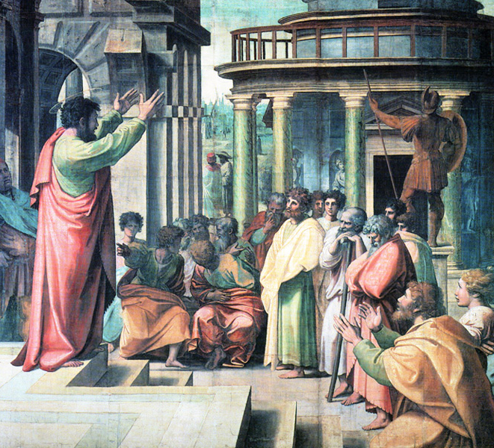
Acts 5

Slide 22
No Longer Slaves
https://www.youtube.com/watch?v=PQqkXg-C9jo

Slide 24
Discussion – Agents of Peace
As a Christian, when have you experienced fear, and how has it affected you?
How have you found peace, and how would you explain it to others?

