Slide 1
Oct 18, 2020

Slide 2
Oh How Good It Is
https://www.youtube.com/watch?v=ZILsLR3PH3Y

Slide 3
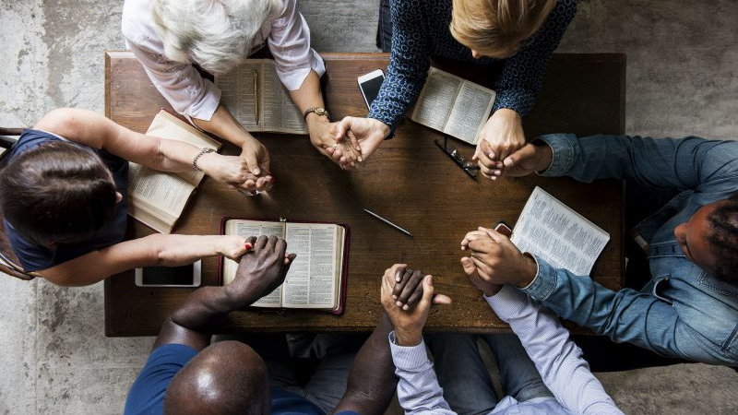
Acts: Becoming the Church
Sundays @ Parkdale & Zoom
New Groups in the fall
Giving online & e-transfer
Parkdalechurch.ca

Slide 4
Membership @ Parkdale
Belonging
Through faith in Jesus, we become children of God, growing to become like Him (John 1:12; 1 John 3:1-3)
And, as members of His worldwide family, we are called to love one another in unity (John 13:34-35, John 17:20-23)
Like parts of a body, we belong to each other, and are given unique gifts to serve one another (Romans 12:4-6)
Leaders are given responsibility to care for the church, and need our prayerful, practical support (Hebrews 13:17)
We belong to God’s worldwide church …but to which local church am I responsible?

Slide 5
Membership @ Parkdale
Committing
Choosing a “home church” and getting involved
Accepting mutual responsibility – to serve, care, and contribute according to your gifts
Accepting mutual authority – supporting leaders, participating by voting & holding leadership positions
Steps
Attending a membership class to understand our beliefs, history and practices
Sharing your testimony to indicate your faith in Christ
Being officially welcomed by the church family

Slide 6
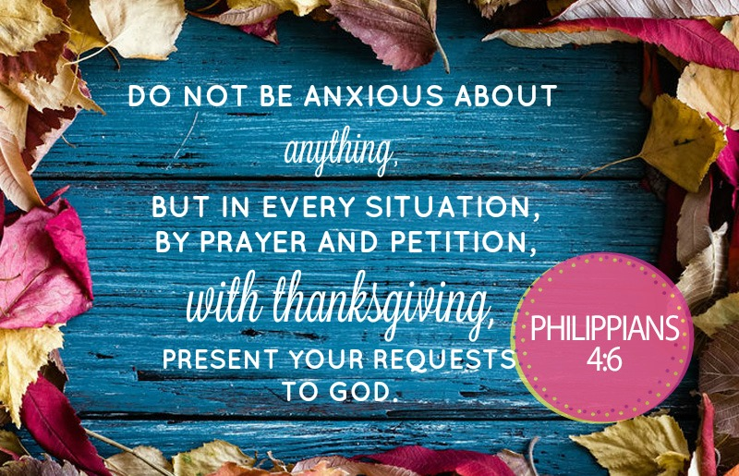

Slide 7
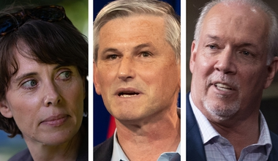
1 Timothy 2:1-6
I urge, then, first of all, that petitions, prayers, intercession and thanksgiving be made for all people - for kings and all those in authority, that we may live peaceful and quiet lives in all godliness and holiness.
This is good, and pleases God our Savior, who wants all people to be saved and to come to a knowledge of the truth. For there is one God and one mediator between God and mankind, the man Christ Jesus, who gave himself as a ransom for all people. This has now been witnessed to at the proper time.

Slide 8
Kids’ Minute: Find the activity sheet on the website!

Slide 9
Samaritan’s Purse Shoeboxes: Operation Christmas Child
https://youtu.be/pmbp0xr7HVk

Slide 10
Discussion Question
What do we mean when something is “wasted”?
What does it mean when something is “well-spent”?
Consider money…
Consider one’s life…
Paul’s Example: Acts 20:24
However, I consider my life worth nothing to me; my only aim is to finish the race and complete the task the Lord Jesus has given me—the task of testifying to the good news of God’s grace.

Slide 11
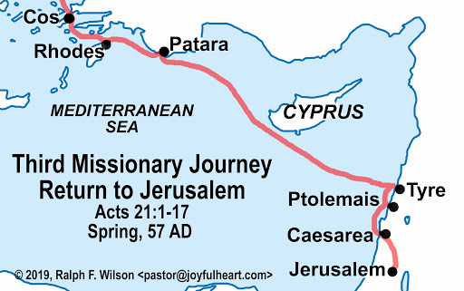
Acts 21:1-6
¹ After we had torn ourselves away from them, we put out to sea and sailed straight to Kos. The next day we went to Rhodes and from there to Patara.² We found a ship crossing over to Phoenicia, went on board and set sail.³ After sighting Cyprus and passing to the south of it, we sailed on to Syria. We landed at Tyre, where our ship was to unload its cargo. ⁴ We sought out the disciples there and stayed with them seven days. Through the Spirit they urged Paul not to go on to Jerusalem. ⁵ When it was time to leave, we left and continued on our way. All of them, including wives and children, accompanied us out of the city, and there on the beach we knelt to pray. ⁶ After saying goodbye to each other, we went aboard the ship, and they returned home.

Slide 12
Acts 21:7-11
⁷ We continued our voyage from Tyre and landed at Ptolemais, where we greeted the brothers and sisters and stayed with them for a day. ⁸ Leaving the next day, we reached Caesarea and stayed at the house of Philip the evangelist, one of the Seven. ⁹ He had four unmarried daughters who prophesied.
¹⁰ After we had been there a number of days, a prophet named Agabus came down from Judea. ¹¹ Coming over to us, he took Paul’s belt, tied his own hands and feet with it and said, “The Holy Spirit says, ‘In this way the Jewish leaders in Jerusalem will bind the owner of this belt and will hand him over to the Gentiles.’”

Slide 13
Acts 21:12-14
¹² When we heard this, we and the people there pleaded with Paul not to go up to Jerusalem.
¹³ Then Paul answered, “Why are you weeping and breaking my heart? I am ready not only to be bound, but also to die in Jerusalem for the name of the Lord Jesus.” ¹⁴ When he would not be dissuaded, we gave up and said, “The Lord’s will be done.”

Slide 14
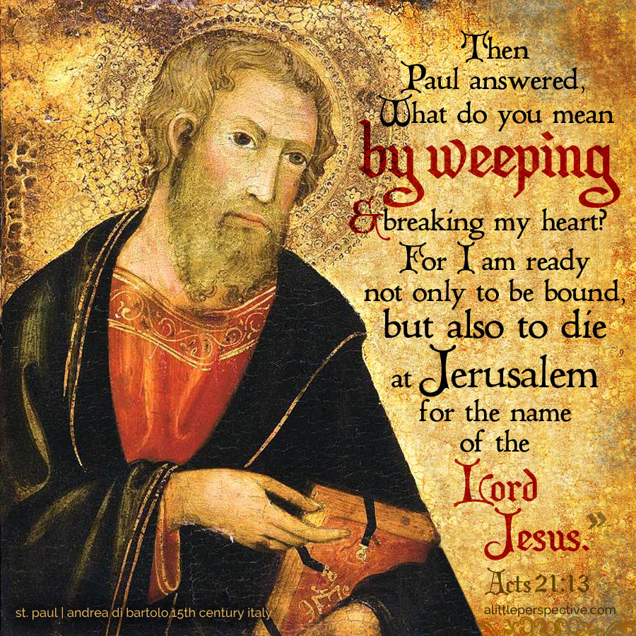
Living with Purpose: Ready for Anything

Slide 15
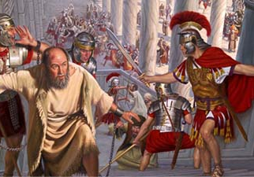
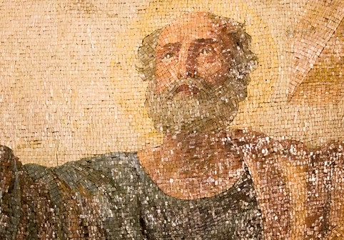
A Life Well Spent

Slide 16
Romans 11:25-32 (NIV)
I do not want you to be ignorant of this mystery, brothers and sisters, so that you may not be conceited: Israel has experienced a hardening in part until the full number of the Gentiles has come in, and in this way all Israel will be saved. As it is written: “The deliverer will come from Zion; he will turn godlessness away from Jacob. And this is my covenant with them when I take away their sins.”
As far as the gospel is concerned, they are enemies for your sake; but as far as election is concerned, they are loved on account of the patriarchs, for God’s gifts and his call are irrevocable. Just as you who were at one time disobedient to God have now received mercy as a result of their disobedience, so they too have now become disobedient in order that they too may now receive mercy as a result of God’s mercy to you. For God has bound everyone over to disobedience so that he may have mercy on them all.

Slide 17
Romans 11:32-36 (NIV)
Oh, the depth of the riches of the wisdom and knowledge of God! How unsearchable his judgments, and his paths beyond tracing out!
“Who has known the mind of the Lord? Or who has been his counselor?” “Who has ever given to God, that God should repay them?”
For from him and through him and for him are all things.
To him be the glory forever! Amen.

Slide 18
Genesis 4:26 (NIV)
Seth also had a son, and he named him Enosh. At that time people began to call on the name of the Lord.
Genesis 11:8-9 (NIV)
So the Lord scattered them from there over all the earth, and they stopped building the city. That is why it was called Babel —because there the Lord confused the language of the whole world. From there the Lord scattered them over the face of the whole earth.
Zephaniah 3:9 (JUB)
For then I will restore to the peoples the pure language that they may all call upon the name of the LORD to serve him with one consent.

Slide 19
Today I Choose
https://www.youtube.com/watch?v=rSOQQVvHwJI

