Slide 1
Nov 22, 2020

Slide 2
Deuteronomy 8:2-5
² Remember how the Lord your God led you all the way in the wilderness these forty years, to humble and test you in order to know what was in your heart, whether or not you would keep his commands.
³ He humbled you, causing you to hunger and then feeding you with manna, which neither you nor your ancestors had known, to teach you that man does not live on bread alone but on every word that comes from the mouth of the Lord.
⁴ Your clothes did not wear out and your feet did not swell during these forty years.
⁵ Know then in your heart that as a man disciplines his son, so the Lord your God disciplines you.

Slide 3
Desert Song
https://www.youtube.com/watch?v=c3l1z7bXY9Y

Slide 4
Being the Church in these times
Online
Sunday Worship @ 10am
Small Groups (see bulletin)
Elections: November 29
Giving (online, email)
In-Person
Baptisms, Support Groups

Slide 5
Being the Church in these times
Compassion: recognize people’s unique situations
Connection: invite, check in, call!

Slide 6
Christmas Decorating: postponed… Kids’ Christmas Service: something creative?

Slide 7
COBS Bread still ready for pickup! Food Cupboard stocking it for Christmas!

Slide 8
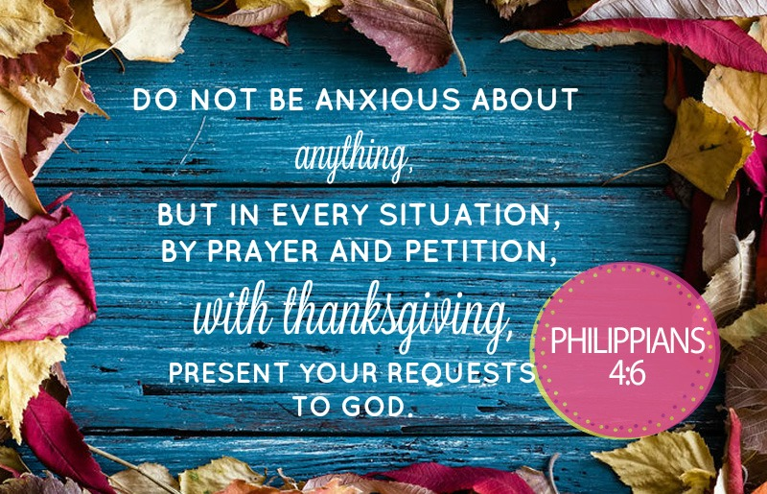

Slide 9
Kids’ Minute: Find the activity sheet on the website!

Slide 10
Will Your Anchor Hold?
https://www.youtube.com/watch?v=PrjKUII-V18

