Slide 1
Jan 3, 2021

Slide 2
Here I am to Worship
https://www.youtube.com/watch?v=qhq0kDw0E8c

Slide 3
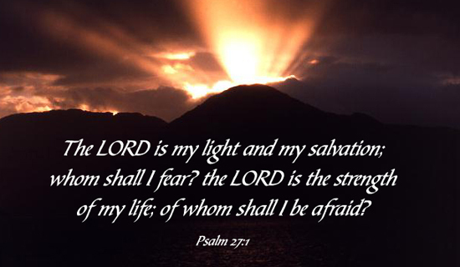

Slide 5
Letters of John: Walking in the Light
1 John 1:1-4
Our Basis for Fellowship

Slide 6
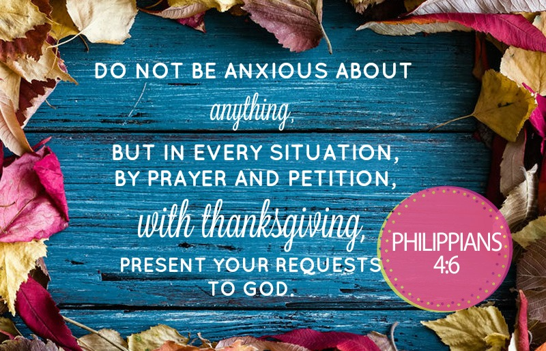

Slide 7
Kids’ Minute: Find the activity sheet on the website!

Slide 8
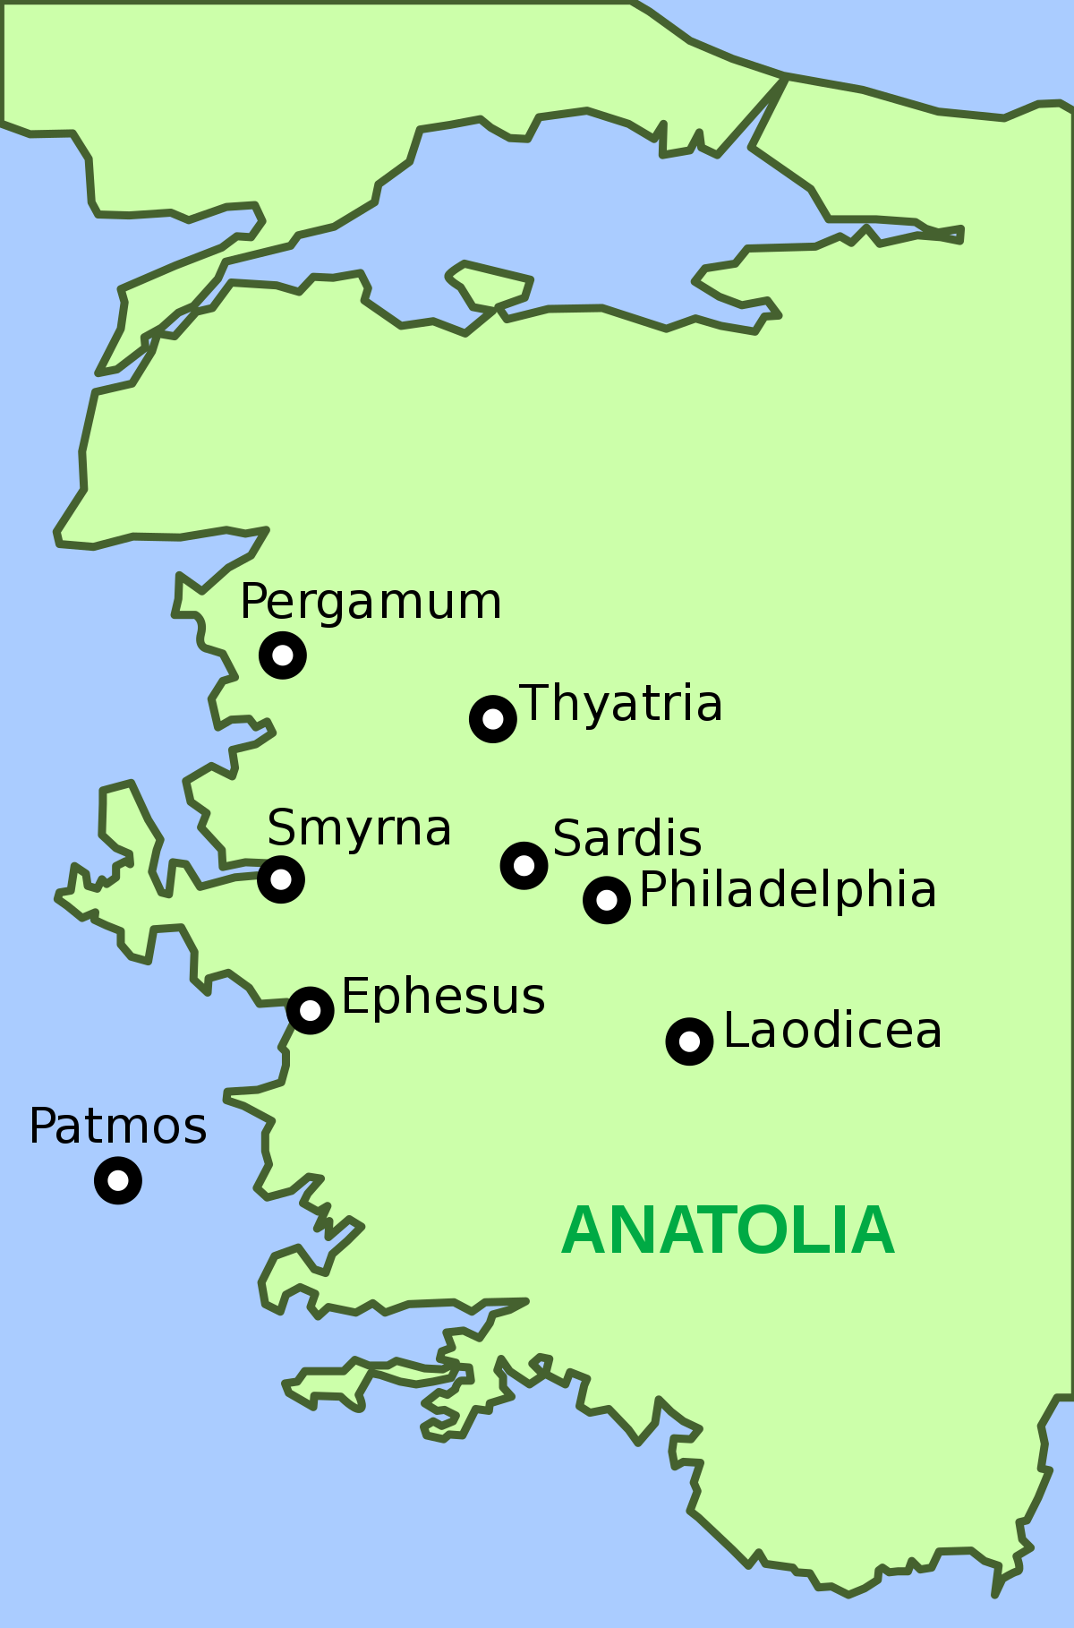
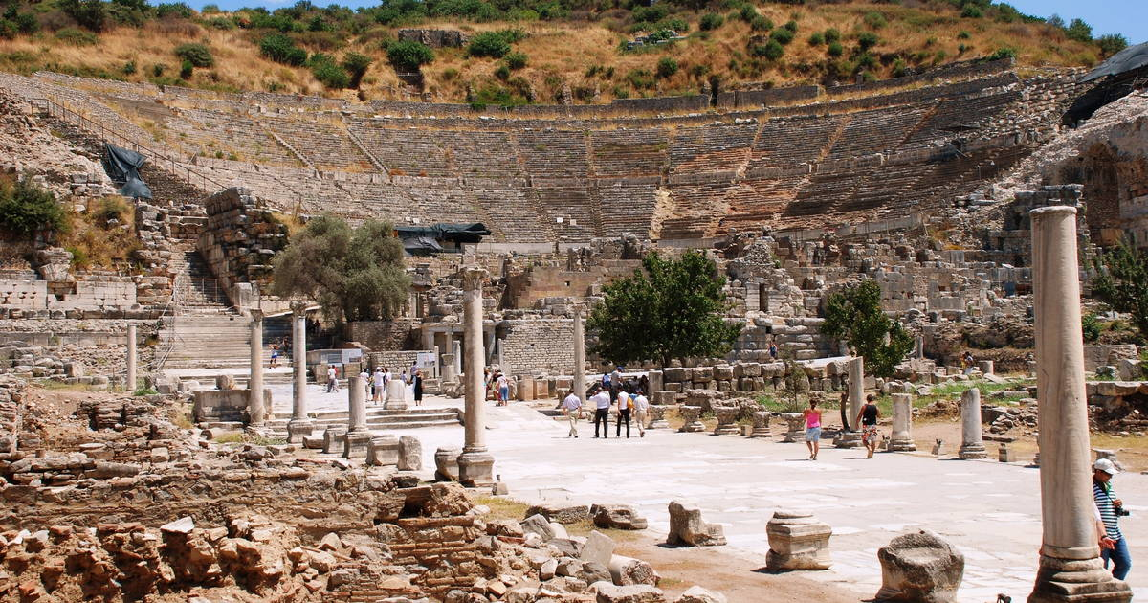
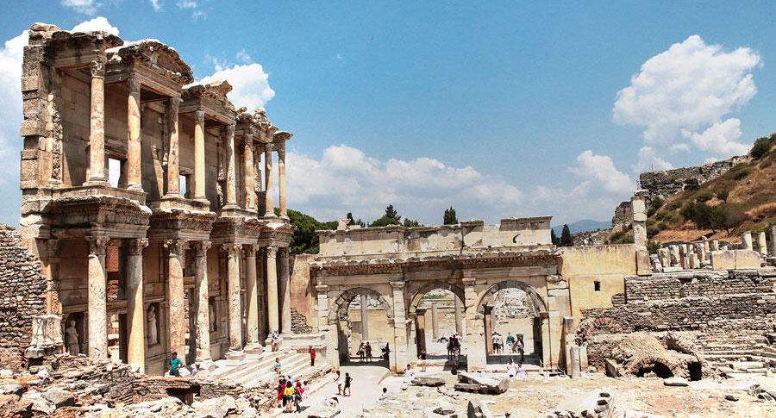

Slide 9
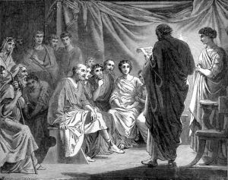
Discussion Questions
What stood out to you?
What did you hear from God?
Was there a verse that challenged or encouraged you? Why?

Slide 10
1 John 1:1-4
That which was from the beginning, which we have heard, which we have seen with our eyes, which we have looked at and our hands have touched—this we proclaim concerning the Word of life. The life appeared; we have seen it and testify to it, and we proclaim to you the eternal life, which was with the Father and has appeared to us.
We proclaim to you what we have seen and heard, so that you also may have fellowship with us. And our fellowship is with the Father and with his Son, Jesus Christ. We write this to make our joy complete.

Slide 11
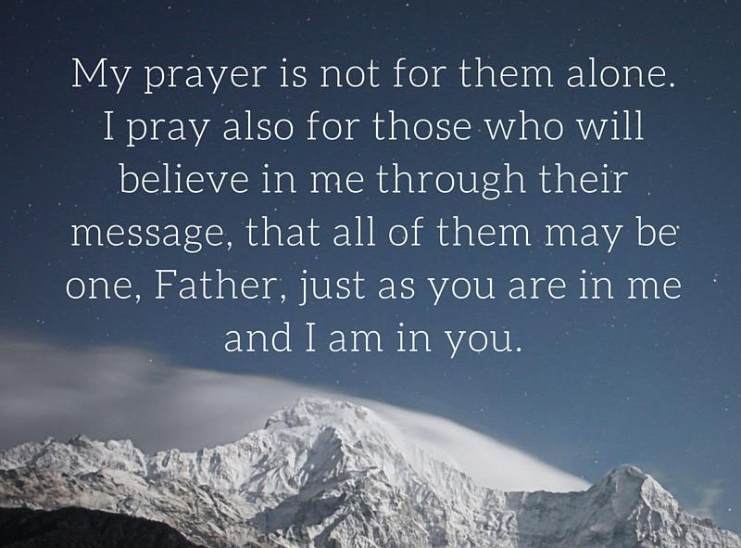

Slide 12
Oh How Good it Is
https://www.youtube.com/watch?v=ZILsLR3PH3Y

