Slide 1
Feb 21, 2021

Slide 3
God of All My Days
https://www.youtube.com/watch?v=ZYkZE8AogDE

Slide 4
The Letters of John: Walking in the Light
1 John 4:1-6
The Spirit of Truth

Slide 5
Walking in the Light …together in 2021
Serving, Giving
Thank you!
Parkdale AGM
Sunday, Feb 28 @ 11:30am
Online group studies:
Ladies: Thursdays @ 3:00pm
Men’s: Thursdays @ 6:30pm
1 John: Wednesdays @ 8:00pm
Authentic Living
Tuesdays @ 7:00pm (Feb 16 start)

Slide 7
Kids’ Minute: Find the activity sheet on the website!

Slide 8
Discussion Questions:
Have you ever been treated a certain way because of certain labels that you carry?
Family position
Employment
Cultural background

Slide 9
1 John 4:1-3
¹ Dear friends, do not believe every spirit, but test the spirits to see whether they are from God, because many false prophets have gone out into the world.
² This is how you can recognize the Spirit of God: Every spirit that acknowledges that Jesus Christ has come in the flesh is from God, ³ but every spirit that does not acknowledge Jesus is not from God. This is the spirit of the antichrist, which you have heard is coming and even now is already in the world.

Slide 10
1 John 4:4-6
⁴ You, dear children, are from God and have overcome them, because the one who is in you is greater than the one who is in the world.
⁵ They are from the world and therefore speak from the viewpoint of the world, and the world listens to them. ⁶ We are from God, and whoever knows God listens to us; but whoever is not from God does not listen to us. This is how we recognize the Spirit of truth and the spirit of falsehood.

Slide 11
1 John 5:13 – I write these things to you who believe in the name of the Son of God so that you may know that you have eternal life.
Ch.1 – Assured that the Gospel message is true, which brings us forgiveness and fellowship with God
Ch.2 – Assured that our faith is true, evidenced by our love and the Spirit’s presence
Ch.3 – Assured that our love is true, as it follows the example of Christ
Ch.4 – Assured that the voice of the Spirit is true, as He guides us to Jesus Christ

Slide 12
1 John 4:1-3
¹ Dear friends, do not believe every spirit, but test the spirits to see whether they are from God, because many false prophets have gone out into the world.
² This is how you can recognize the Spirit of God: Every spirit that acknowledges that Jesus Christ has come in the flesh is from God, ³ but every spirit that does not acknowledge Jesus is not from God. This is the spirit of the antichrist, which you have heard is coming and even now is already in the world.

Slide 13
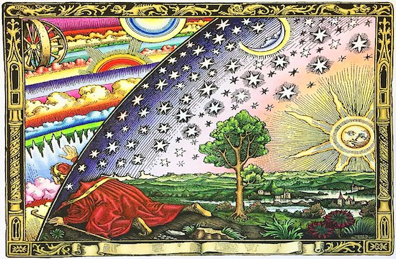
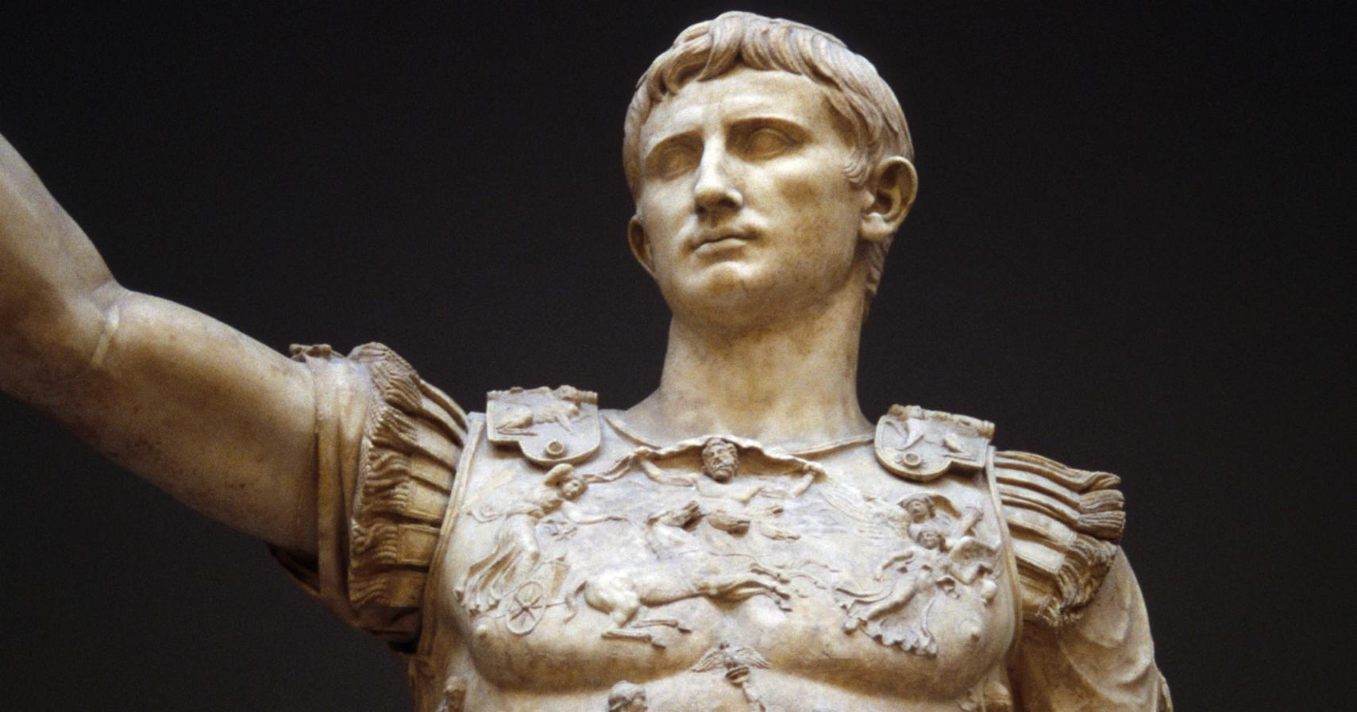
Gnosticism
Denial of the physical world
Pursuit of divine knowledge
Secularism & Paganism
Denial of the true God
Pursuit of worldly power

Slide 14
The Role of the Spirit
John 15:26
“When the Advocate comes, whom I will send to you from the Father—the Spirit of truth who goes out from the Father—he will testify about me.
John 16:13
But when he, the Spirit of truth, comes, he will guide you into all the truth. He will not speak on his own; he will speak only what he hears, and he will tell you what is yet to come.

Slide 15
1 John 4:4-6
⁴ You, dear children, are from God and have overcome them, because the one who is in you is greater than the one who is in the world.
⁵ They are from the world and therefore speak from the viewpoint of the world, and the world listens to them. ⁶ We are from God, and whoever knows God listens to us; but whoever is not from God does not listen to us. This is how we recognize the Spirit of truth and the spirit of falsehood.

Slide 16
Keeping Conversation with God
2 Timothy 3:16-17
All Scripture is God-breathed and is useful for teaching, rebuking, correcting and training in righteousness, so that the servant of God may be thoroughly equipped for every good work.
Remember – journaling
Reflect – meditating
Respond – an open heart
Reassurance – in community

Slide 17
Ancient Words
https://www.youtube.com/watch?v=ue6a3LERJW8

