Slide 1
Feb 28, 2021

Slide 2
One Thing Remains
https://www.youtube.com/watch?v=234MrMdWo8E

Slide 3
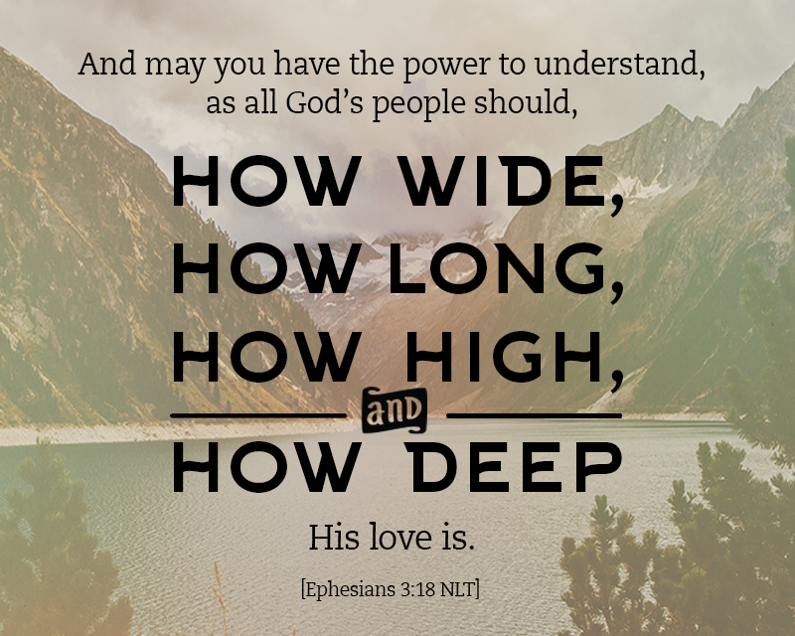

Slide 4
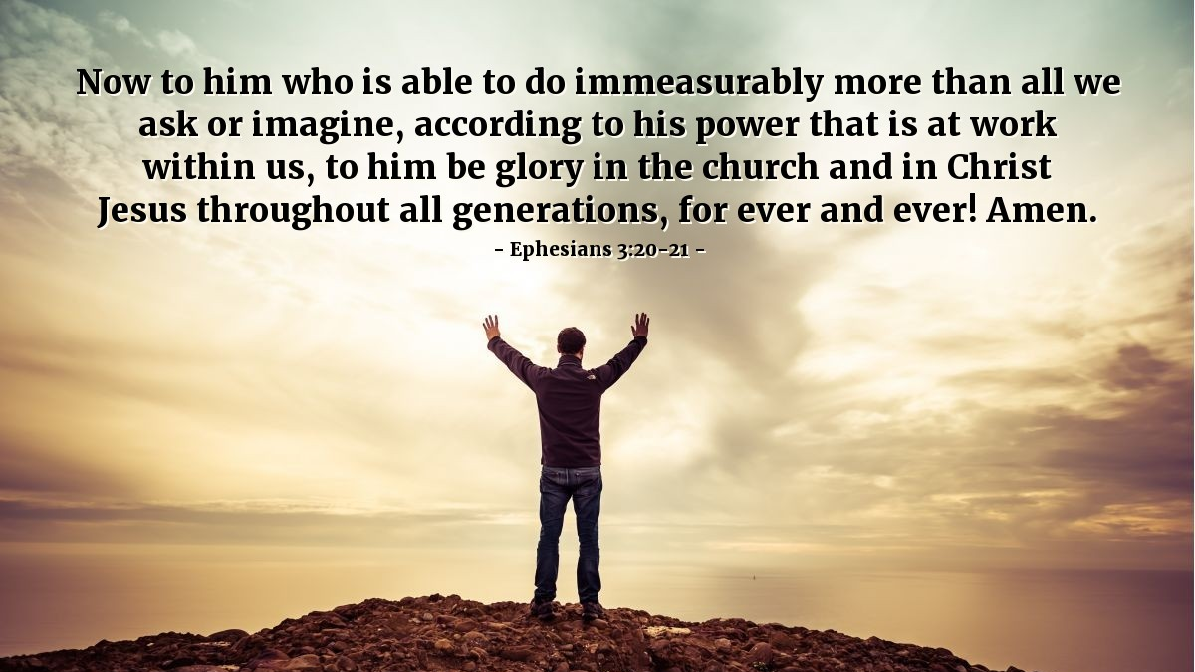

Slide 5
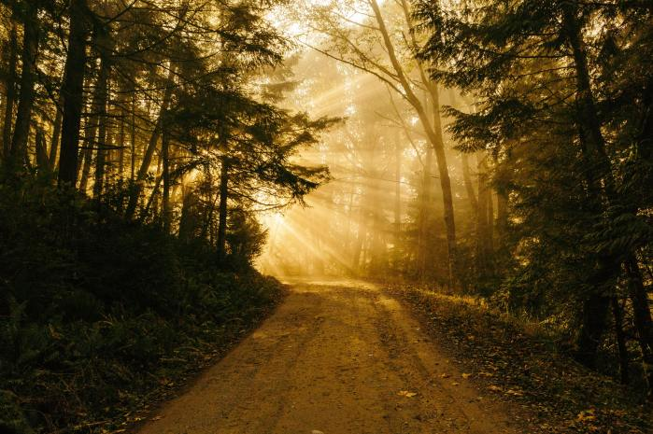
The Letters of John: Walking in the Light
1 John 4:7-21
The Beginning and End of Love

Slide 6
Walking in the Light …together in 2021
Serving, Giving
Thank you!
Parkdale AGM
Sunday, Feb 28 @ 11:30am
Online group studies:
Ladies: Thursdays @ 3:00pm
Men’s: Thursdays @ 6:30pm
1 John: Wednesdays @ 8:00pm
Authentic Living
Tuesdays @ 7:00pm (Feb 16 start)

Slide 8
Kids’ Minute: Find the activity sheet on the website!

Slide 9
Discussion Questions
If someone asked you what Christianity was all about, what would you say?
What’s the best explanation you’ve heard?
How would you summarize its basic message?
How do you become a Christian, and live as one?
Practically, how does it work?

Slide 10
1 John 4:7-12
⁷ Dear friends, let us love one another, for love comes from God. Everyone who loves has been born of God and knows God. ⁸ Whoever does not love does not know God, because God is love. ⁹ This is how God showed his love among us: He sent his one and only Son into the world that we might live through him. ¹⁰ This is love: not that we loved God, but that he loved us and sent his Son as an atoning sacrifice for our sins. ¹¹ Dear friends, since God so loved us, we also ought to love one another. ¹² No one has ever seen God; but if we love one another, God lives in us and his love is made complete in us.

Slide 11
1 John 4:13-18
¹³ This is how we know that we live in him and he in us: He has given us of his Spirit. ¹⁴ And we have seen and testify that the Father has sent his Son to be the Savior of the world. ¹⁵ If anyone acknowledges that Jesus is the Son of God, God lives in them and they in God. ¹⁶ And so we know and rely on the love God has for us.
God is love. Whoever lives in love lives in God, and God in them. ¹⁷ This is how love is made complete among us so that we will have confidence on the day of judgment: In this world we are like Jesus. ¹⁸ There is no fear in love. But perfect love drives out fear, because fear has to do with punishment. The one who fears is not made perfect in love.

Slide 12
1 John 4:19-21
¹⁹ We love because he first loved us.
²⁰ Whoever claims to love God yet hates a brother or sister is a liar. For whoever does not love their brother and sister, whom they have seen, cannot love God, whom they have not seen.
²¹ And he has given us this command: Anyone who loves God must also love their brother and sister.

Slide 13
Living in Love
The Beginning:
God is Love
The Middle:
Love completes us
The End:
We Love others

Slide 14
Living in Love
The Beginning:
God is Love
Upward: Believe Where do I look?
The Middle:
Love completes us
Inward: Receive Who am I becoming?
The End:
We Love others
Outward: Follow Who shall I love?

Slide 15
Enough
https://www.youtube.com/watch?v=hXeW36NwBok

