Slide 1
December 19, 2021

Slide 2
Opening Songs
O Come Emmanuel
What Child is This

Slide 3
Events @ Parkdale
Weekly Events
Small Groups (see bulletin)
Ministry teams (see bulletin)
Giving
Website, e-transfer, in-person
Special Events
December 19 – Sunday school play
December 24 – Candlelight service on Zoom @ 4pm
December 26 – Service @10am

Slide 4
Sharing & Prayer
Philippians 4:4-9
Do not be anxious about anything, but in every situation, by prayer and petition, with thanksgiving, present your requests to God. And the peace of God, which transcends all understanding, will guard your hearts and your minds in Christ Jesus.
Finally, brothers and sisters, whatever is true, whatever is noble, whatever is right, whatever is pure, whatever is lovely, whatever is admirable—if anything is excellent or praiseworthy—think about such things. Whatever you have learned or received or heard from me, or seen in me —put it into practice. And the God of peace will be with you.

Slide 5
Hark the Herod
A Christmas play,
by Miriam Stewart

Slide 6
Scene 1
O Come Oh Come Emmanuel
Mary, scrubbing the floor is visited by Gabriel. Gabriel trips of the water bucket then gives her his message.
Gabriel: You are to have a son and you will call him Jesus.
Mary: Wow, what? Are you okay?
Gabriel: Don’t be afraid, it is the truth, God has chosen you to have His son!
Mary: Okay. I believe you. Bye!
Mary and Joseph leave home and travel to Bethlehem

Slide 7
O Little Town of Bethlehem
They arrive and the innkeeper sends them to a stable, because there’s no room in the inn. Mary lays down in the hay and pulls a plastic baby from her shirt.
Joseph: Our baby is plastic!?
Mary: Shhh… no, he’s not. Just in the play, remember?
Joseph: Oh yeah

Slide 8
Scene 2
The First Noel
Angels come to the field where the shepherds and sheep are.
Angels: Jingle bells, jingle bells, jingle all the way… oh what fun it is to ride…
Shepherds look confused/freaked out
Angels: Oh wait, wrong song. Hark the herald angels sing… Don’t be afraid! The son of God has been born in a stable, go and worship him!

Slide 9
Scene 3
Away in a Manger
Shepherds arrive at the stable and look in. Baby crying in the background…
Shepherds: The little Lord Jesus no crying he makes…
Shepherds #1: This can’t be the baby, he’s crying. Let’s keep looking.
Mary: Wait it is the baby!
Shepherd #2: Oh, well in that case…
Shepherds bow down before Jesus
Mary: Thanks for coming, see you!

Slide 10
Scene 4
Noel, noel…
Guard: You have some visitors, your Majesty
Herod: Bring them in you fool!
Wise man #1: All hail King Arthur!
From behind the scenes a dragon runs out. Jesus cries.
Herod: I do not live in Camelot!
Dragon quickly runs away to get changed
Herod: My name is also not King Arthur!

Slide 11
Wise man #2: All hail King Richard!
Warrior runs out from behind the scenes in crusade attire
Herod: This isn’t the crusades! That happens way after I die!
Crusader runs off the stage to get changed.
Herod: My name is also not Richard!
Wise man #3: All hail Queen Elizabeth!
Someone walks out from behind the scenes holding a British flag
Herod: We are not in London!
The person runs away looking sad.

Slide 12
Herod: You thought, I, King Herod, was a girl?! By the way, my name’s Herod.
Wise man #1: Well, King Herod, we have come to ask you where the newborn king of the Jews is
Herod: King of the Jews? I am the king of the Jews!!
Guard: (whispers) Make them think that you want to worship him too. I have heard he was born in Bethlehem.
Herod: Actually, I have heard that the new king is in Bethlehem. God and tell me where he is so I can worship him too.
Wise men leave.

Slide 13
Scene 5
We Three Kings
Wise men arrive at the stable.
Mary: Hey, you’re early, you’re not supposed to come till he’s two!
Wise man #1: Oh, well, we just followed the star quickly today, I guess…
Wise man #2: Here are your gifts!
They give their gifts to Jesus.
Mary: Thank you gentlemen, now, Goodbye!

Slide 14
Go Tell it on the Mountain
Feel free to stand and sing with us! :)

Slide 15
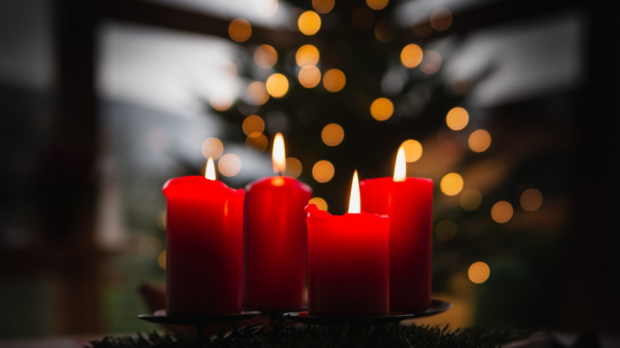
Peace
Luke 2:13-14
Suddenly a great company of the heavenly host appeared with the angel, praising God and saying, “Glory to God in the highest heaven, and on earth peace to those on whom his favor rests.”

Slide 16
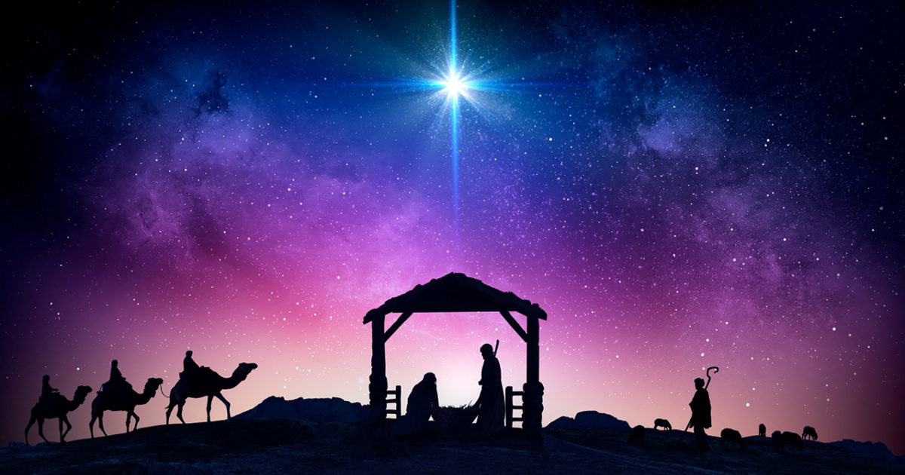
Peace: The King is Coming
Isaiah 9:1-7

Slide 17
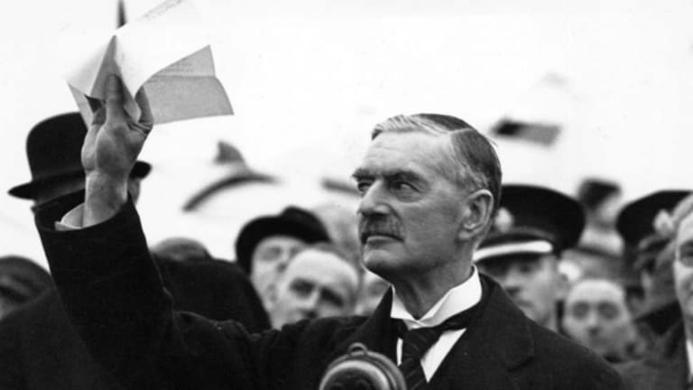
The Search for Peace
Luke 2:13-14
Suddenly a great company of the heavenly host appeared with the angel, praising God and saying, “Glory to God in the highest heaven, and on earth peace to those on whom his favor rests.”
“Peace in our Time”
“The Piece of Paper”

Slide 18
Isaiah 9:1-2
¹ Nevertheless, there will be no more gloom for those who were in distress. In the past he humbled the land of Zebulun and the land of Naphtali, but in the future he will honor Galilee of the nations, by the Way of the Sea, beyond the Jordan—
² The people walking in darkness have seen a great light; on those living in the land of deep darkness a light has dawned.

Slide 19
Isaiah 9:3-5
³ You have enlarged the nation and increased their joy; they rejoice before you as people rejoice at the harvest, as warriors rejoice when dividing the plunder. ⁴ For as in the day of Midian’s defeat, you have shattered the yoke that burdens them, the bar across their shoulders, the rod of their oppressor. ⁵ Every warrior’s boot used in battle and every garment rolled in blood will be destined for burning, will be fuel for the fire.

Slide 20
Isaiah 9:6-7
⁶ For to us a child is born, to us a son is given, and the government will be on his shoulders. And he will be called Wonderful Counselor, Mighty God, Everlasting Father, Prince of Peace.
⁷ Of the greatness of his government and peace there will be no end. He will reign on David’s throne and over his kingdom, establishing and upholding it with justice and righteousness from that time on and forever. The zeal of the Lord Almighty will accomplish this.

Slide 21
The Promise of Peace
Isaiah 7:14
Therefore the Lord himself will give you a sign: The virgin will conceive and give birth to a son, and will call him Immanuel.
Isaiah 8:10
Devise your strategy, but it will be thwarted; propose your plan, but it will not stand, for God is with us.
Isaiah 8:17
I will wait for the Lord, who is hiding his face from the descendants of Jacob. I will put my trust in him.

Slide 22
The Promise of Peace
1-2 – A light shines in the dark; hope comes to Galilee of the Gentiles
3-5 – Growth, freedom and peace for God’s people – see Isaiah 60, 61
6 – Wonderful Counselor; Mighty God; Everlasting Father
John 10:30 – I and the Father are One”
6-7 – Prince of Peace – on David’s throne, ruling with justice & righteousness

Slide 23
Finding Peace
Luke 1:78-79 – the rising sun will come to us from heaven to shine on those living in darkness and in the shadow of death, to guide our feet into the path of peace.”
Luke 2:29-32 – “Sovereign Lord, as you have promised, you may now dismiss your servant in peace. For my eyes have seen your salvation, which you have prepared in the sight of all nations: a light for revelation to the Gentiles, and the glory of your people Israel.”

Slide 24
Finding Peace
Philippians 4:4-9
Do not be anxious about anything, but in every situation, by prayer and petition, with thanksgiving, present your requests to God. And the peace of God, which transcends all understanding, will guard your hearts and your minds in Christ Jesus.
Finally, brothers and sisters, whatever is true, whatever is noble, whatever is right, whatever is pure, whatever is lovely, whatever is admirable—if anything is excellent or praiseworthy—think about such things. Whatever you have learned or received or heard from me, or seen in me —put it into practice. And the God of peace will be with you.

Slide 25
Making Peace
Ephesians 2:14-17 – For he himself is our peace, who has made the two groups one and has destroyed the barrier, the dividing wall of hostility, by setting aside in his flesh the law with its commands and regulations.
His purpose was to create in himself one new humanity out of the two, thus making peace, and in one body to reconcile both of them to God through the cross, by which he put to death their hostility. He came and preached peace to you who were far away and peace to those who were near.
Matthew 5:9 - Blessed are the peacemakers, for they will be called children of God.

Slide 26
1 Corinthians 11:23-26
For I received from the Lord what I also passed on to you: The Lord Jesus, on the night he was betrayed, took bread, and when he had given thanks, he broke it and said, “This is my body, which is for you; do this in remembrance of me.”
In the same way, after supper he took the cup, saying, “This cup is the new covenant in my blood; do this, whenever you drink it, in remembrance of me.”
For whenever you eat this bread and drink this cup, you proclaim the Lord’s death until he comes.

Slide 27
Closing Song
He Shall Reign forevermore

