Slide 1
May 1, 2022

Slide 2
Opening Songs
Turn your eyes upon Jesus
You Shine
Yet not I but through Christ in me

Slide 3
The Apostles’ Teaching: Exploring the New Testament
January – April: The Gospels
May: The Disciples’ Letters
June: Acts of the Apostles

Slide 4
Connecting & Contributing
Small Groups
Newcomers’ Group – May 29
See bulletin for more
Serving
Music, coffee, Sunday school
Yard sale & BBQ (May 28)
Giving
Website, mail, white drop-box
e-transfer: parkdaleoneline@gmail.com

Slide 6
Victoria Pregnancy Centre - video
https://vimeo.com/704740937/482ecad280

Slide 7
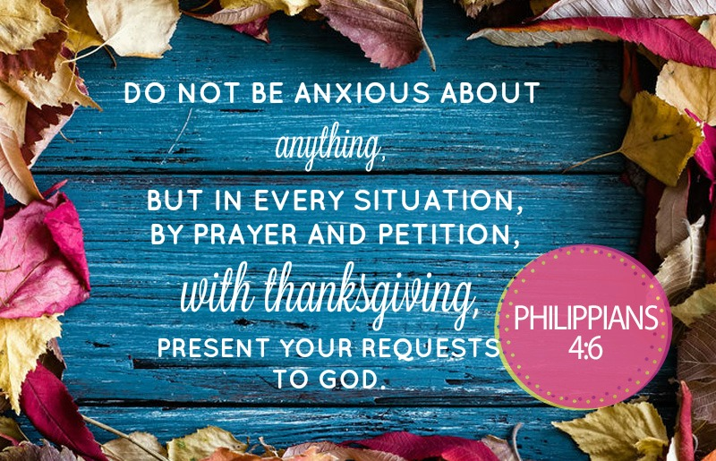

Slide 8
Kids’ Minute: Sunday School for ages 5-12!

Slide 9
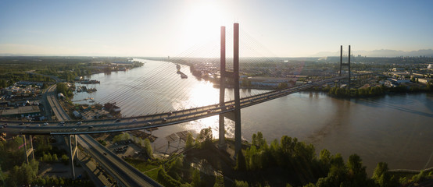
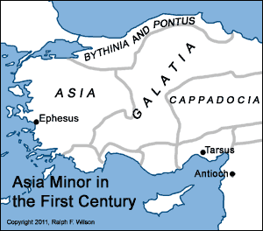
Today: Diversity
What can unite us?
What can divide us?
Peter
Shepherd of the early church
Flock – growing & changing
Diaspora – scattered

Slide 10
1 Peter 1:1-2
Peter, an apostle of Jesus Christ,
To God’s elect, exiles scattered throughout the provinces of Pontus, Galatia, Cappadocia, Asia and Bithynia,
who have been chosen according to the foreknowledge of God the Father, through the sanctifying work of the Spirit, to be obedient to Jesus Christ and sprinkled with his blood:
Grace and peace be yours in abundance.

Slide 11
Identity
Diaspora – geographically scattered
Elected – chosen for a purpose
Defined by Who they belong to
Exiled – parepidemos
Abraham – Genesis 23:4; Hebrews 11
Not about where they are from, but defined by where they are going
Sojourning, pilgrim – on their way
Post secondary education

Slide 12
Purpose
Elected, exiled diaspora…
According to God’s foreknowledge
Romans 8:28-29 – And we know that in all things God works for the good of those who love him, who have been called according to his purpose. For those God foreknew he also predestined to be conformed to the image of his Son…
In sanctification of the Spirit
Developing Christlike character for service
For obedience to Christ & sprinkled with His blood
1 Peter 2:5 – you also, like living stones, are being built into a spiritual house to be a holy priesthood, offering spiritual sacrifices…

Slide 13
1 Peter 1:3-5
³ Praise be to the God and Father of our Lord Jesus Christ! In his great mercy he has given us new birth into a living hope through the resurrection of Jesus Christ from the dead, ⁴ and into an inheritance that can never perish, spoil or fade.
This inheritance is kept in heaven for you, ⁵ who through faith are shielded by God’s power until the coming of the salvation that is ready to be revealed in the last time.

Slide 14
1 Peter 1:6-9
⁶ In all this you greatly rejoice, though now for a little while you may have had to suffer grief in all kinds of trials.
⁷ These have come so that the proven genuineness of your faith—of greater worth than gold, which perishes even though refined by fire—may result in praise, glory and honor when Jesus Christ is revealed.
⁸ Though you have not seen him, you love him; and even though you do not see him now, you believe in him and are filled with an inexpressible and glorious joy, ⁹ for you are receiving the end result of your faith, the salvation of your souls.

Slide 15
Destiny
3-5 – Our hope
By His mercy, a new beginning (birth)
Into a living hope through Christ’s resurrection
Into an imperishable inheritance kept in heaven
Through faith we are shielded by His power until His coming
6-9 – Our joy
Thru temporary trials, we have eternal hope
Faith is purified, refined, proven true
Though we can’t see Him, we experience His love, the goal of our faith

Slide 16
A Pilgrim Perspective
Identity – not where we live, but Who we belong to
Purpose – called to follow Christ
Destiny – see beyond trials to destination
Therefore…how shall we live?
Hope (1:13) – remember where we’re going
Holiness (1:16) – remember who we are & why we’re here

Slide 18
Closing Song
Lord, Reign in Me

