Slide 1
June 12, 2022

Slide 2
Opening Songs
Jesus Hope of the Nations
Build Your Kingdom Here
Glorify Thy Name

Slide 3
The Apostles’ Teaching: Exploring the New Testament
January – April: The Gospels
May: The Disciples’ Letters
June: Acts of the Apostles

Slide 4
Yard Sale & BBQ
Saturday, June 18 9:00am – 2:00pm
In support of Victoria Pregnancy Centre
Please email Paige at spcantle@gmail.com to find out how to help!
See Bulletin insert for drop-off times this week

Slide 7
Kids’ Minute: Sunday School for ages 5-12!

Slide 8
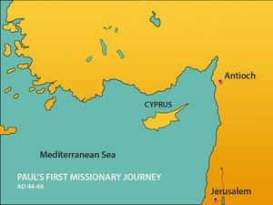
Lessons from Antioch: The First Missionaries
Acts: Life after Pentecost
3-5 – Persecution & Local Growth
6 – Organization & leadership
7-8 – Persecution & Broader growth
8:4 – Therefore, those who had been scattered went about preaching the word.
9-10 – Crossing Cultural Barriers

Slide 9
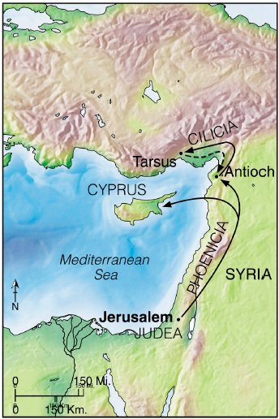
The Scattered Church
¹⁹ Now those who had been scattered by the persecution that broke out when Stephen was killed traveled as far as Phoenicia, Cyprus and Antioch, spreading the word only among Jews.
²⁰ Some of them, however, men from Cyprus and Cyrene, went to Antioch and began to speak to Greeks also, telling them the good news about the Lord Jesus. ²¹ The Lord’s hand was with them, and a great number of people believed and turned to the Lord.

Slide 10
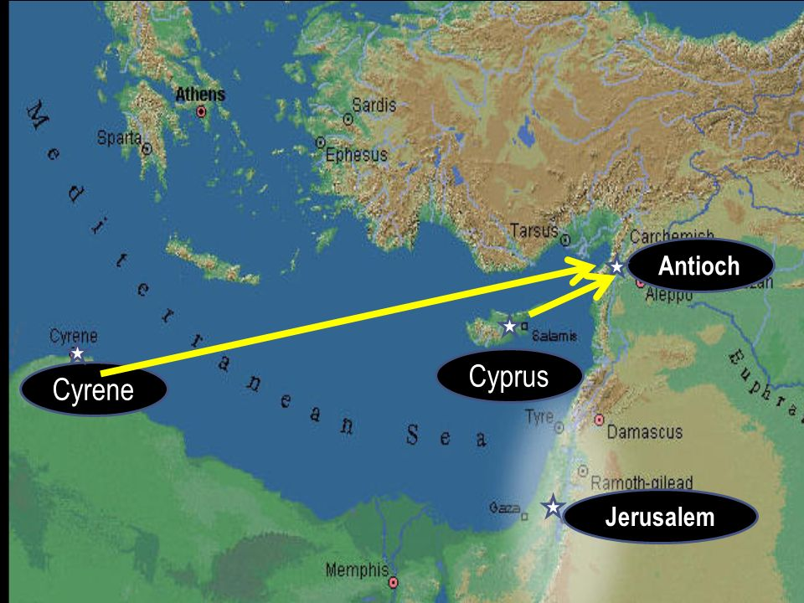
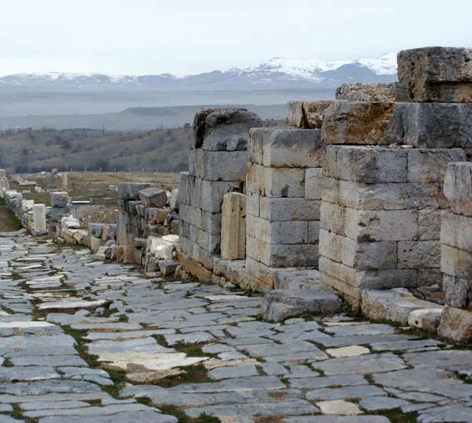
A New Church
Cross-cultural ministry, multicultural church

Slide 11
²² News of this reached the church in Jerusalem, and they sent Barnabas to Antioch. ²³ When he arrived and saw what the grace of God had done, he was glad and encouraged them all to remain true to the Lord with all their hearts. ²⁴ He was a good man, full of the Holy Spirit and faith, and a great number of people were brought to the Lord.
²⁵ Then Barnabas went to Tarsus to look for Saul, ²⁶ and when he found him, he brought him to Antioch. So, for a whole year Barnabas and Saul met with the church and taught great numbers of people. The disciples were called Christians first at Antioch.

Slide 12
The Church in Antioch
Jerusalem sends “encouragement”
4:36-37 – Joseph, a Levite from Cyprus, whom the apostles called Barnabas (which means “son of encouragement”), sold a field he owned and brought the money and put it at the apostles’ feet.
Barnabas brings Saul/Paul, and they teach the young church
13:1 – Now in the church at Antioch there were prophets and teachers: Barnabas, Simeon called Niger, Lucius of Cyrene, Manaen (who had been brought up with Herod the tetrarch) and Saul
Diverse leadership in a diverse church
Christianity is not originally western
The church came by God’s grace

Slide 13
²⁷ During this time some prophets came down from Jerusalem to Antioch. ²⁸ One of them, named Agabus, stood up and through the Spirit predicted that a severe famine would spread over the entire Roman world. (This happened during the reign of Claudius.)
²⁹ The disciples, as each one was able, decided to provide help for the brothers and sisters living in Judea. ³⁰ This they did, sending their gift to the elders by Barnabas and Saul.

Slide 14
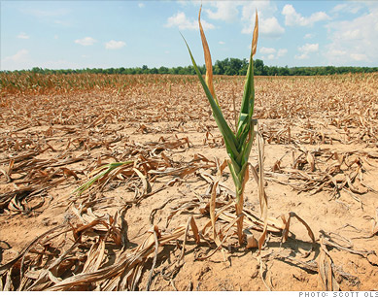
Famine: Crisis in Jerusalem
How Will Antioch Respond?
Blaming God
Blaming Others
How can we help?
Congregational initiative
Mission – diakonia = service

Slide 15
Part of Something Greater
We’re here because of missionary efforts
How do we respond to crises?
They test our relationship with God
Do we blame Him or trust Him?
That affects our relationships with each other
We’re taken care of, set free to share with others
Countercultural – our tendency to hoard for ourselves
By the grace of God – set free and part of His work

Slide 16
Closing Song
Enough

