Slide 1
July 3, 2022

Slide 2
Opening Songs
Be Thou My Vision
You Shine
How Great is Our God

Slide 3
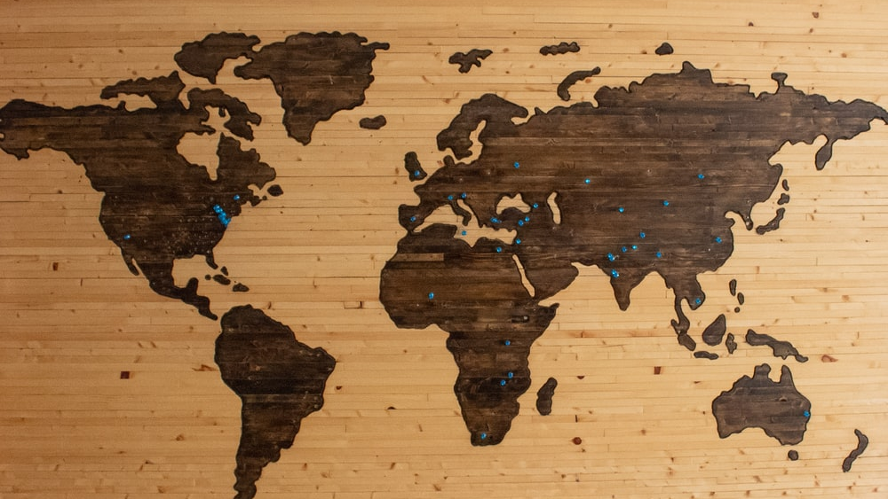
Psalm 67
¹ May God be gracious to us and bless us and make his face shine on us— ² so that your ways may be known on earth, your salvation among all nations.
³ May the peoples praise you, God; may all the peoples praise you. ⁴ May the nations be glad and sing for joy, for you rule the peoples with equity and guide the nations of the earth. ⁵ May the peoples praise you, God; may all the peoples praise you.
⁶ The land yields its harvest; God, our God, blesses us. ⁷ May God bless us still, so that all the ends of the earth will fear him.

Slide 4
Connecting & Contributing
Connecting
Prayer – Sundays @ 9:30am
Check bulletin for small groups!
Serving
Coffee rotation – talk to Helen
Music team – talk to Emily
Giving
Website, mail, white drop-box
e-transfer: parkdaleoneline@gmail.com

Slide 5
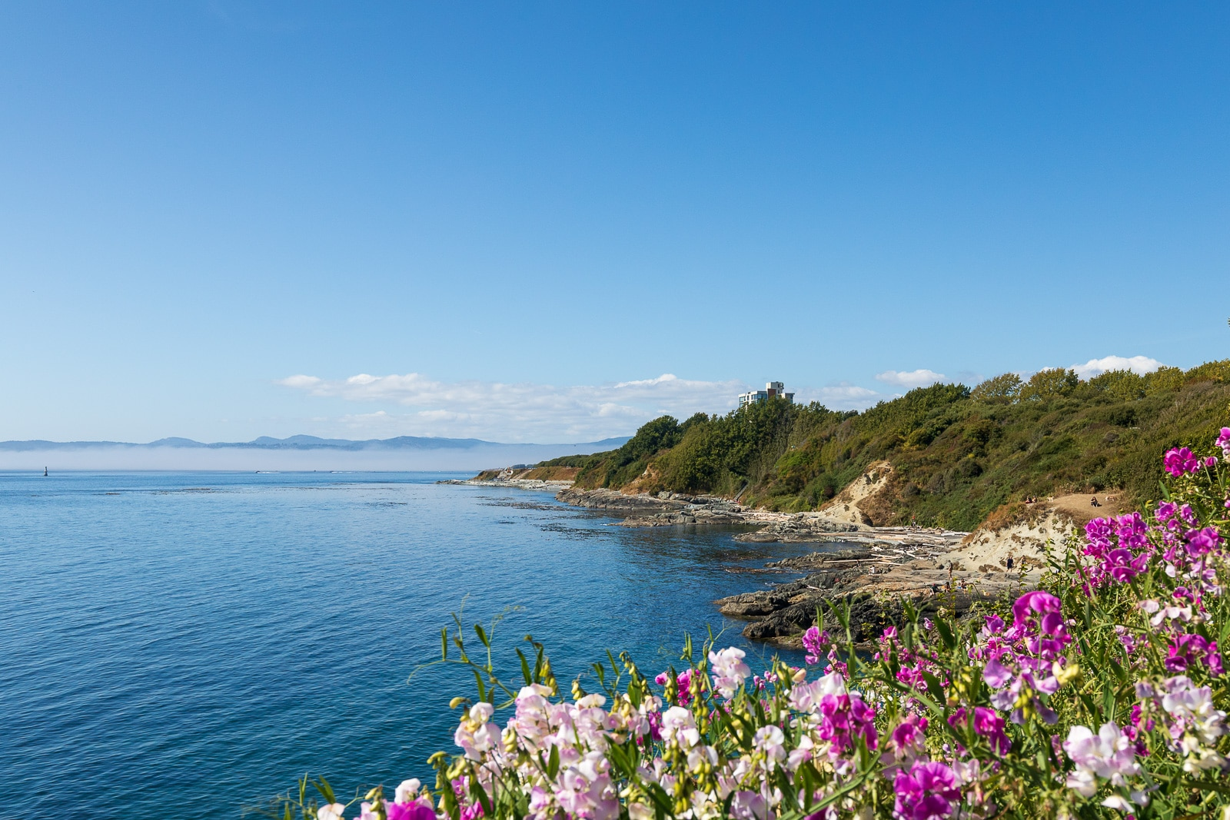
Summer @ Parkdale
July & August
July 10 – Appreciation for Morri
July 17 – Picnic in the park
Aug 28 – Joint service @ Beacon Hill
Winsome Games – kids’ sports program
Aug 29-31 – Game Days!
Messages from Romans & Corinthians
Some special guest speakers & musicians

Slide 6
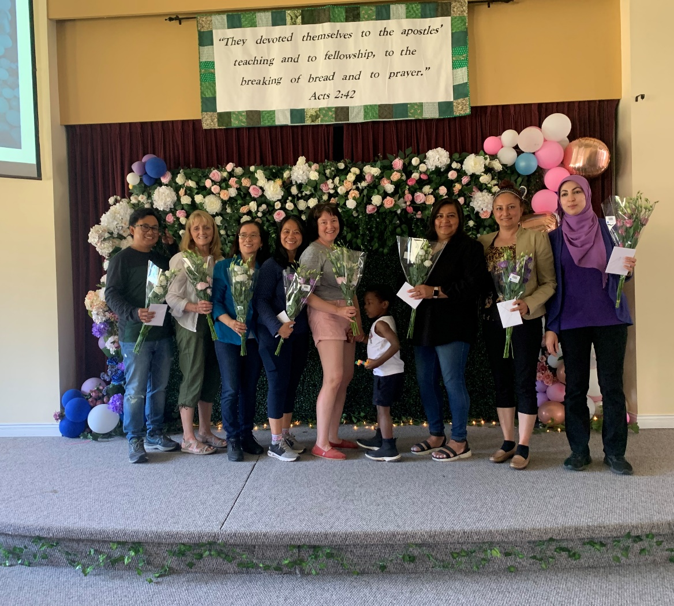
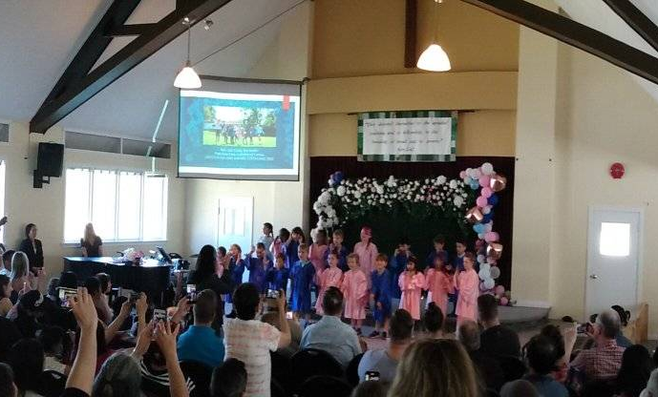
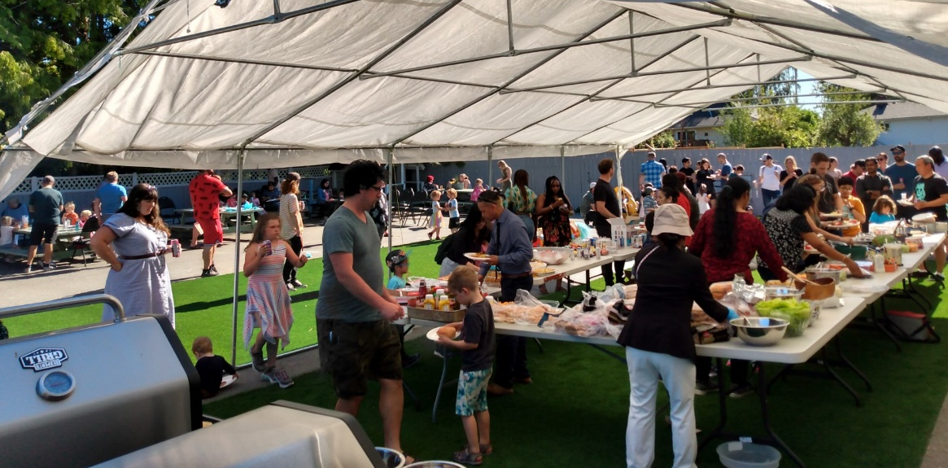
Daycare Grad!

Slide 8
Kids’ Minute: Sunday School for ages 5-12!

Slide 9
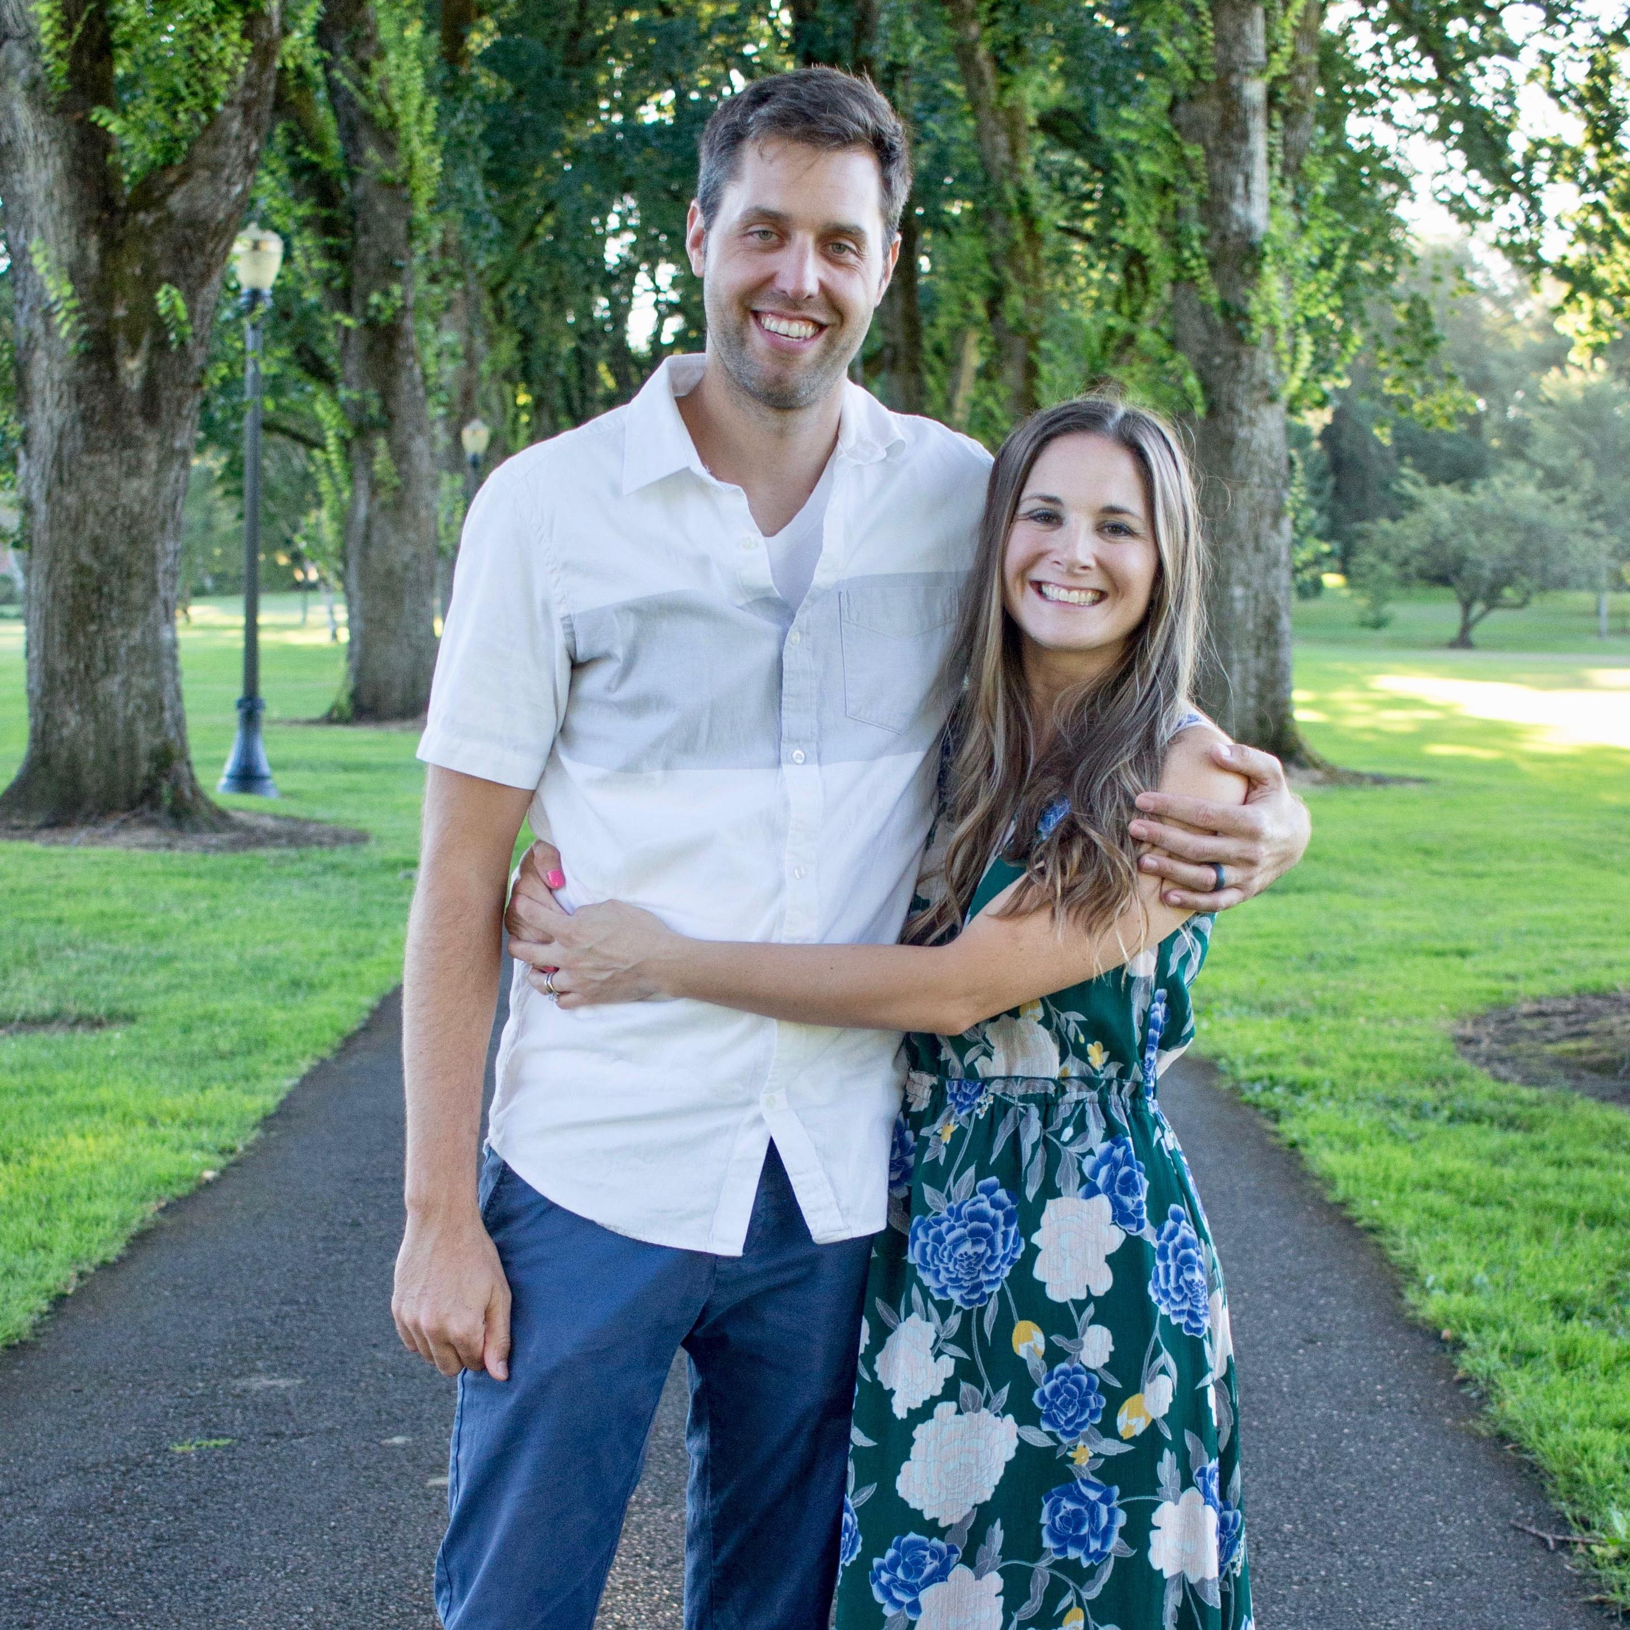
Guest Speaker
Stephen Brucker
Pastor, The Chapel Church, Puyallup, Washington

Slide 10
Closing Song
Battle Belongs

