Slide 1

Aug 7, 2022

Slide 2
Psalm 148
Praise the Lord.
Praise the Lord from the heavens; praise him in the heights above.
Praise him, all his angels; praise him, all his heavenly hosts.
Praise him, sun and moon; praise him, all you shining stars.
Praise him, you highest heavens and you waters above the skies.
Let them praise the name of the Lord,
for at his command they were created,
and he established them for ever and ever—
he issued a decree that will never pass away

Slide 3
Praise the Lord from the earth,
you great sea creatures and all ocean depths,
lightning and hail, snow and clouds, stormy winds that do his bidding,
you mountains and all hills, fruit trees and all cedars,
wild animals and all cattle, small creatures and flying birds,
kings of the earth and all nations, you princes and all rulers on earth,
young men and women, old men and children.
Let them praise the name of the Lord,
for his name alone is exalted;
his splendor is above the earth and the heavens.
And he has raised up for his people a horn,
the praise of all his faithful servants,
of Israel, the people close to his heart.
Praise the Lord

Slide 4
Opening Songs
Desert Song
Lord, you have my Heart
Show us Christ

Slide 5

Connecting & Contributing
Connecting
Prayer – Sundays @ 9:30am
Check bulletin for small groups!
Serving
Before Sunday service – coffee, setup
Music team – talk to Emily
Giving
Website, mail, white drop-box
e-transfer: parkdaleoneline@gmail.com

Slide 6
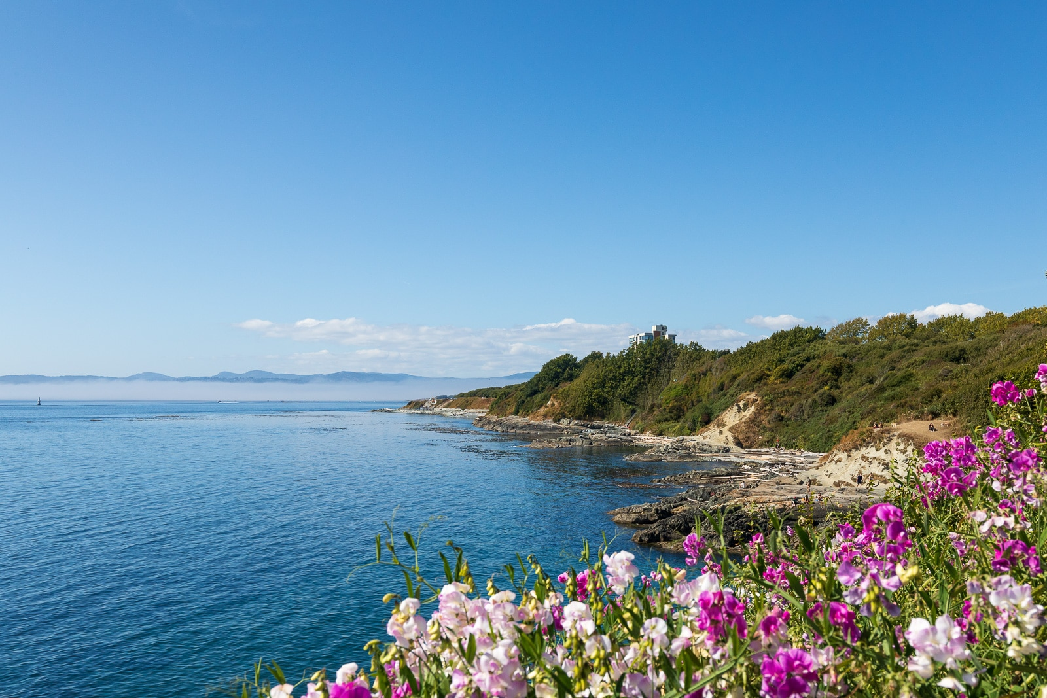
Summer @ Parkdale
July & August
Messages from Romans & Corinthians
Some special guest speakers & musicians
Aug 28 – Joint outdoor service & BBQ
Day Camps!
July 3-Aug 26 – Day camps for age 5-8
Aug 29-31 – Game Days for age 6-11
Campers & volunteers welcome!

Slide 7
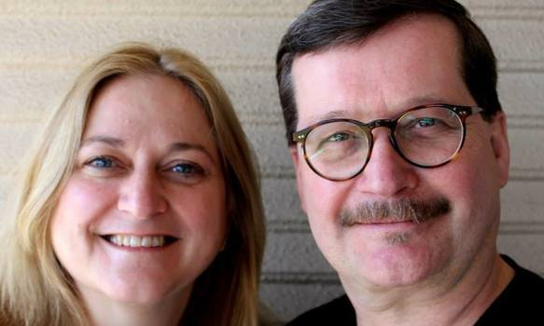
Next Week’s Speaker
Daniel McDougall
International Student Ministries Canada
University of Victoria

Slide 8
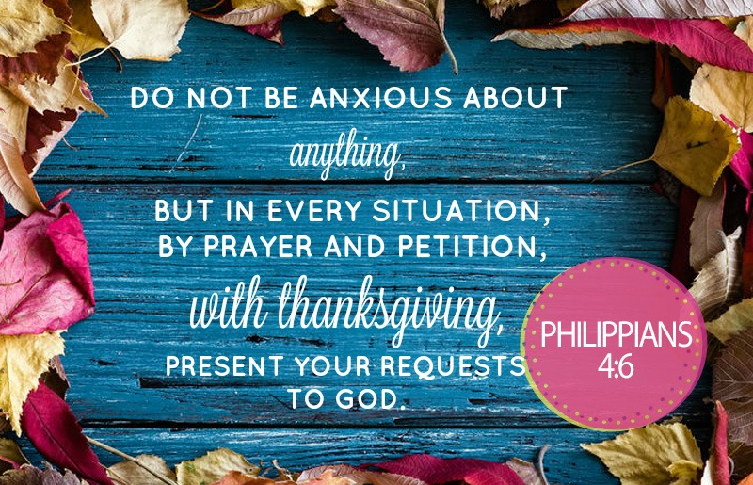

Slide 9
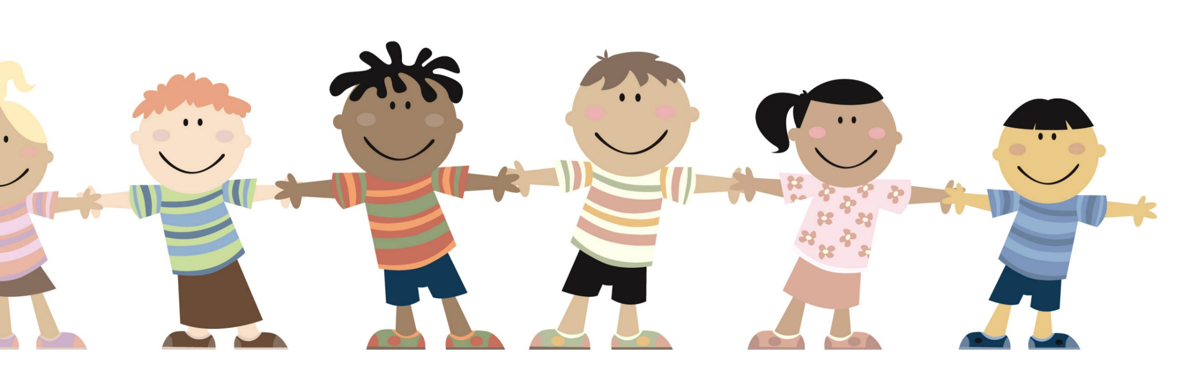
Kids’ Minute:
Sunday School for ages 5-12!

Slide 10

The Apostles’ Teaching:
Exploring the New Testament
July – Romans
A Gospel for All
August – 1 & 2 Corinthians
Called to Be Church

Slide 11
Corinth: A Motley Crew
1:2 - To the church of God in Corinth, to those sanctified in Christ Jesus and called to be his holy people
1:4-9 – given God’s grace, enriched with spiritual gifts, will be kept firm and blameless by God’s faithfulness
1:10-11 – division and quarreling
1:26-29 – Not many of you were wise by human standards; not many were influential; not many were of noble birth. But God chose the foolish things of the world to shame the wise; God chose the weak things of the world to shame the strong…so that no one may boast before him

Slide 12
Corinth: Loving Reminders
6:19-20 – Do you not know that your bodies are temples of the Holy Spirit, who is in you, whom you have received from God? You are not your own;
you were bought at a price. Therefore honor God with your bodies.
11:1 – Follow my example, as I follow the example of Christ.

Slide 13
1 Corinthians 12:12-14
¹² Just as a body, though one, has many parts, but all its many parts form one body, so it is with Christ. ¹³ For we were all baptized by one Spirit so as to form one body—whether Jews or Gentiles, slave or free—and we were all given the one Spirit to drink.
¹⁴ Even so the body is not made up of one part but of many.

Slide 14
1 Corinthians 12:12-14
Individual people – forming a new collective
Diversity and Unity
Parts of the Body – one purpose
4-7 – There are different kinds of gifts, but the same Spirit
distributes them. There are different kinds of service,
but the same Lord. There are different kinds of working,
but in all of them and in everyone it is the same God at work.
Now to each one the manifestation of the Spirit is given for the common good.

Slide 15
1 Corinthians 12:15-20
¹⁵ Now if the foot should say, “Because I am not a hand, I do not belong to the body,” it would not for that reason stop being part of the body. ¹⁶ And if the ear should say, “Because I am not an eye, I do not belong to the body,” it would not for that reason stop being part of the body. ¹⁷ If the whole body were an eye, where would the sense of hearing be? If the whole body were an ear, where would the sense of smell be?
¹⁸ But in fact God has placed the parts in the body, every one of them, just as he wanted them to be. ¹⁹ If they were all one part, where would the body be?
²⁰ As it is, there are many parts, but one body.

Slide 16
1 Corinthians 12:15-20
What do we learn about ourselves?
15-16 – We compare ourselves, feel inferior, left out
Corinth – flaunting spiritual gifts, ranking in order
What does God have to say?
18 – He designed us this way – to be parts of a body
17-19 – Crippled, disabled, if parts are all the same
20 – Diversity is key for a functional body
29 – Are all apostles? Are all prophets? Are all teachers? Do all work miracles?

Slide 17
1 Corinthians 12:21-26
²¹ The eye cannot say to the hand, “I don’t need you!” And the head cannot say to the feet, “I don’t need you!” ²² On the contrary, those parts of the body that seem to be weaker are indispensable, ²³ and the parts that we think are less honorable we treat with special honor. And the parts that are unpresentable are treated with special modesty, ²⁴ while our presentable parts need no special treatment.
But God has put the body together, giving greater honor to the parts that lacked it, ²⁵ so that there should be no division in the body, but that its parts should have equal concern for each other.
²⁶ If one part suffers, every part suffers with it; if one part is honored, every part rejoices with it.

Slide 18
1 Corinthians 12:21-26
What do we learn about ourselves?
15 & 21 – From “I don’t belong” to “I don’t need you”
  Exclusive groups – others are a threat/burden
  Solo Christians – just me and Jesus?
What does God desire for us?
24-26 – But God…
  22-24 – Giving honor to the weaker – they are indispensable
  25-26 – Vision for us – equal concern for each other
  8 – For the common good; the way of love
You are needed; and you need others

Slide 19
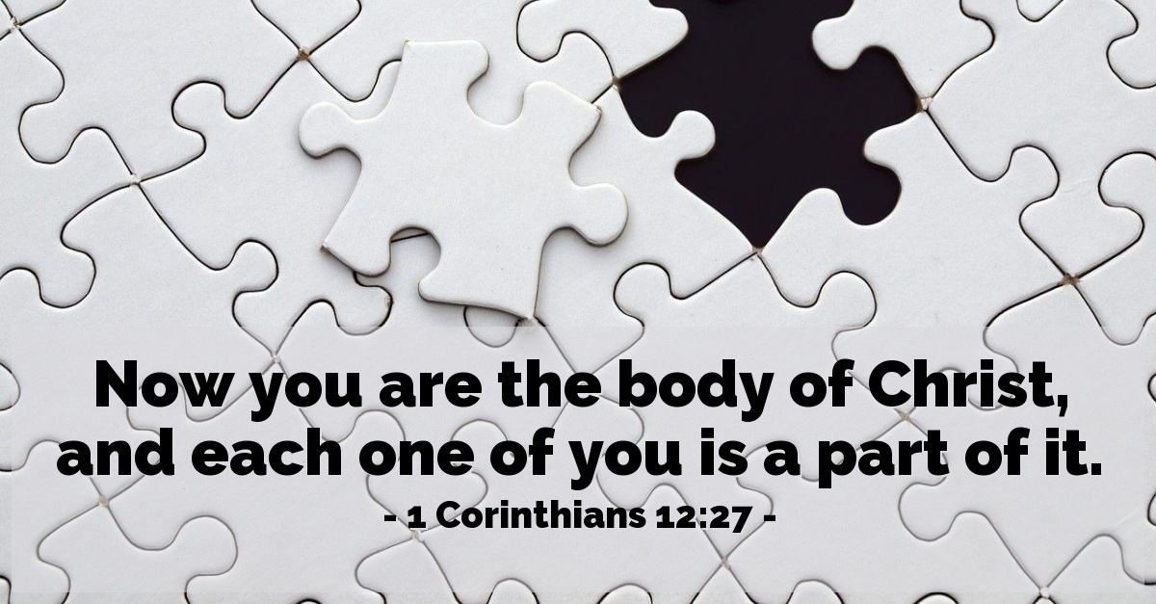

Slide 20
Metaphors of the Church
Hospital – come for healing
School – come for knowledge
God’s house – come for an experience
Body – participation
  Membership – belonging & connection
  Membership – authority & responsibility
  Priesthood of all believers
What part are you?

Slide 21
Closing Song
Oh How Good it Is

