Slide 1

Aug 21, 2022

Slide 2
Opening Songs
How Great Thou Art
His Mercy is More
Trading my Sorrows

Slide 3

Connecting & Contributing
Connecting
Prayer – Sundays @ 9:30am
Check bulletin for small groups!
Serving
Before Sunday service – coffee, setup
Music team – talk to Emily
Giving
Website, mail, white drop-box
e-transfer: parkdaleoneline@gmail.com

Slide 4
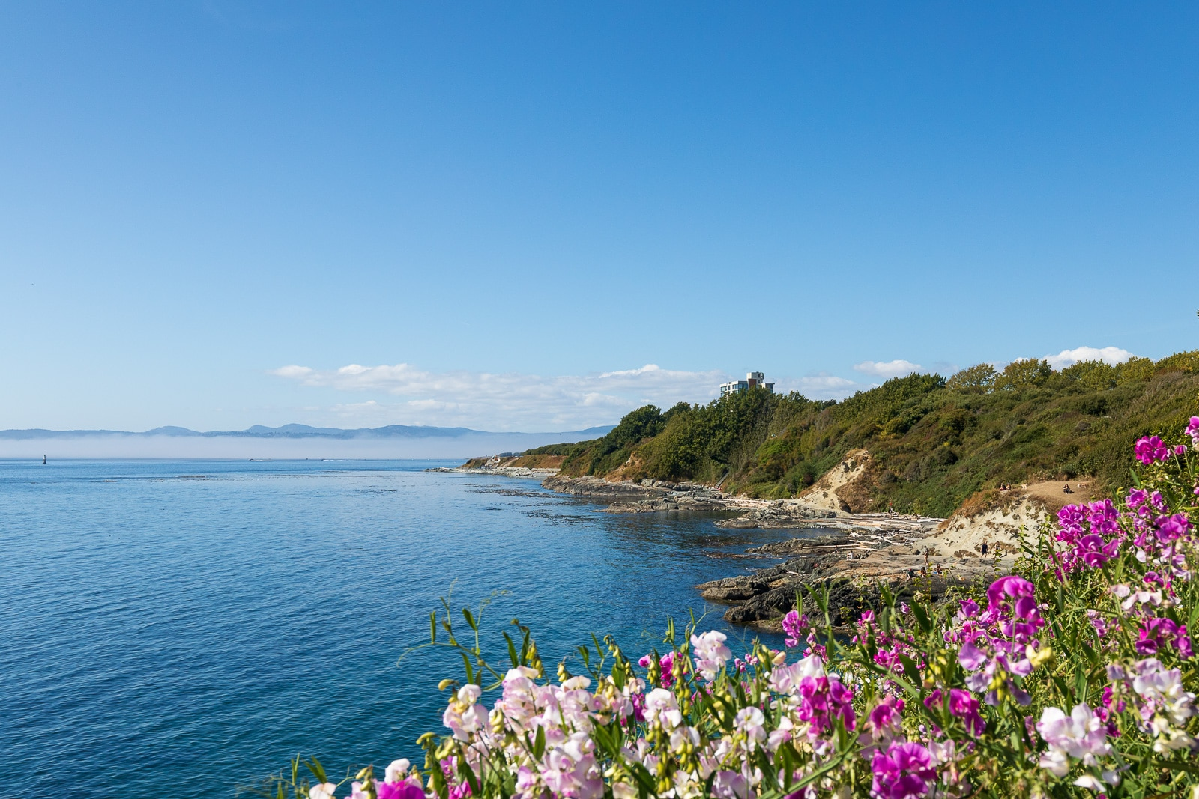
Summer @ Parkdale
July & August
Messages from Romans & Corinthians
Some special guest speakers & musicians
Aug 28 – Joint outdoor service & BBQ
Day Camps!
July 3-Aug 26 – Day camps for age 5-8
Aug 29-31 – Game Days for age 6-11
Campers & volunteers welcome!

Slide 5


Slide 6

Kids’ Minute:
Sunday School for ages 5-12!

Slide 7

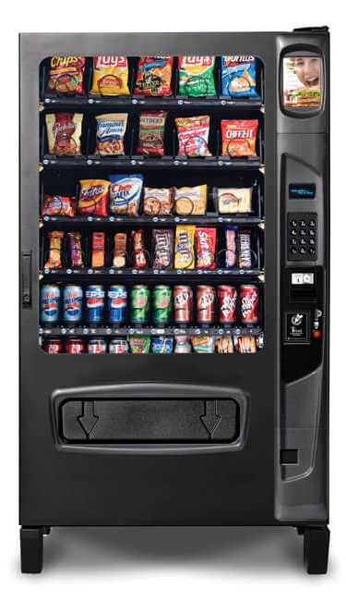
Not as Advertised
“God helps those who help themselves”
But God acted first
God as a vending machine
Does He ever fail to deliver?

Slide 8

Not as Advertised
Marketing Christianity
Misled, disappointed
Romans – gospel for all
1 Corinthians – God’s people
2 Corinthians – Paul’s ministry approach

Slide 9
2 Corinthians 4
¹ Therefore, since through God’s mercy we have this ministry, we do not lose heart.
² Rather, we have renounced secret and shameful ways; we do not use deception, nor do we distort the word of God. On the contrary, by setting forth the truth plainly we commend ourselves to everyone’s conscience in the sight of God.
³ And even if our gospel is veiled, it is veiled to those who are perishing. ⁴ The god of this age has blinded the minds of unbelievers, so that they cannot see the light of the gospel that displays the glory of Christ, who is the image of God.

Slide 10
Paul’s Method
1 – His ministry
2 Cor 3:12 – “since we have such a hope, we are very bold”
2 Cor 3:18 – God’s glory unveiled through Christ; and by the work of the Spirit, we grow to reflect Him
2 – His method
Not deception or distortion, but speaking plain truth
3-4 – His reception
Disconnect – some are veiled, blind to the light, truth

Slide 11
2 Corinthians 4
⁵ For what we preach is not ourselves, but Jesus Christ as Lord, and ourselves as your servants for Jesus’ sake.
⁶ For God, who said, “Let light shine out of darkness,” made his light shine in our hearts to give us the light of the knowledge of God’s glory displayed in the face of Christ.

Slide 12
Paul’s Message
5 – Not himself, but Christ as Lord, and they as servants
Not peddlers of gospel, but merely messengers
6 – Containers – carrying God’s light, truth
The gospel, pointing to Christ as the revelation of God

Slide 13
2 Corinthians 4
⁷ But we have this treasure in jars of clay to show that this all-surpassing power is from God and not from us.
⁸ We are hard pressed on every side, but not crushed; perplexed, but not in despair; ⁹ persecuted, but not abandoned; struck down, but not destroyed.
¹⁰ We always carry around in our body the death of Jesus, so that the life of Jesus may also be revealed in our body.
¹¹ For we who are alive are always being given over to death for Jesus’ sake, so that his life may also be revealed in our mortal body. ¹² So then, death is at work in us, but life is at work in you.

Slide 14
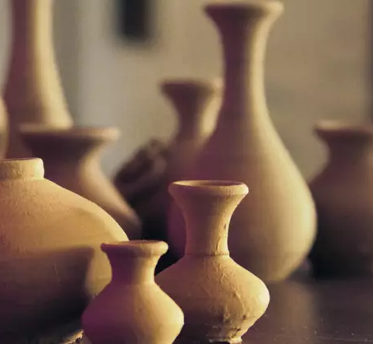
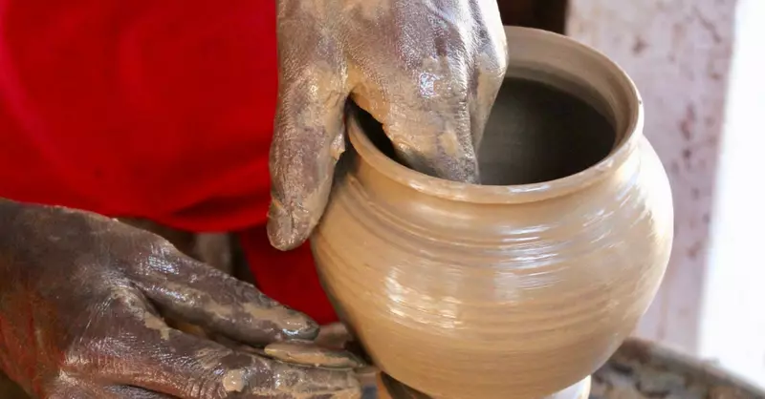
The Messenger
A Metaphor: Jars of Clay
Lamentations 4; 2 Tim 2:20
– plain, common, breakable
Genesis 2, Isaiah 64, Romans 9
– formed by hand, with purpose of containing something
Nothing special, but containing treasure
2 Cor 12:9 – my grace is sufficient for you,
for my power is made perfect in weakness

Slide 15
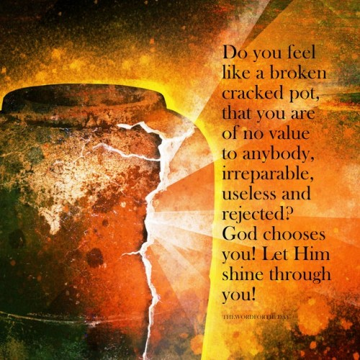
Purpose and Perspective
8-9 – Paul’s hardships & endurance
10-12 – experiencing Christ’s
death so that His life may be revealed to others
13-15 – living with hope
– for the benefit of others to see
Perspective: seeing God’s purpose
in the midst of our suffering

Slide 16
2 Corinthians 4
¹⁶ Therefore we do not lose heart.
Though outwardly we are wasting away,
yet inwardly we are being renewed day by day.
¹⁷ For our light and momentary troubles are achieving for us an eternal glory that far outweighs them all.
¹⁸ So we fix our eyes not on what is seen,
but on what is unseen,
since what is seen is temporary,
but what is unseen is eternal.

Slide 17
Closing Song
Turn Your Eyes Upon Jesus
Blessed Be Your Name

