Slide 1
Sep 4, 2022

Slide 2
Opening Songs
My Hope is in You, Lord
It is Well
Your Love is Amazing

Slide 3
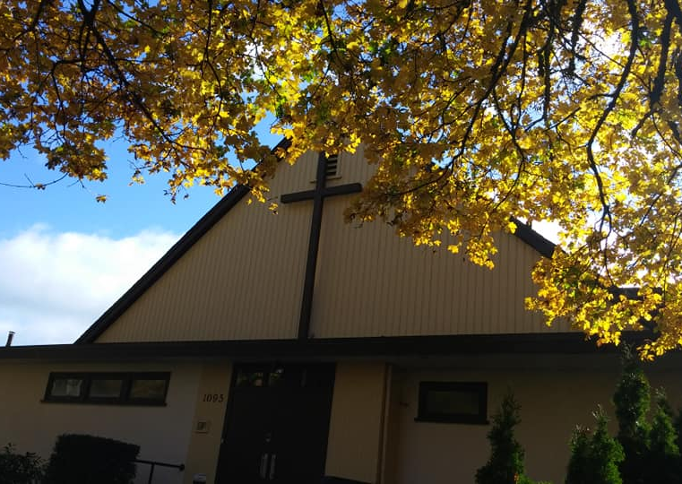
Autumn @ Parkdale
Connecting & Contributing
Groups, gatherings, serving, giving
See bulletin
Youth Alpha – Fridays @ 6pm
Sept 9 training; Sept 16 start!
Sunday Fellowship
Picnic lunch & games in the park!

Slide 5
Kids’ Minute: Sunday School for all ages!

Slide 6
Matthew 11:28-30
“Come to me, all you who are weary and burdened, and I will give you rest.
Take my yoke upon you and learn from me, for I am gentle and humble in heart, and you will find rest for your souls. For my yoke is easy and my burden is light.”

Slide 7
Galatians 3:3
Are you so foolish?
After beginning by means of the Spirit, are you now trying to finish by means of the flesh?

Slide 8
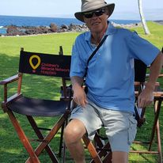
Today’s Speaker
Andy Wells

Slide 9
Closing Song
In Christ Alone

