Slide 1
Oct 16, 2022

Slide 2
Opening Songs
Made to Worship
Faithful One / Be Unto Your Name
All in All / Seek Ye First

Slide 3
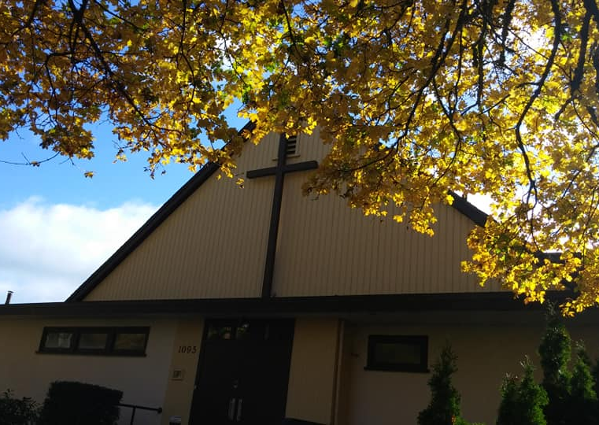
Autumn @ Parkdale
Bulletin: Connecting & Contributing
Serving opportunities
Sunday school – help with younger ones
Coffee – before Sunday services
Directory & Birthday update
Giving – see financial update
November 20 – Congregational Meeting
November 26 – Decorating & fall cleanup

Slide 4
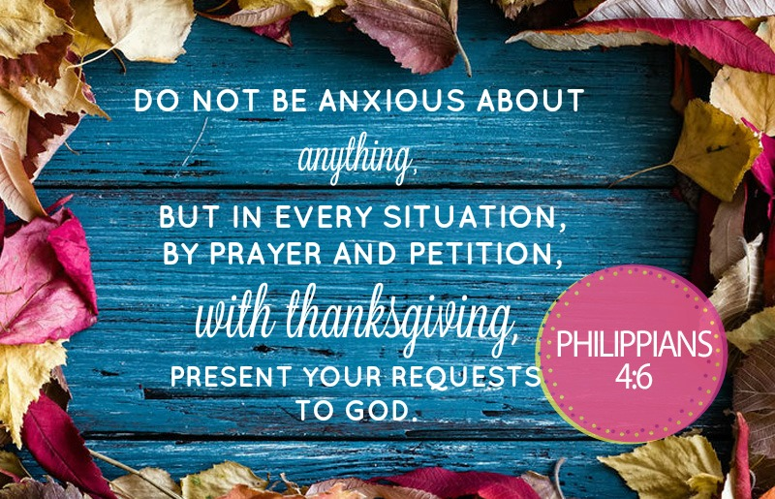

Slide 6
Kids’ Minute: Sunday School for all ages! https://www.youtube.com/watch?v=a_9ojycUegE

Slide 7
The Apostles’ Teaching: Exploring the New Testament
January – April: The Gospels
May: The Disciples’ Letters
June: Acts of the Apostles
July-October: Letters of Paul
To Churches and to Individuals

Slide 8
Money
Jesus’s teachings & parables – any come to mind?

Slide 9
Money
What are some potential dangers of money?
“Too many people spend money they earned…to buy things they don't want …to impress people they don't like.” --Will Rogers
Money often costs too much. --Ralph Waldo Emerson

Slide 10
Money
When can it be helpful?
Frugality includes all the other virtues. --Cicero
“Wealth consists not in having great possessions, but in having few wants.” --Epictetus

Slide 11
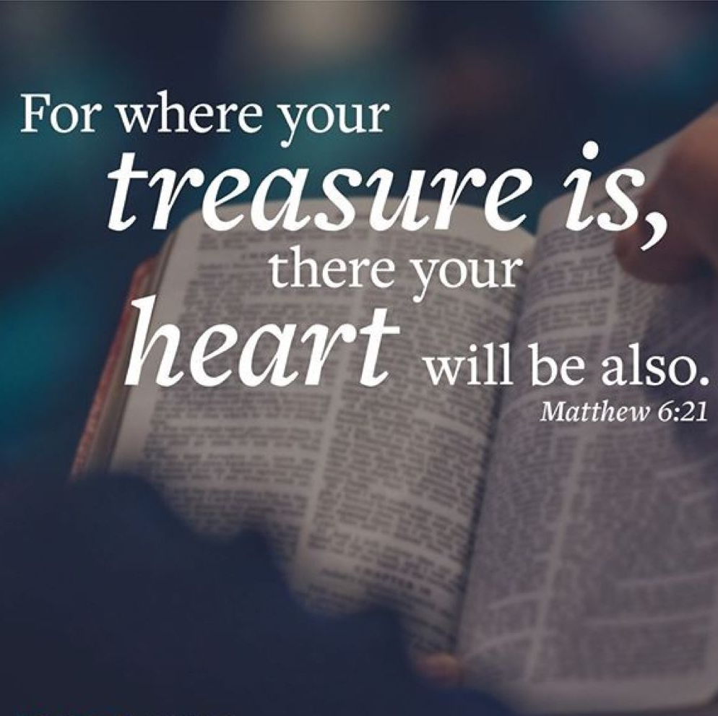
Money
Matthew 6:24 “No one can serve two masters. Either you will hate the one and love the other, or you will be devoted to the one and despise the other. You cannot serve both God and money.

Slide 12
1 Timothy 6
⁶ But godliness with contentment is great gain. ⁷ For we brought nothing into the world, and we can take nothing out of it. ⁸ But if we have food and clothing, we will be content with that.
⁹ Those who want to get rich fall into temptation and a trap and into many foolish and harmful desires that plunge people into ruin and destruction. ¹⁰ For the love of money is a root of all kinds of evil. Some people, eager for money, have wandered from the faith and pierced themselves with many griefs.

Slide 13
Contentment
6 – But – in contrast to false teachers, greedy for money
“Godliness as a means to financial gain”
6 – “Godliness with contentment”
Philippians 4:12-13 – …in any and every situation …I can do all this through him who gives me strength.
6 – “Godliness with contentment is great gain”
7-8 – Earthly things don’t last
9-10 – Wealth actually harms!

Slide 14
1 Timothy 6
¹¹ But you, man of God, flee from all this, and pursue righteousness, godliness, faith, love, endurance and gentleness.
¹² Fight the good fight of the faith. Take hold of the eternal life to which you were called when you made your good confession in the presence of many witnesses.
¹³ In the sight of God, who gives life to everything, and of Christ Jesus, who while testifying before Pontius Pilate made the good confession, I charge you ¹⁴ to keep this command without spot or blame until the appearing of our Lord Jesus Christ, ¹⁵ which God will bring about in his own time—God, the blessed and only Ruler, the King of kings and Lord of lords, ¹⁶ who alone is immortal and who lives in unapproachable light, whom no one has seen or can see. To him be honor and might forever. Amen.

Slide 15
Worship
11-12 – Alternative pursuits
What we have vs. who we become
Temporary wealth vs. eternal life
13-15 – Encouragement and hope
15-16 – Response of worship

Slide 16
1 Timothy 6
¹⁷ Command those who are rich in this present world not to be arrogant nor to put their hope in wealth, which is so uncertain, but to put their hope in God, who richly provides us with everything for our enjoyment. ¹⁸ Command them to do good, to be rich in good deeds, and to be generous and willing to share.
¹⁹ In this way they will lay up treasure for themselves as a firm foundation for the coming age, so that they may take hold of the life that is truly life.

Slide 17
Hope
Matthew 6 – When teaching about money, Jesus focuses on the heart
17 – Paul’s concern – not possession, but attitude
Do not hope in wealth, which is uncertain, but hope in God, who richly provides everything for our enjoyment
18 – Hope in God enables a different relationship with money
To be rich in good deeds, to be generous, to share
19 – Storing up treasure in His eternal kingdom

Slide 18
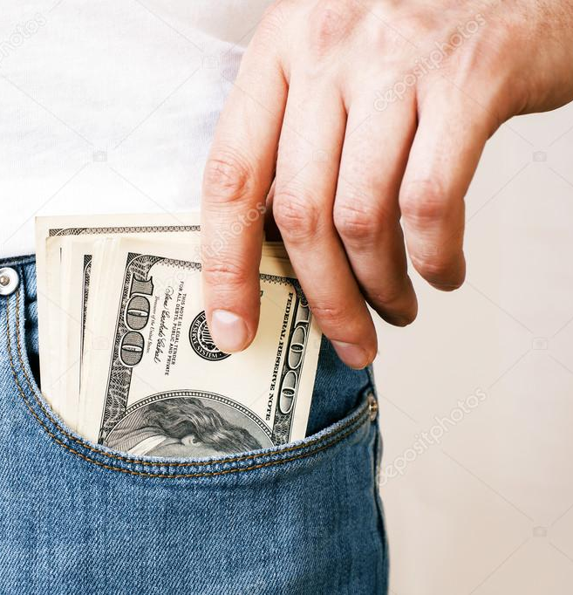
Putting Money in its Place
Money doesn’t bring contentment – so don’t try to use God to get it!
Money isn’t worthy of our worship – but God is!
Money isn’t a reliable hope – but can be invested in what counts!
Heart check: - where is my hope?

Slide 19
Closing Song
Enough

