Slide 1
Nov 27, 2022

Slide 2
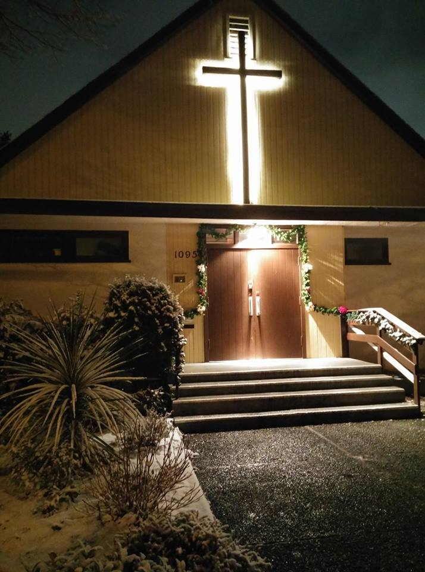
Welcome to Parkdale Church!
Today is the first Sunday of Advent!
Please Check Your Bulletin for:
Small groups & gatherings
Opportunities to give and serve
See parkdalechurch.ca for more info
This week: Ladies’ crafting & tea on Saturday @10am

Slide 3
Opening Songs
O Come, Emmanuel
Jesus, Hope of the Nations
Come, Though Long Expected Jesus

Slide 4
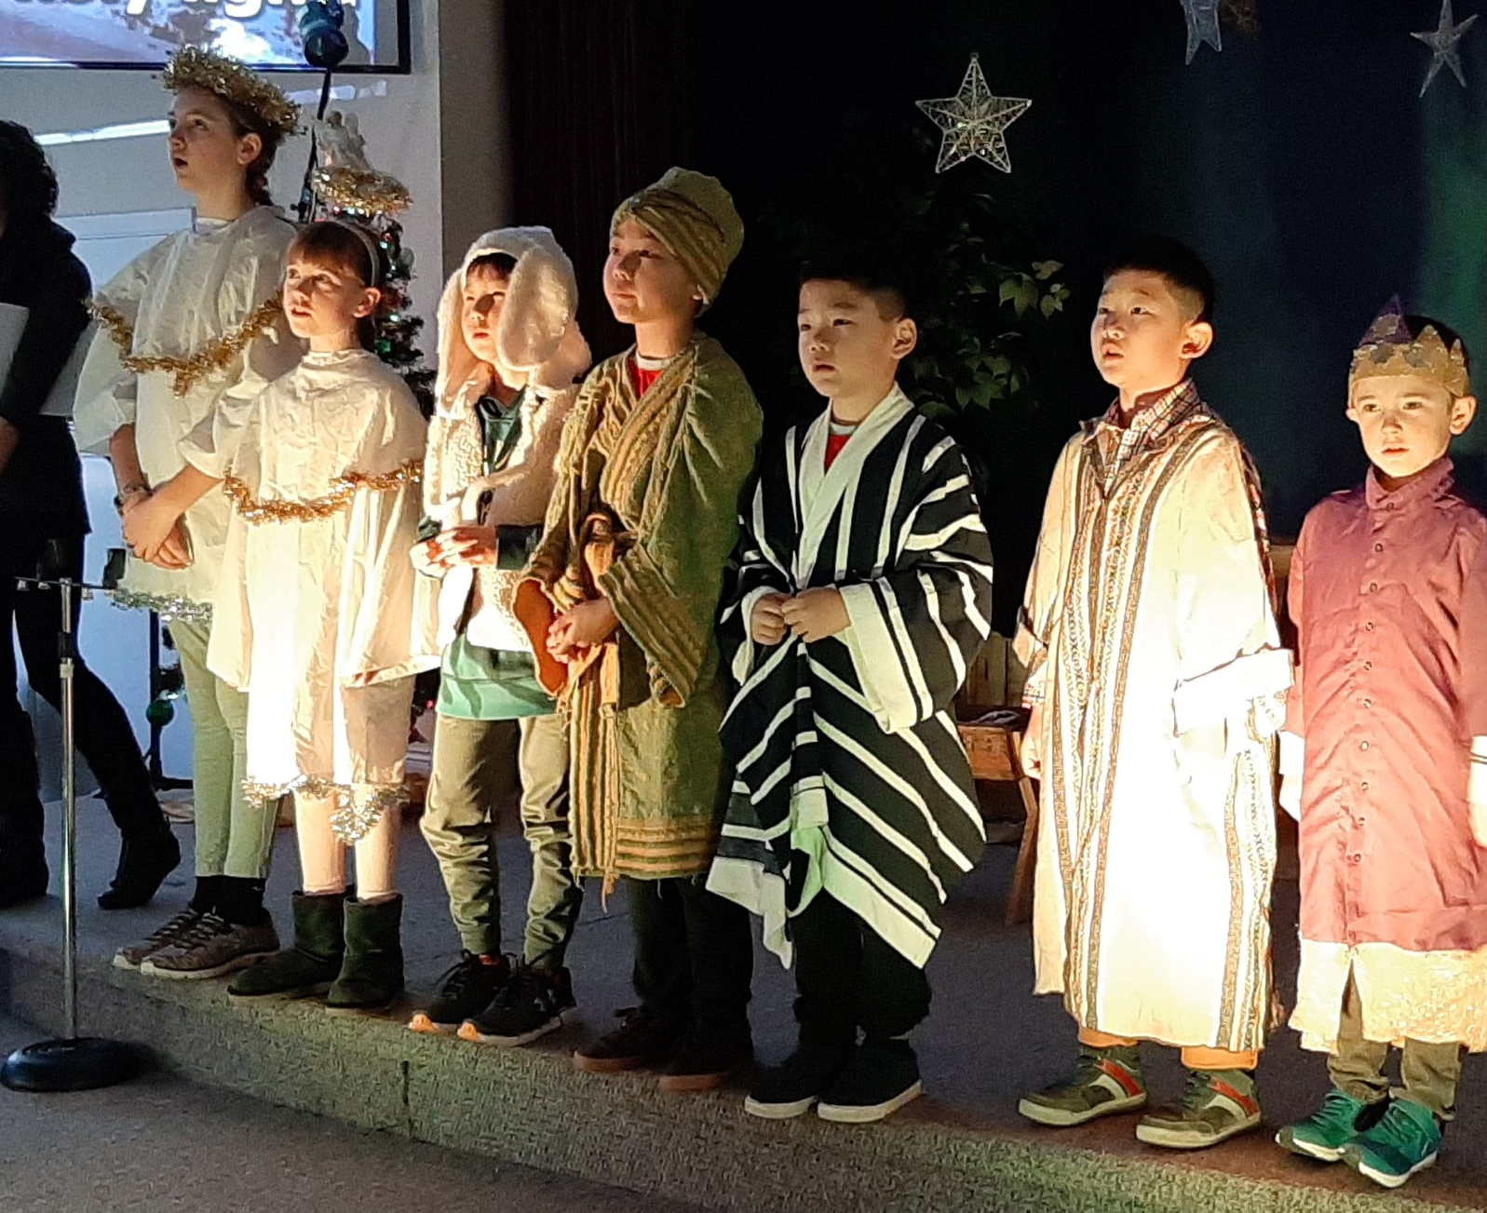
Christmas @ Parkdale
December 3 @ 10am – Ladies’ Christmas tea
December 11 @ 11:30am – Chili & bun potluck!
December 24 @ 6pm – Christmas Eve Candlelight service & kids’ skit
December 25 @ 11am – brunch & Christmas service

Slide 5
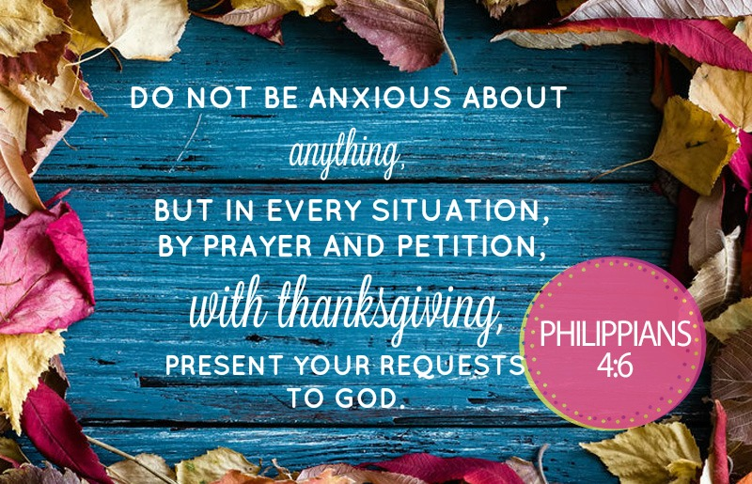

Slide 6
Kids’ Minute: Sunday School for all ages!

Slide 7
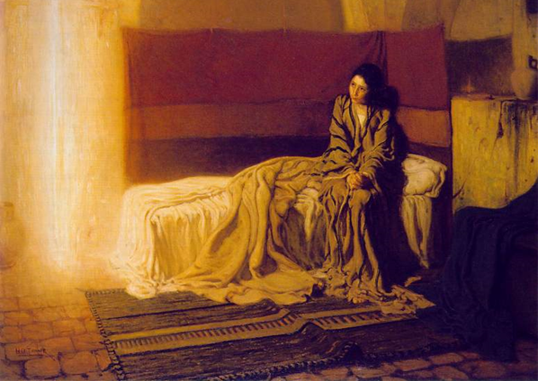
Hope
Luke 1:35-37
The angel answered, “The Holy Spirit will come on you, and the power of the Most High will overshadow you. So, the holy one to be born will be called the Son of God.
Even Elizabeth your relative is going to have a child in her old age, and she who was said to be unable to conceive is in her sixth month.
For no word from God will ever fail.”

Slide 8
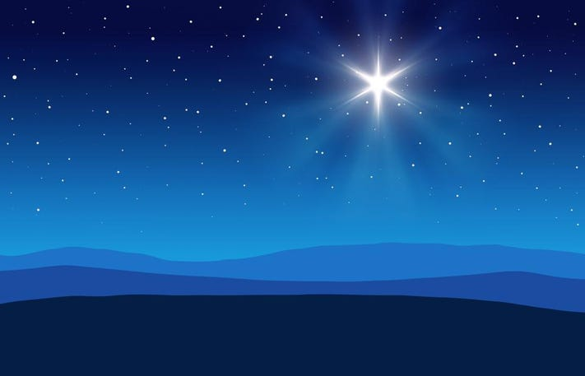
Hope: Looking to Jesus
Advent – “coming”
Old Testament, Israel – waiting
New Testament, Church – celebrating
Hope is not yet fulfilled
In-between time: Looking back & looking forward
Philippians 3:20-21 – But our citizenship is in heaven. And we eagerly await a Savior from there, the Lord Jesus Christ, who, by the power that enables him to bring everything under his control, will transform our lowly bodies so that they will be like his glorious body.

Slide 9
The Apostles’ Teaching: Exploring the New Testament
The Letter to the Hebrews
What is the relationship between faith & hope?
In these stories, where does hope show up?

Slide 10
Hebrews 11
¹ Now faith is confidence in what we hope for and assurance about what we do not see. ² This is what the ancients were commended for.
³ By faith we understand that the universe was formed at God’s command, so that what is seen was not made out of what was visible.
⁴ By faith Abel brought God a better offering than Cain did. By faith he was commended as righteous, when God spoke well of his offerings. And by faith Abel still speaks, even though he is dead.

Slide 11
⁵ By faith Enoch was taken from this life, so that he did not experience death: “He could not be found, because God had taken him away.” For before he was taken, he was commended as one who pleased God.
⁶ And without faith it is impossible to please God, because anyone who comes to him must believe that he exists and that he rewards those who earnestly seek him.
⁷ By faith Noah, when warned about things not yet seen, in holy fear built an ark to save his family. By his faith he condemned the world and became heir of the righteousness that is in keeping with faith.

Slide 12
⁸ By faith Abraham, when called to go to a place he would later receive as his inheritance, obeyed and went, even though he did not know where he was going. ⁹ By faith he made his home in the promised land like a stranger in a foreign country; he lived in tents, as did Isaac and Jacob, who were heirs with him of the same promise. ¹⁰ For he was looking forward to the city with foundations, whose architect and builder is God.
¹¹ And by faith even Sarah, who was past childbearing age, was enabled to bear children because she considered him faithful who had made the promise. ¹² And so from this one man, and he as good as dead, came descendants as numerous as the stars in the sky and as countless as the sand on the seashore.

Slide 13
¹³ All these people were still living by faith when they died.
They did not receive the things promised; they only saw them and welcomed them from a distance, admitting that they were foreigners and strangers on earth.
¹⁴ People who say such things show that they are looking for a country of their own. ¹⁵ If they had been thinking of the country they had left, they would have had opportunity to return.
¹⁶ Instead, they were longing for a better country—a heavenly one. Therefore God is not ashamed to be called their God, for he has prepared a city for them.

Slide 14
¹⁷ By faith Abraham, when God tested him, offered Isaac as a sacrifice. He who had embraced the promises was about to sacrifice his one and only son, ¹⁸ even though God had said to him, “It is through Isaac that your offspring will be reckoned.”
¹⁹ Abraham reasoned that God could even raise the dead, and so in a manner of speaking he did receive Isaac back from death.

Slide 15
²⁰ By faith Isaac blessed Jacob and Esau in regard to their future.
²¹ By faith Jacob, when he was dying, blessed each of Joseph’s sons, and worshiped as he leaned on the top of his staff.
²² By faith Joseph, when his end was near, spoke about the exodus of the Israelites from Egypt and gave instructions concerning the burial of his bones.
²³ By faith Moses’ parents hid him for three months after he was born, because they saw he was no ordinary child, and they were not afraid of the king’s edict.

Slide 16
²⁴ By faith Moses, when he had grown up, refused to be known as the son of Pharaoh’s daughter. ²⁵ He chose to be mistreated along with the people of God rather than to enjoy the fleeting pleasures of sin. ²⁶ He regarded disgrace for the sake of Christ as of greater value than the treasures of Egypt, because he was looking ahead to his reward.
²⁷ By faith he left Egypt, not fearing the king’s anger; he persevered because he saw him who is invisible. ²⁸ By faith he kept the Passover and the application of blood, so that the destroyer of the firstborn would not touch the firstborn of Israel.

Slide 17
²⁹ By faith the people passed through the Red Sea as on dry land; but when the Egyptians tried to do so, they were drowned.
³⁰ By faith the walls of Jericho fell, after the army had marched around them for seven days.
³¹ By faith the prostitute Rahab, because she welcomed the spies, was not killed with those who were disobedient.

Slide 18
³² And what more shall I say? I do not have time to tell about Gideon, Barak, Samson and Jephthah, about David and Samuel and the prophets, ³³ who through faith conquered kingdoms, administered justice, and gained what was promised; who shut the mouths of lions, ³⁴ quenched the fury of the flames, and escaped the edge of the sword; whose weakness was turned to strength; and who became powerful in battle and routed foreign armies.
³⁵ Women received back their dead, raised to life again. There were others who were tortured, refusing to be released so that they might gain an even better resurrection. ³⁶ Some faced jeers and flogging, and even chains and imprisonment.

Slide 19
³⁷ They were put to death by stoning; they were sawed in two; they were killed by the sword. They went about in sheepskins and goatskins, destitute, persecuted and mistreated— ³⁸ the world was not worthy of them. They wandered in deserts and mountains, living in caves and in holes in the ground.
³⁹ These were all commended for their faith, yet none of them received what had been promised, ⁴⁰ since God had planned something better for us so that only together with us would they be made perfect.

Slide 20
Stories of Faith (and Hope)
1 – Faith is confidence in what we hope for and the assurance of what we do not see
Hope is the object of faith
Abel, Enoch, Noah – hope in reward, salvation
Abraham & family – hope in promise for future
Moses & Israel – hope in invisible God, better future
Hope is future perspective; faith is a present response

Slide 21
Hebrews 12
¹ Therefore, since we are surrounded by such a great cloud of witnesses, let us throw off everything that hinders and the sin that so easily entangles.
And let us run with perseverance the race marked out for us, ² fixing our eyes on Jesus, the pioneer and perfecter of faith. For the joy set before him he endured the cross, scorning its shame, and sat down at the right hand of the throne of God.
³ Consider him who endured such opposition from sinners, so that you will not grow weary and lose heart.

Slide 22
A Response of Faith
1 – Therefore…since…let us
Since we’re surrounded by so great a cloud of witnesses
Heroes of the faith who’ve finished the race
They’ve experienced God’s faithfulness, can testify to it
Let us throw off what hinders, sin that entangles
Weights…burdens…commitments that slow us down
Sins…entanglements…that trip us up
2-3 – Let us run the race…fixing our eyes on Jesus
Pioneer (trailblazer, leader) & perfecter (finished ahead)

Slide 23
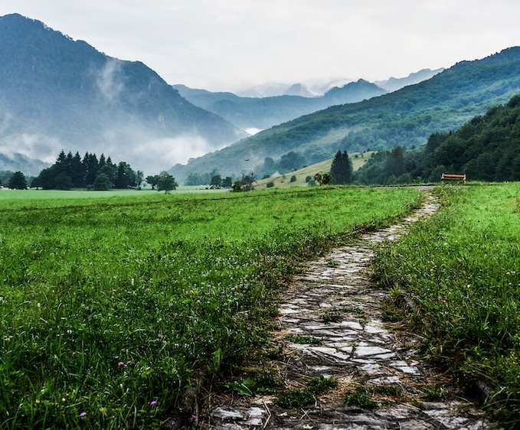
Traveling Light
What do I need for my journey of faith?
What will hinder? What will help?

Slide 24
Closing Song
By Faith

