Slide 1
Mar 19, 2023

Slide 2
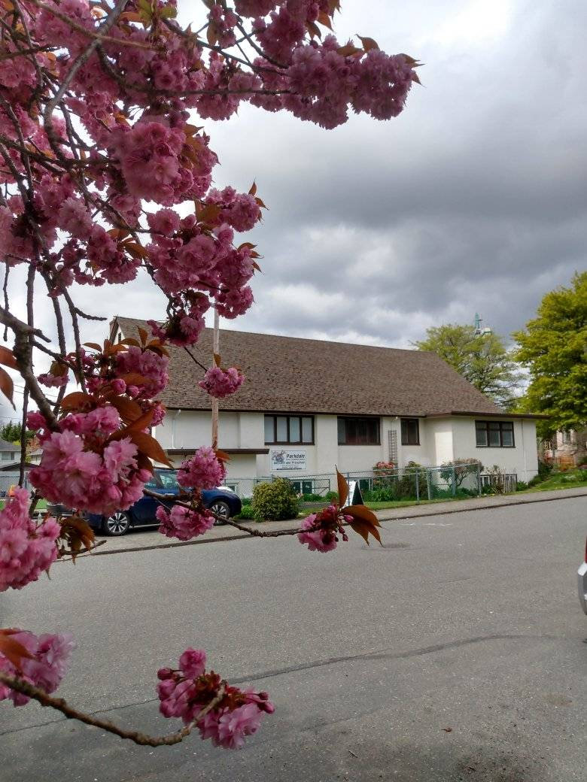
Welcome to Parkdale Church!
Today we will serve Communion at the end of the service.
Please Check Your Bulletin for:
Small groups & gatherings
Opportunities to give and serve
Prayer items & today’s Scripture
See parkdalechurch.ca for more

Slide 3
Opening Songs
The Steadfast Love
10,000 Reasons
Holy, Holy, Holy

Slide 4
Parkdale this Season:
Serving:
Sunday school helpers
Music team
Building & Yard maintenance
Giving:
See bulletin, website, or drop-box
Connecting:
Small groups – see bulletin
“Guess Who’s coming for dinner” on April 2 – see signup sheet

Slide 5
Membership: Chris Stratton
Membership: 1 Corinthians 12 – “part of the Body”
Commitment: to this particular church family
Agreement & Accountability
Responsibility & Authority
Requirement: to be part of God’s family!
Expressed through Testimony

Slide 6
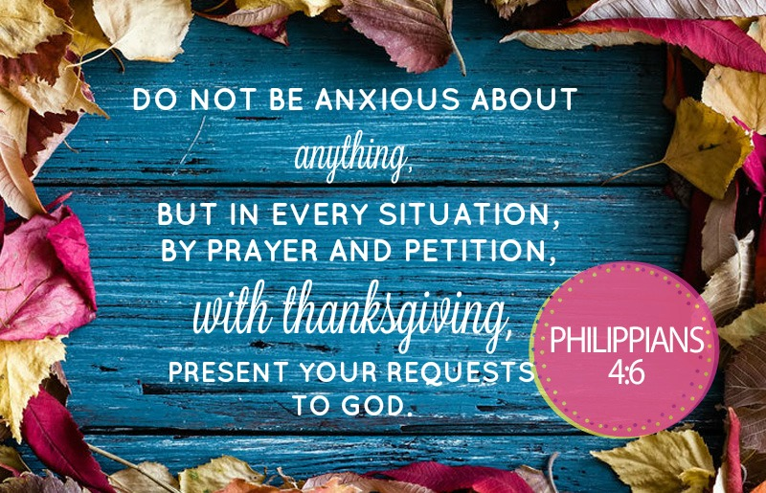

Slide 7
Kids’ Minute: Sunday School for all ages!

Slide 8
Entering God’s Rest
Ecclesiastes 3:1 – “There is a time for everything”

Slide 9
Mark 4:26-29
²⁶ He also said, “This is what the kingdom of God is like. A man scatters seed on the ground.
²⁷ Night and day, whether he sleeps or gets up, the seed sprouts and grows, though he does not know how.
²⁸ All by itself the soil produces grain—first the stalk, then the head, then the full kernel in the head.
²⁹ As soon as the grain is ripe, he puts the sickle to it, because the harvest has come.”

Slide 10
Entering God’s Rest
Creation – the gift of the week, beginning with rest
Israel – Sabbath – time to rest and remember
The 4th Command – but often neglected…

Slide 11
Psalm 95
⁷ Today, if only you would hear his voice, ⁸ “Do not harden your hearts as you did at Meribah, as you did that day at Massah in the wilderness, ⁹ where your ancestors tested me; they tried me, though they had seen what I did. ¹⁰ For forty years I was angry with that generation; I said, ‘They are a people whose hearts go astray, and they have not known my ways.’
¹¹ So I declared on oath in my anger, ‘They shall never enter my rest.’”

Slide 12
Hebrews 4
¹ Therefore, since the promise of entering his rest still stands, let us be careful that none of you be found to have fallen short of it. ² For we also have had the good news proclaimed to us, just as they did; but the message they heard was of no value to them, because they did not share the faith of those who obeyed. ³ Now we who have believed enter that rest, just as God has said,
“So I declared on oath in my anger, ‘They shall never enter my rest.’”
And yet his works have been finished since the creation of the world. ⁴ For somewhere he has spoken about the seventh day in these words: “On the seventh day God rested from all his works.” ⁵ And again in the passage above he says, “They shall never enter my rest.”

Slide 13
Hebrews 4
⁶ Therefore since it still remains for some to enter that rest, and since those who formerly had the good news proclaimed to them did not go in because of their disobedience, ⁷ God again set a certain day, calling it “Today.” This he did when a long time later he spoke through David, as in the passage already quoted:
“Today, if you hear his voice, do not harden your hearts.”
⁸ For if Joshua had given them rest, God would not have spoken later about another day. ⁹ There remains, then, a Sabbath-rest for the people of God; ¹⁰ for anyone who enters God’s rest also rests from their works, just as God did from his. ¹¹ Let us, therefore, make every effort to enter that rest, so that no one will perish by following their example of disobedience.

Slide 14
Entering God’s Rest – Today
Why?
Mark 2:27-28 – Then he said to them, “The Sabbath was made for man, not man for the Sabbath.
What?
“Have to do”
Idols – striving, dependence
How?
“Get to do”
Serving in joy

Slide 15
Matthew 11:28-30
²⁸ “Come to me, all you who are weary and burdened, and I will give you rest.
²⁹ Take my yoke upon you and learn from me, for I am gentle and humble in heart, and you will find rest for your souls.
³⁰ For my yoke is easy and my burden is light.”

Slide 16
1 Corinthians 11:23-26
The Lord Jesus, on the night He was betrayed, took bread, and when He had given thanks, he broke it and said, “This is My body, which is for you; do this in remembrance of Me.”
In the same way, after supper He took the cup, saying, “This cup is the new covenant in My blood; do this, whenever you drink it, in remembrance of Me.”
For whenever you eat this bread and drink this cup, you proclaim the Lord’s death until He comes.

Slide 17
Closing Song
How Deep the Father’s Love
Cornerstone

