Slide 1
Mar 26, 2023

Slide 2
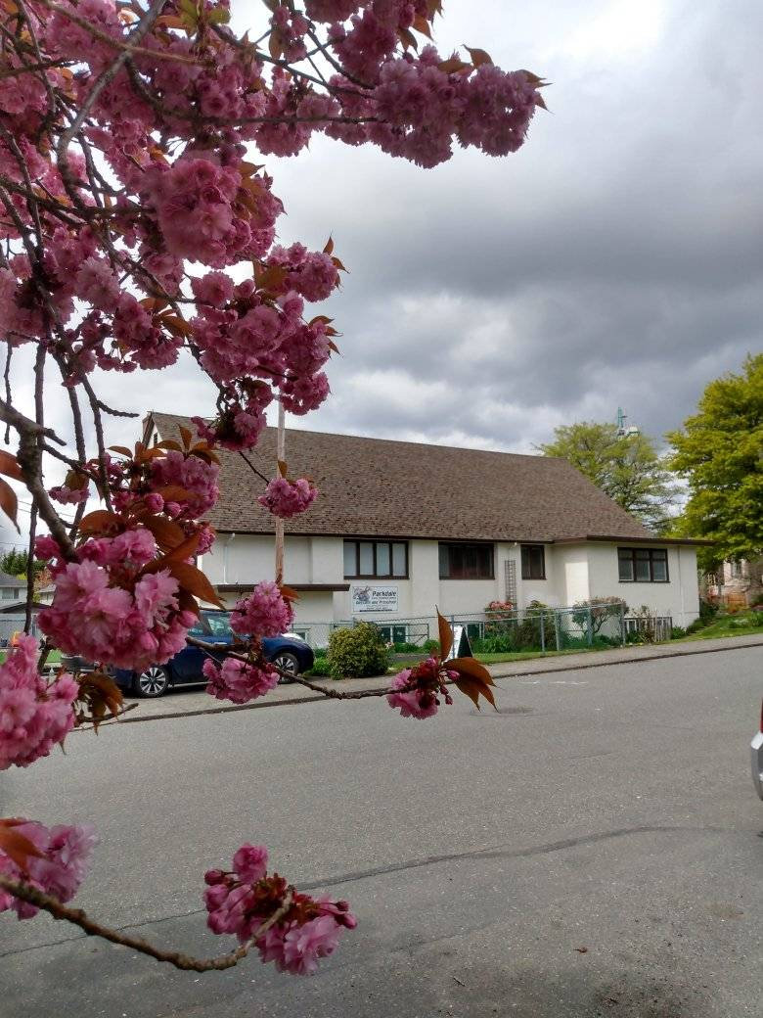
Welcome to Parkdale Church!
Today, we will have a special guest speaker.
Please Check Your Bulletin for:
Small groups & gatherings
Opportunities to give and serve
Prayer items & today’s Scripture
See parkdalechurch.ca for more

Slide 3
Opening Songs
In Christ Alone
Our God is Greater
His Mercy is More

Slide 4
Parkdale this Season:
Serving:
Sunday school helpers
Music team
Building & Yard maintenance
Giving:
See bulletin, website, or drop-box
Connecting:
Small groups – see bulletin
“Guess Who’s coming for dinner” on April 2 – see signup sheet

Slide 5
Membership: Chris Stratton
Membership: 1 Corinthians 12 – “part of the Body”
Commitment: to this particular church family
Agreement & Accountability
Responsibility & Authority
Requirement: to be part of God’s family!
Expressed through Testimony

Slide 6
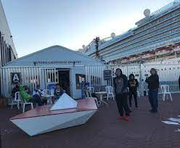
Missions Spotlight
Al Kelly
Lighthouse Harbour Ministries

Slide 8
Kids’ Minute: Sunday School for all ages!

Slide 9
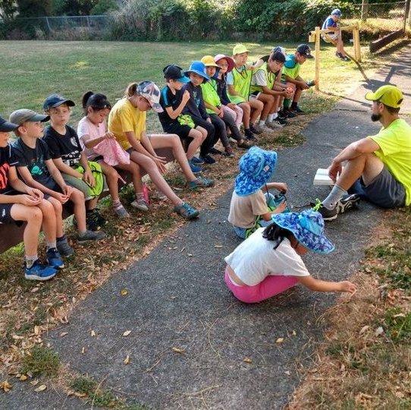
Guest Speaker
Nathan Kinsey
Winsome Games, LPD-EFCC

Slide 10
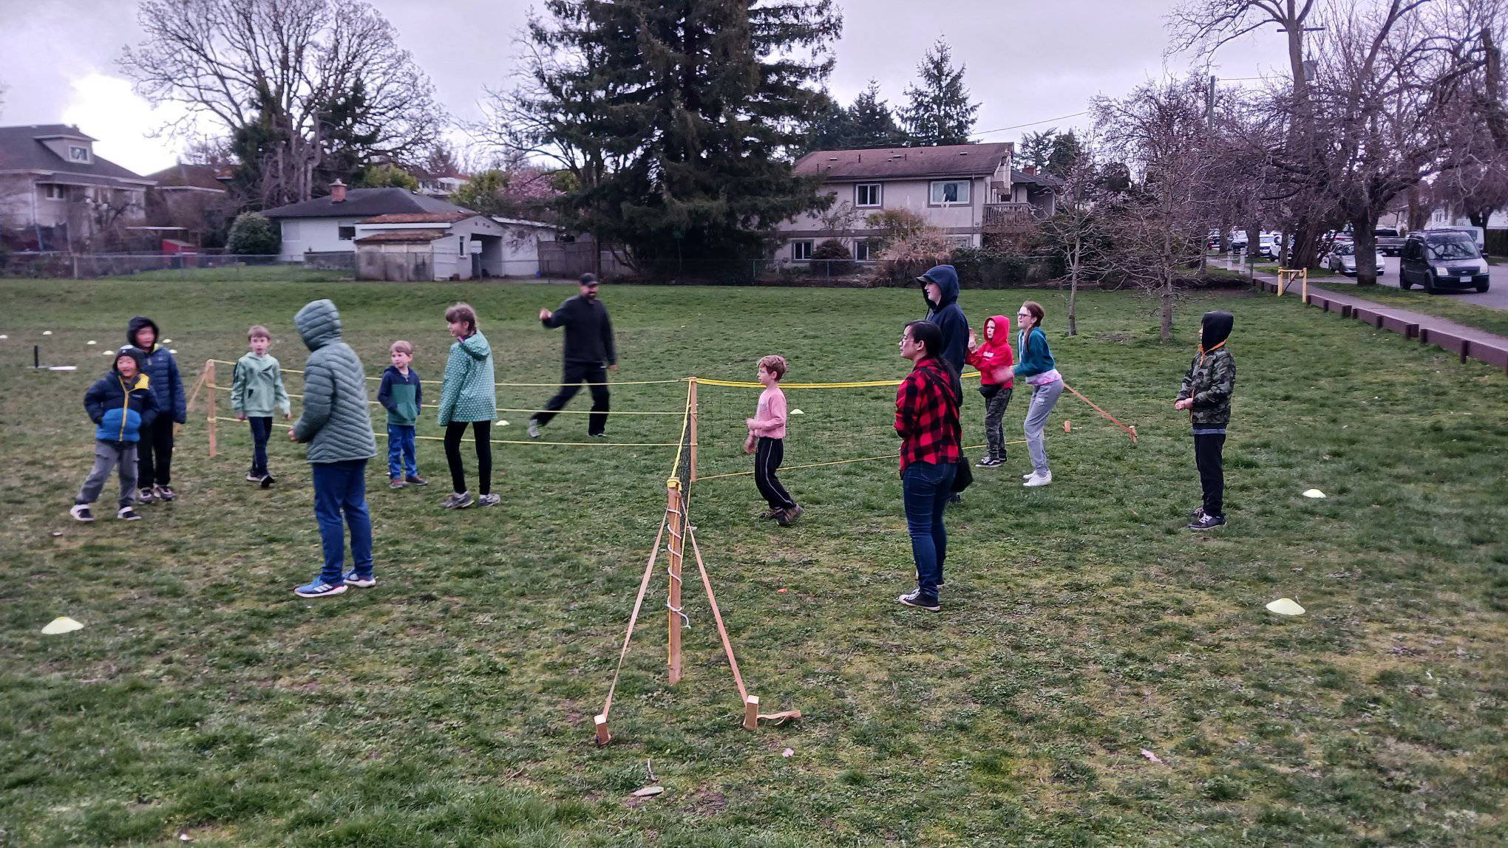

Slide 11
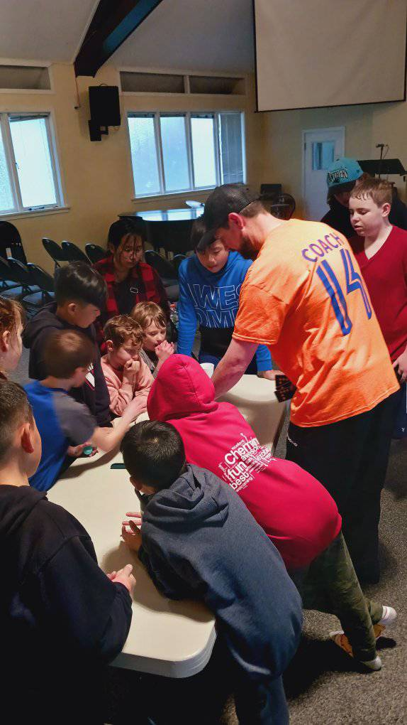
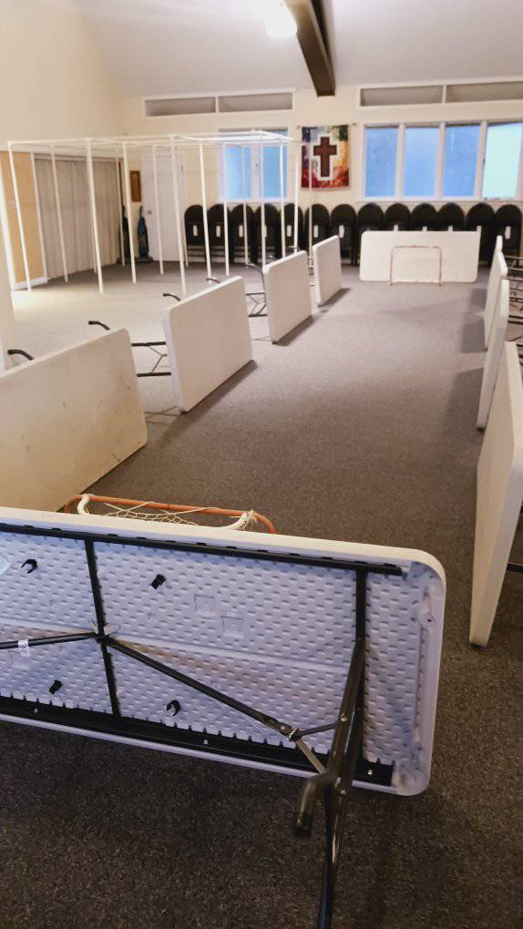

Slide 12
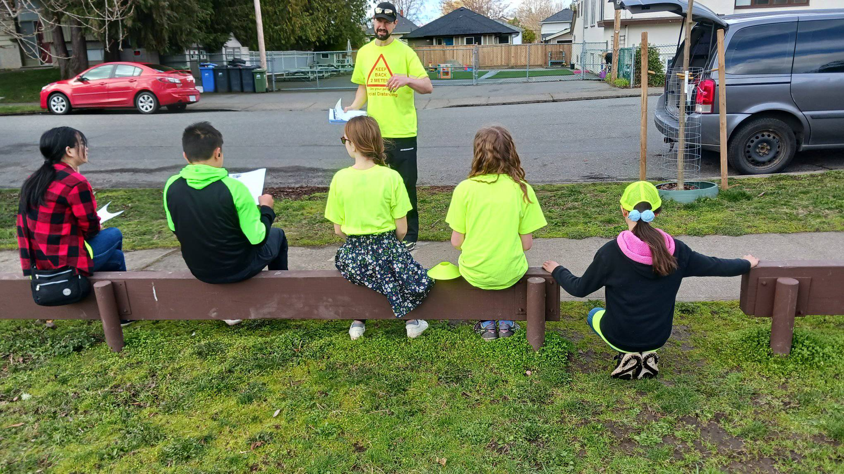

Slide 13
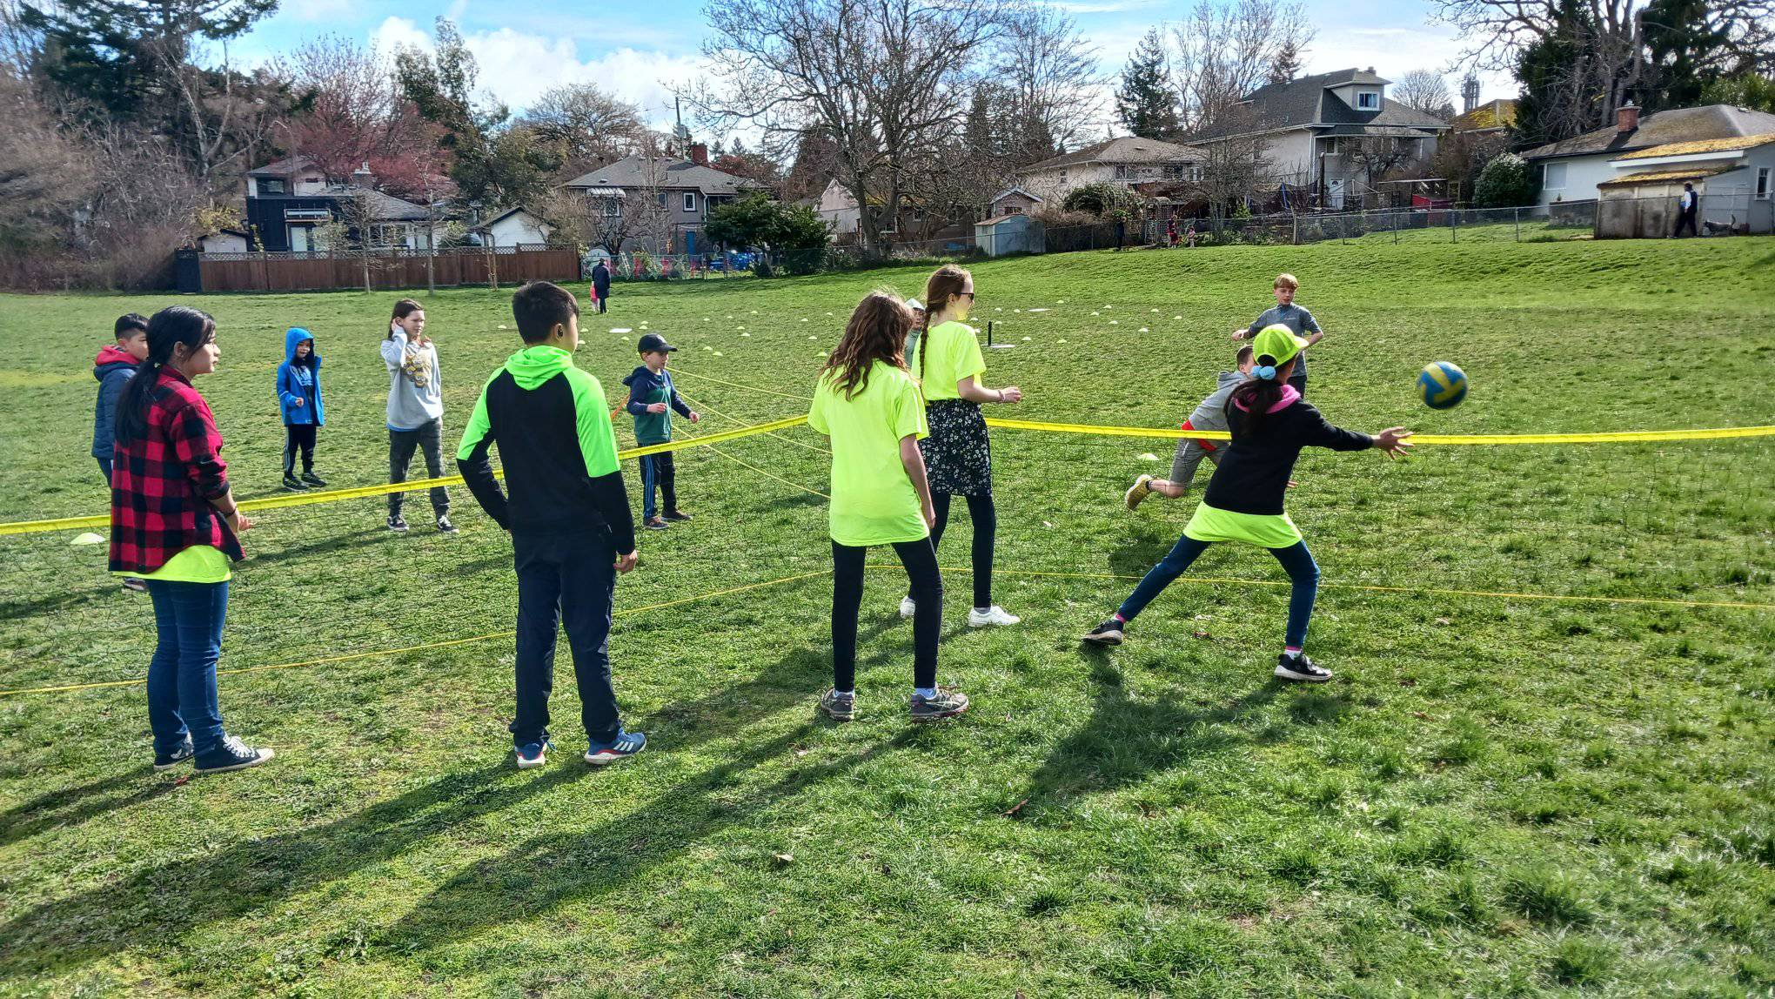

Slide 14
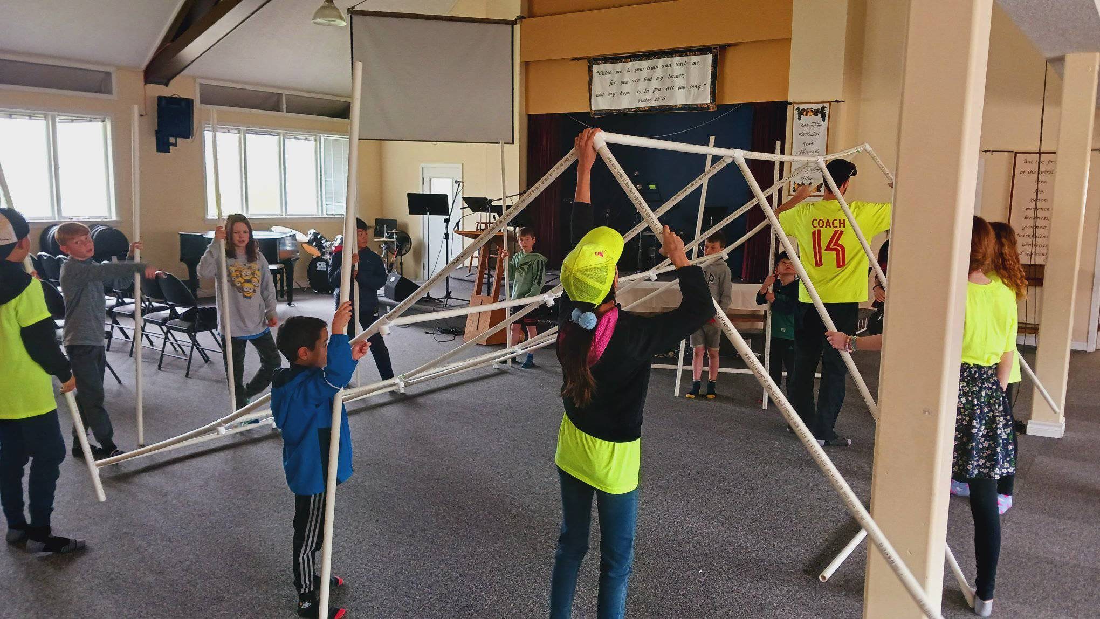

Slide 15
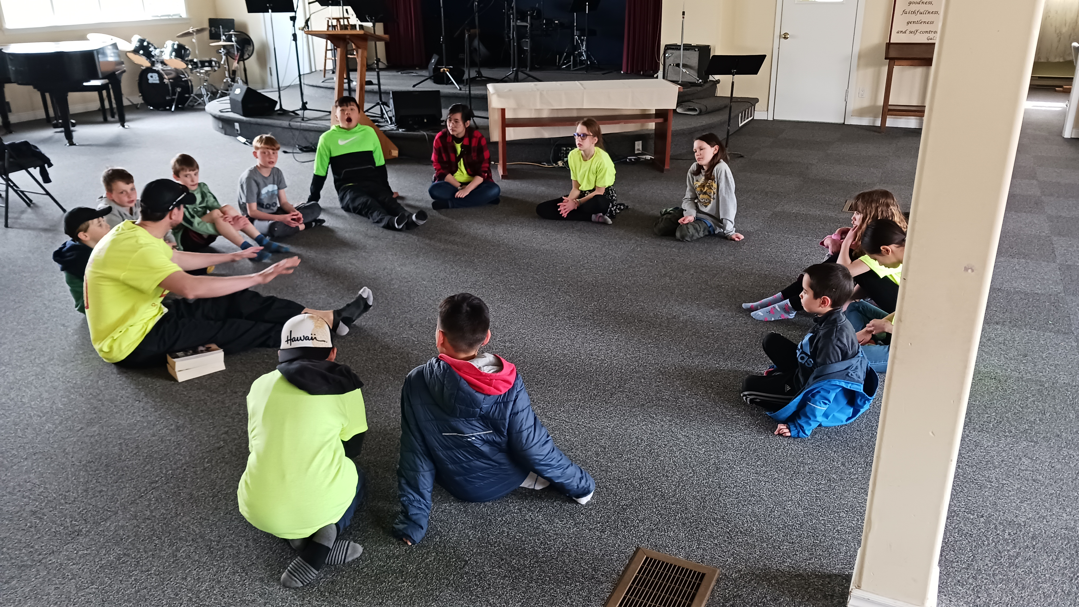

Slide 16
Closing Song
Mighty to Save

