Slide 1
Oct 1, 2023

Slide 2
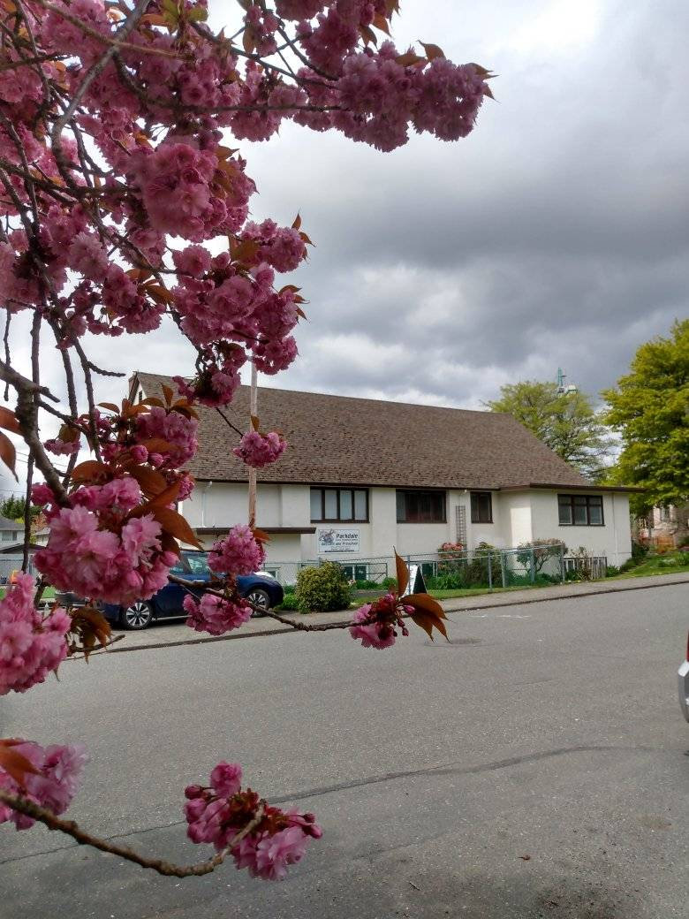
Welcome to Parkdale Church!
We’re so glad you came!
Please Check Your Bulletin for:
Small groups & gatherings
Opportunities to give and serve
Prayer items & today’s Scripture
See parkdalechurch.ca for more
Or parkdaleonline@gmail.com

Slide 3
Opening Songs
Lord, Reign in Me
Come Thou Fount
Great Are You Lord

Slide 4
Fall @ Parkdale
Freedom Session:
Talk with Ted or Emily!
Youth Night:
Tuesday, October 3
Next Church Potluck:
Sunday, October 15
Congregational Meeting:
Sunday, November 26

Slide 5
Offering
Thank you to all who contribute!
White drop-box in the coffee corner of the sanctuary
Online giving via the website or by e-transfer to parkdaleonline@gmail.com

Slide 7
Kids’ Minute: Sunday School for all ages!

Slide 8
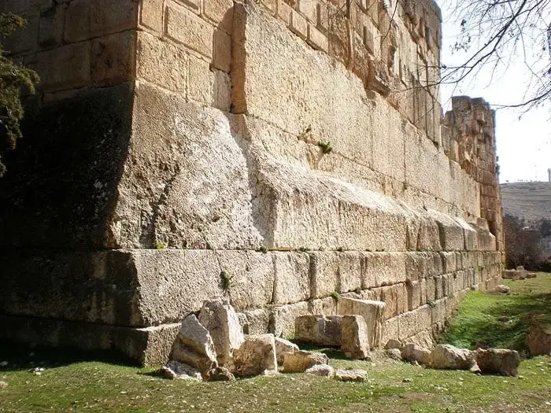
Identity & Purpose
Israel: God’s chosen people, called to be His representatives
All: John 1:12 – to those who received Him, to those who believed in His Name, He gave the right to be called children of God
Church: 1 Peter 2:9-12 – Chosen people, to declare God’s praises and glorify Him with our good works

Slide 9
Mission Statements?
To inspire and nurture the human spirit – one person, one cup, and one neighborhood at a time
Our worldwide operations are aligned around a global strategy called the Plan to Win, which center on an exceptional customer experience – People, Products, Place, Price and Promotion
To help make every brand more inspiring, and the world more intelligent
To be a company that inspires and fulfills your curiosity

Slide 10
Mission Statements?
to develop well-rounded youth, better prepared for success in the world
___ helps keep the world's oceans and citizens safe
Values: duty, integrity, loyalty & courage
Motto: “ready, aye, ready”
Our Mission: Passion for God, Compassion for People
make disciples of all nations, baptizing them & teaching them to follow everything I have commanded you
What to do…but also why and how?

Slide 11
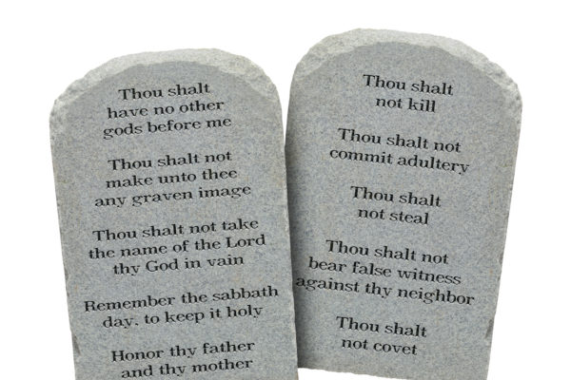
Matthew 24:34-40
Context – Jerusalem, approaching Passover
Jesus’s final teachings & confrontations
34-35 – Pharisees trying to trap him with tough questions
36 – Expert lawyer asks Jesus – which is the greatest commandment?
Expecting Him to pick a side, fall to an extreme

Slide 12
Matthew 24:34-40
Jesus’s Answer – what do you notice?
37-38 – First: Love God – Deuteronomy 6:5
39 – Second: Love your neighbor – Leviticus 19:18
Double answer: avoiding false dichotomy, silly debate
Both/and – abstract & concrete – inseparable
1 John 3:17 – If anyone has material possessions and sees a brother or sister in need but has no pity on them, how can the love of God be in that person?

Slide 13
Matthew 24:34-40
Jesus’s Answer – what do you notice?
Order – love for God first, then for neighbor
1 John 4:7-8 – Dear friends, let us love one another, for love comes from God. Everyone who loves has been born of God and knows God. Whoever does not love does not know God, because God is love.
1 John 4:11, 19 – Dear friends, since God so loved us, we also ought to love one another …We love because He first loved us.

Slide 14
Matthew 24:34-40
Jesus’s Answer – what do you notice?
40 – All the law & prophets hang on these two commands
How do you define love?
Love sums up the law (Romans 13:8-10)
Jesus fulfills the law & prophets (Matthew 5:17)
Love: God’s true intent for the law
Love: Our motivation to obey

Slide 15
Passion for God; Compassion for People
Why we do what we do; and how we do it
Filled to overflow
Seeing people with God’s eyes
Compassion based on truth can actually help the needy
Compassion drawn from God’s love can fulfill the giver
Living it out – time for God, space for people

Slide 16
Closing Song
Prince of Peace
Lord, You Have my Heart

Slide 17
We’re so glad you joined us today!
Please join us for refreshments & fellowship!
Please find the sign-up sheet or contact us if you’d like to join our email list or directory
Please check the bulletin or ask about small groups & ways to serve!

