Slide 1
Oct 8, 2023

Slide 2
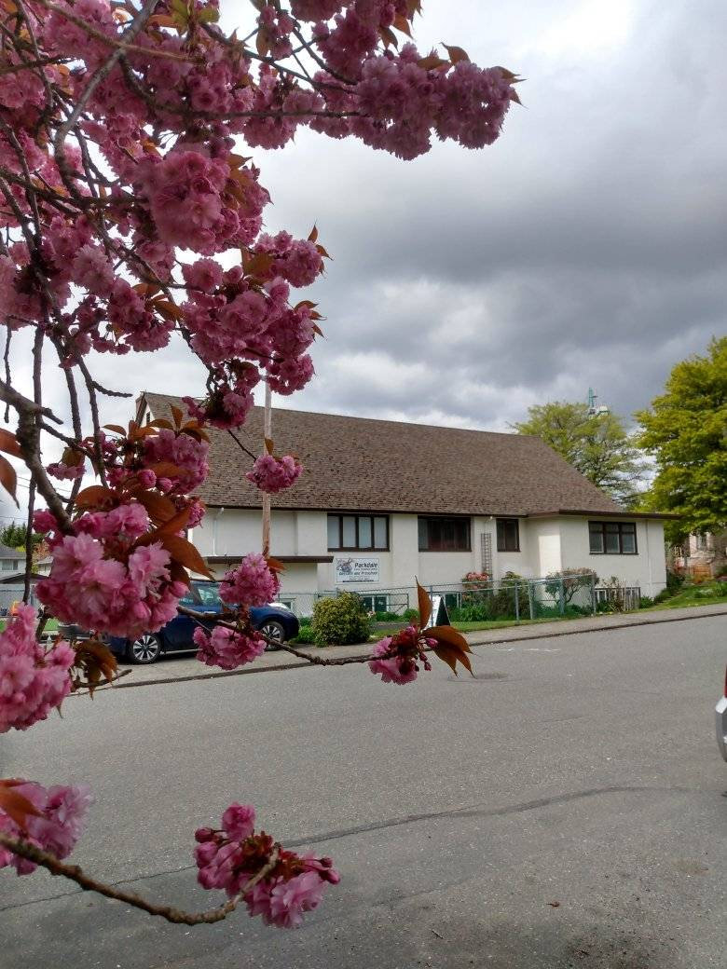
Welcome to Parkdale Church!
We’re so glad you came!
Please Check Your Bulletin for:
Small groups & gatherings
Opportunities to give and serve
Prayer items & today’s Scripture
See parkdalechurch.ca for more
Or parkdaleonline@gmail.com

Slide 3
Opening Songs
Forever – G
By Faith – G
Cornerstone – C

Slide 4
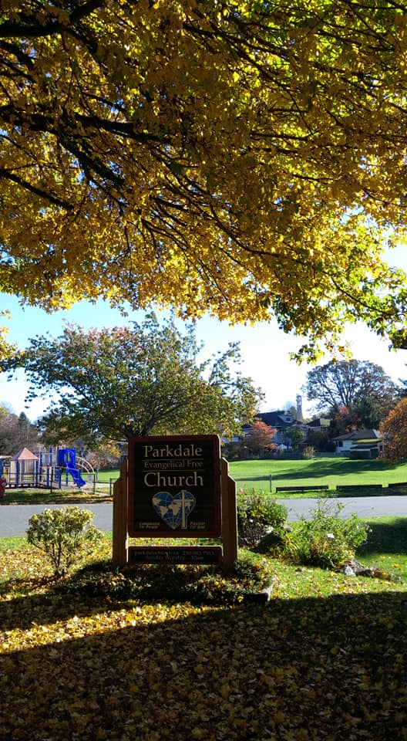
Fall @ Parkdale
Next Church Potluck:
Sunday, October 15
Congregational Meeting:
Sunday, November 26
Ask about Membership
Secretary Position:
Thank you, Paige!
Emily – Ministry Coordination

Slide 5
Offering
Thank you to all who contribute!
White drop-box in the coffee corner of the sanctuary
Online giving via the website or by e-transfer to parkdaleonline@gmail.com

Slide 6
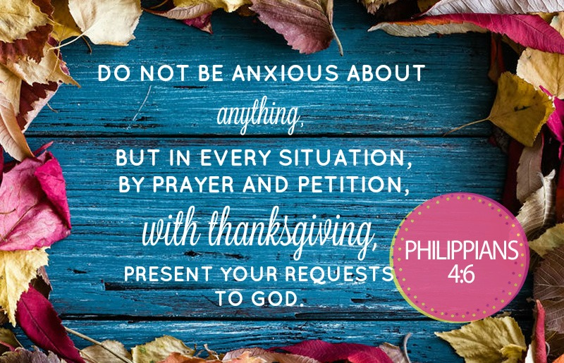

Slide 7
Kids’ Minute: Sunday School for all ages!

Slide 8
Our Identity & Purpose
Love: God’s beloved people, called to love others
Faith & Hope: People on the Way
Psalm 107:1-2 – Give thanks to the Lord, for He is good; His love endures forever. Let the redeemed of the Lord tell their story
Sharing: Al Kelly

Slide 9
Faith & Hope: People on the Way
Uncertain future?
Looking to stories of faith from the past
Gaining hope for the future

Slide 10
Hebrews 11
10:39 – But we do not belong to those who shrink back and are destroyed, but to those who have faith and are saved.
11:1 – definition of faith
Assurance, confidence
Substance, proof
Living at present in light of our future hope
James 2:26 – As the body without the spirit is dead, so faith without deeds is dead.

Slide 11
2 – Stories of ancients – “cloud of witnesses” (12:1)
3 – Creation – an item of faith
4 – Abel – offering His best, trusting God for the rest
5-6 – Enoch – pleased God – beyond belief, also trust
7 – Noah – responded to unseen
8-10 – Abraham – left home for hope in a better one
11-12 – Sarah – considered Him faithful who made the promise

Slide 12
Hebrews 11
13 – All these were still living by faith when they died
“Not by sight” – not yet received what was promised
Faith – seeing from a distance what we hope for
Foreigners & strangers on earth
14-16 – Hopes fulfilled in heavenly city (Revelation 21-22)
Glimpses along the way

Slide 13
Faith & Hope
Remembrance: Faith in what God has done to reconcile us with Him & each other
Reunion: Hope in our future together & celebrating along the way

Slide 14
Closing Song
In Christ Alone – D

Slide 15
1 Corinthians 11:23-26
The Lord Jesus, on the night He was betrayed, took bread, and when He had given thanks, he broke it and said, “This is My body, which is for you; do this in remembrance of Me.”
In the same way, after supper He took the cup, saying, “This cup is the new covenant in My blood; do this, whenever you drink it, in remembrance of Me.”
For whenever you eat this bread and drink this cup, you proclaim the Lord’s death until He comes.

Slide 16
We’re so glad you joined us today!
Please join us for refreshments & fellowship!
Please find the sign-up sheet or contact us if you’d like to join our email list or directory
Please check the bulletin or ask about small groups & ways to serve!

