Slide 1
Nov 26, 2023

Slide 2
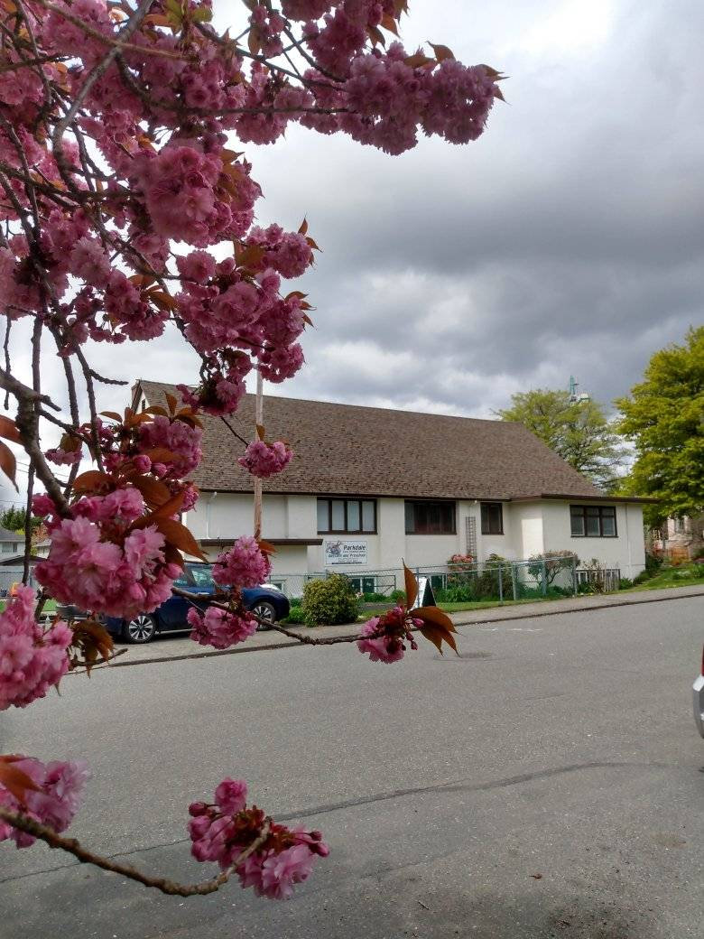
Welcome to Parkdale Church!
We’re so glad you came!
Please Check Your Bulletin for:
Small groups & gatherings
Opportunities to give and serve
Prayer items & today’s Scripture
See parkdalechurch.ca for more
Or parkdaleonline@gmail.com

Slide 3
Opening Songs
Made to Worship
He is Exalted
Build Your Kingdom Here

Slide 4
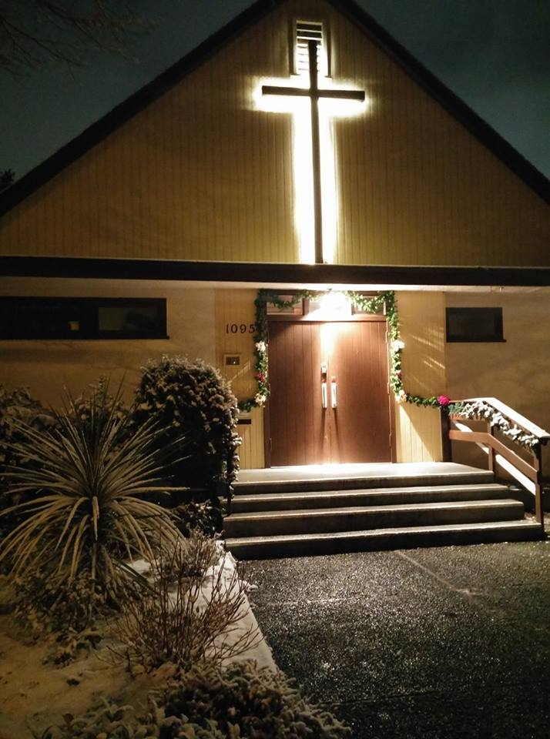
Christmas @ Parkdale
Advent Decorating:
Saturday, December 2
Youth Christmas Party:
Tuesday, December 12 @ 6:30pm
Daycare Concert
Thursday, December 14 @ 5pm
Candlelight Service:
Sunday, December 24 @ 6pm

Slide 5
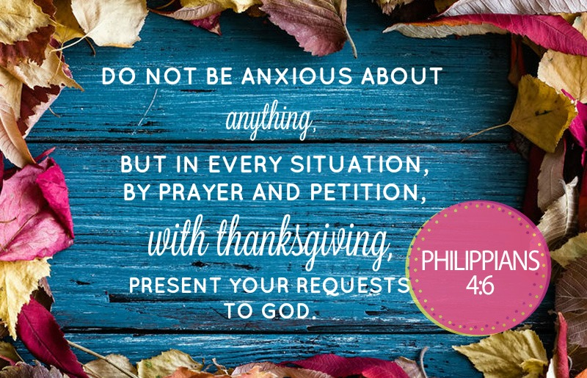

Slide 6
Offering
Thank you to all who contribute!
White drop-box in the coffee corner of the sanctuary
Online giving via the website or by e-transfer to parkdalebookkeeper@gmail.com

Slide 7
Independent in 1984
150 churches
80 missionaries
Trinity Western University
“In essentials unity, in non-essentials charity, in all things Jesus Christ”

Slide 8
Kids’ Minute: Sunday School for all ages!

Slide 9
Faith Story: Dona Walker
Philippians 4:13 “I can do all things thru Christ who strengthens me”
Acts 16 – first stop in Europe – unreached territory
An odd collection of converts forming a new church

Slide 10
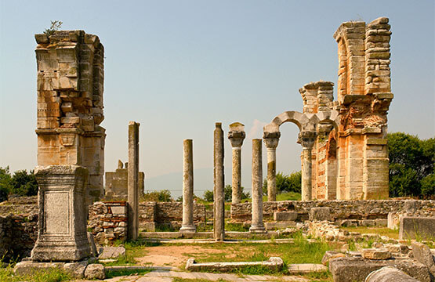
Philippians 3:17-4:1
17 – Follow Paul’s example
1:21 – “to live is Christ, and to die is gain”
1 Cor 11:1 – “follow me as I follow Christ”
Php 2:5 – “in your relationships with one another, have the same mindset as Christ Jesus”
Philippians 3:13-14 – But one thing I do: Forgetting what is behind and straining toward what is ahead, I press on toward the goal to win the prize for which God has called me heavenward in Christ Jesus

Slide 11
Philippians 3:17-4:1
18 – Enemies of the cross of Christ
19 – Destiny is destruction, god is stomach, glory in shame, mind set on earthly things
20 – Those awaiting Christ in Philippi
20-21 – Citizenship in heaven, Son of God coming, will experience glory in resurrection
4:1 – called to stand firm

Slide 12
Citizens of Heaven
John 14:1-3 – Destination after death
Roman citizens of Philippi – where they came from
Living as Christians in this World (not of this world)
1 Peter 2:11-12 – Dear friends, I urge you, as foreigners and exiles, to abstain from sinful desires, which wage war against your soul. ¹² Live such good lives among the pagans that, though they accuse you of doing wrong, they may see your good deeds and glorify God on the day he visits us.
Anticipating His coming kingdom (Revelation 21:2-5)
Serving as Christ’s ambassadors (2 Corinthians 5:18-20)

Slide 13
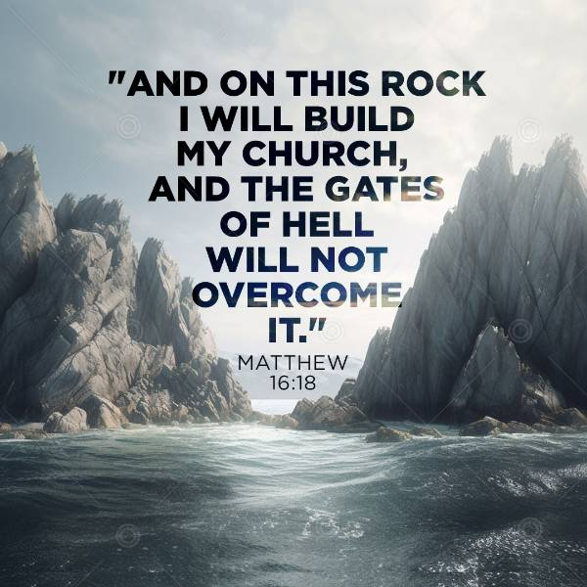

Slide 14
Closing Song
Seek Ye First

Slide 15
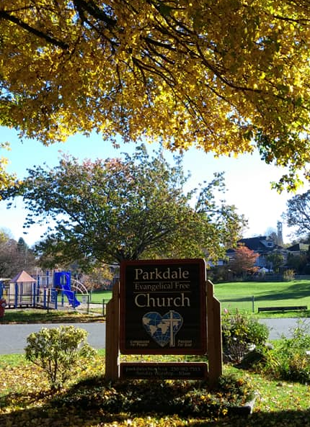
We’re so glad you joined us today!
Please join us for refreshments & fellowship!
See the bulletin for more info, or contact us at parkdaleonline@gmail.com if you’d like to keep in contact!

