Slide 1

June 14, 2026

Slide 2
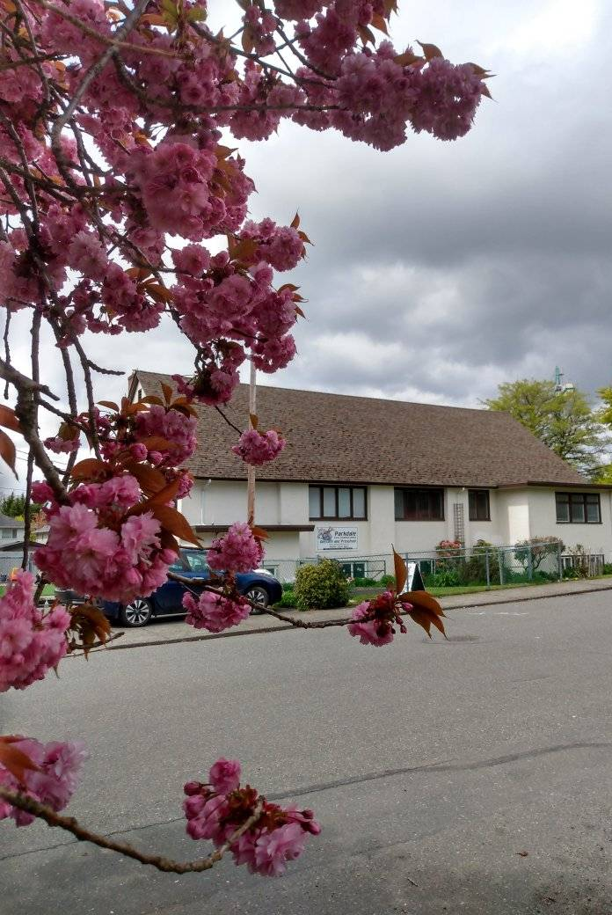
Welcome to Parkdale Church!
We’re so glad you came!
Please see the Bulletin
or parkdalechurch.ca for:
  Weekly gatherings
  Prayer items
  Other news
Or contact us at: parkdaleonline@gmail.com

Slide 3
Songs
Made to Worship
You are Holy
Softly and Tenderly
Through it All
Holy Forever

Slide 4

Offering
Thank you to all
who contribute!
White drop-box near the coffee corner
Online giving via the website
Or by e-transfer to parkdalebookkeeper
@gmail.com

Slide 5
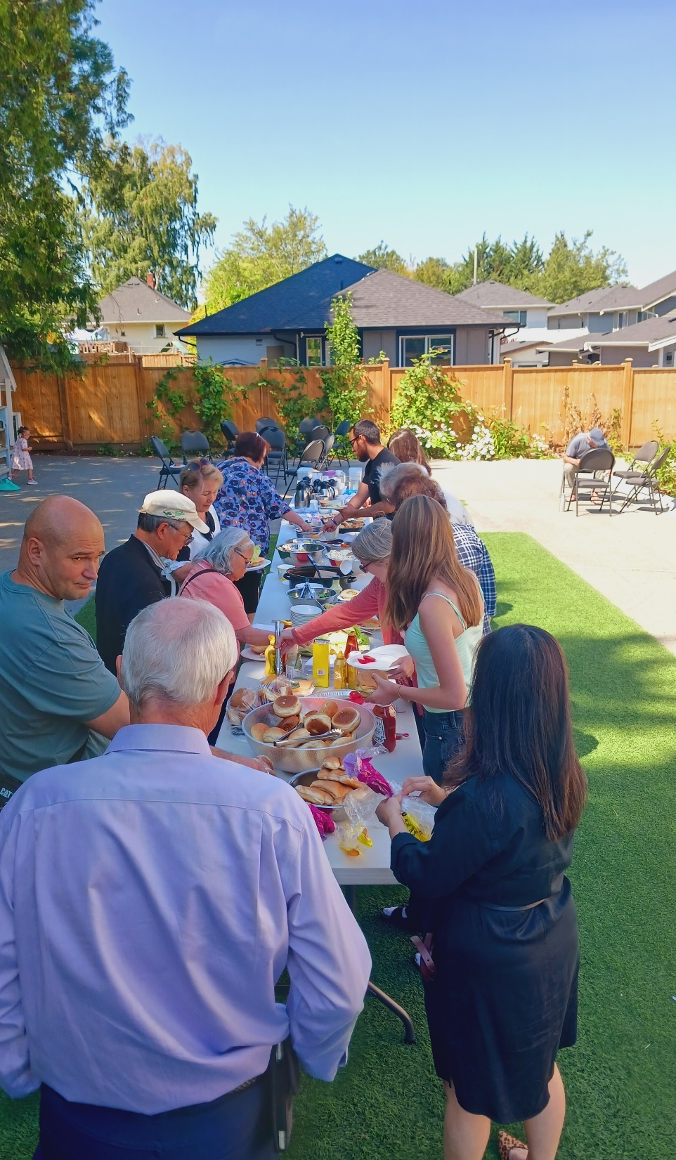
Parkdale News
Sunday, June 21
Father’s Day
Welcome members!
Sunday, June 28
Doug Hamm
Sunday, July 5
Evans Hundermark
BBQ & Commission

Slide 6

https://vimeo.com/1189519521/c472b4f86f?share=copy&fl=sv&fe=ci

Slide 7


Slide 8
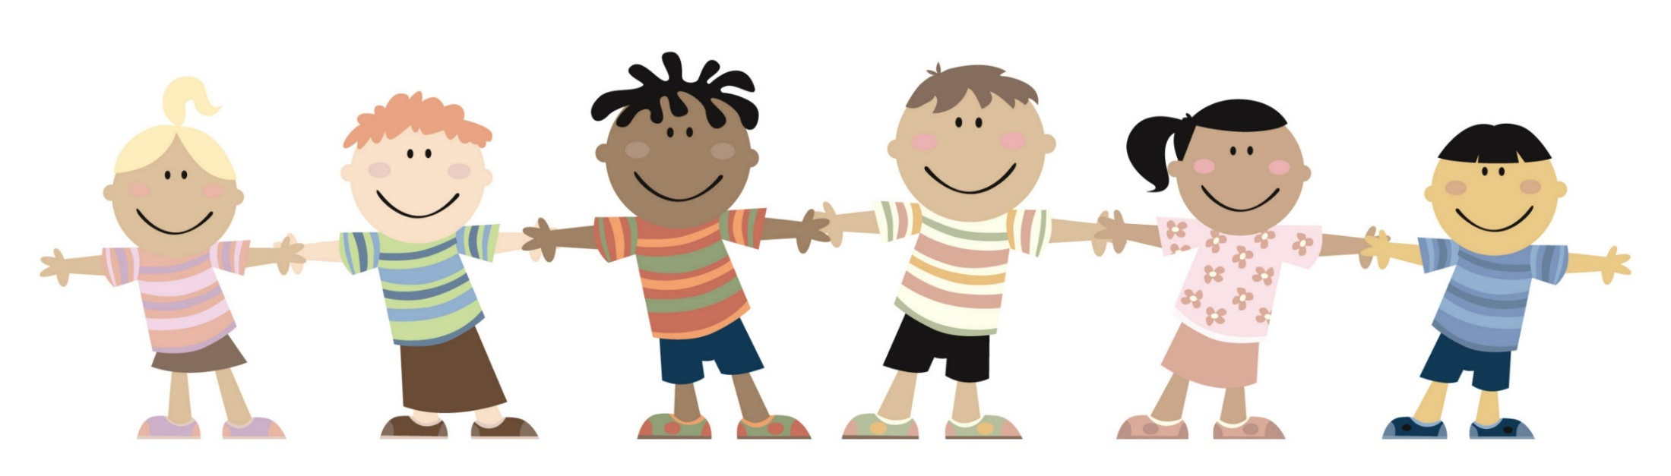
Kids’ Minute
& Sunday
School

Slide 9

Today’s Speaker:
Andy Wells

Slide 10
Jesus is Calling!
How to interact with Jesus and change your life!
Scripture: John 10: 1-10

Slide 11
John 10:1-6: “Very truly I tell you Pharisees,
anyone who does not enter the sheep pen by the gate, but climbs in by some other way, is a thief and a robber. ² The one who enters by the gate is the shepherd of the sheep. ³ The gatekeeper opens the gate for him, and the sheep listen to his voice. He calls his own sheep by name and leads them out. ⁴ When he has brought out all his own, he goes on ahead of them, and his sheep follow him because they know his voice.
⁵ But they will never follow a stranger; in fact, they will run away from him because they do not recognize a stranger’s voice.” ⁶ Jesus used this figure of speech, but the Pharisees did not understand what he was telling them.

Slide 12
John 10: 7-10:
⁷ Therefore Jesus said again, “Very truly I tell you, I am the gate for the sheep. ⁸ All who have come before me are thieves and robbers, but the sheep have not listened to them. ⁹ I am the gate; whoever enters through me will be saved. They will come in and go out and find pasture. ¹⁰ The thief comes only to steal and kill and destroy; I have come that they may have life and have it to the full.

Slide 13
How Jesus called Tim to a new ministry
Well Tim, has the Lord given you a clear idea of His purpose for you in your ministry here in His earthly vineyard?

Slide 14
How Jesus called Tim to a new ministry
Well Tim, has the Lord given you a clear idea of His purpose for you in your ministry here in His earthly vineyard?
Can you describe how you asked Jesus to help you through this pivotal moment in the lives of you and your family?

Slide 15
How Jesus called Tim to a new ministry
Well Tim, has the Lord given you a clear idea of His purpose for you in your ministry here in His earthly vineyard?
Can you describe how you asked Jesus to help you through this pivotal moment in the lives of you and your family?
In what way did He answer your prayers? Were His answers the responses you expected?

Slide 16
How Jesus called Tim to a new ministry
Well Tim, has the Lord given you a clear idea of His purpose for you in your ministry here in His earthly vineyard?
Can you describe how you asked Jesus to help you through this pivotal moment in the lives of you and your family?
In what way did He answer your prayers? Were His answers the responses you expected?
How has this strengthened your relationship with Jesus.

Slide 17
How Tim was called by Jesus to a new ministry
Well Tim, has the Lord given you a clear idea of His purpose for you in your ministry here in His earthly vineyard?
Can you describe how you asked Jesus to help you through this pivotal moment in the lives of you and your family?
In what way did He answer your prayers? Were His answers the responses you expected?
How has this strengthened your relationship with Jesus.
Is there a particular scripture that has guided your path through this time?

Slide 18
How Tim was called by Jesus to a new ministry
Well Tim, has the Lord given you a clear idea of His purpose for you in your ministry here in His earthly vineyard?
Can you describe how you asked Jesus to help you through this pivotal moment in the lives of you and your family?
In what way did He answer your prayers? Were His answers the responses you expected?
How has this strengthened your relationship with Jesus.
Is there a particular scripture that has guided your path through this time?
What else stood out to you in your conversations with Jesus through your calling?

Slide 19
² The one who enters by the gate is the shepherd of the sheep.
³ The gatekeeper opens the gate for him, and the sheep listen to his voice. He calls his own sheep by name and leads them out.
⁴ When he has brought out all his own, he goes on ahead of them, and his sheep follow him because they know his voice.

Slide 20
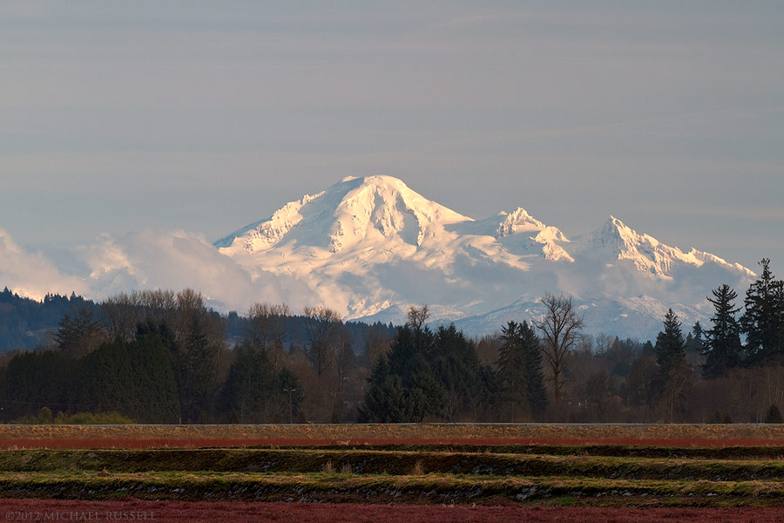

Slide 21
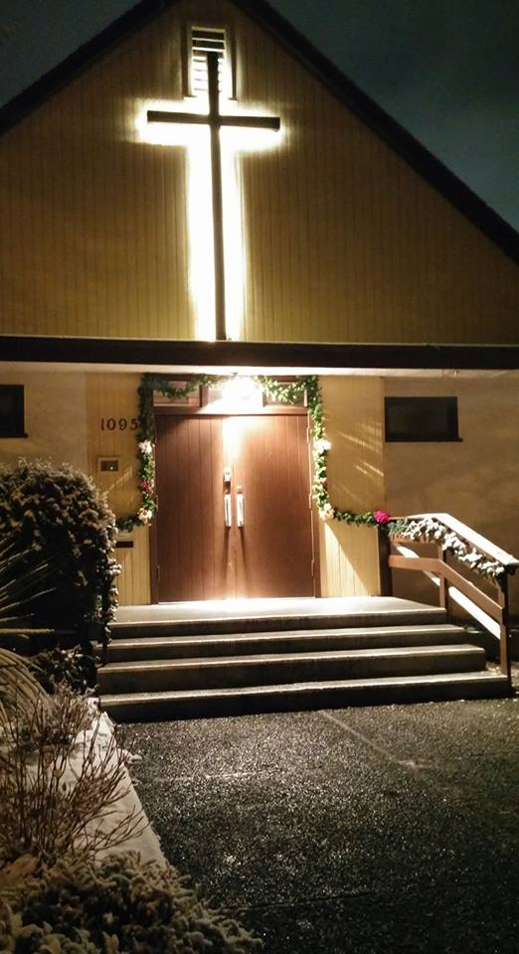
We’re so glad you joined us today!
Please join us
for refreshments
& fellowship!
See the bulletin
for more info,
or contact us at parkdaleonline@gmail.com

