Slide 1

June 21, 2026

Slide 2
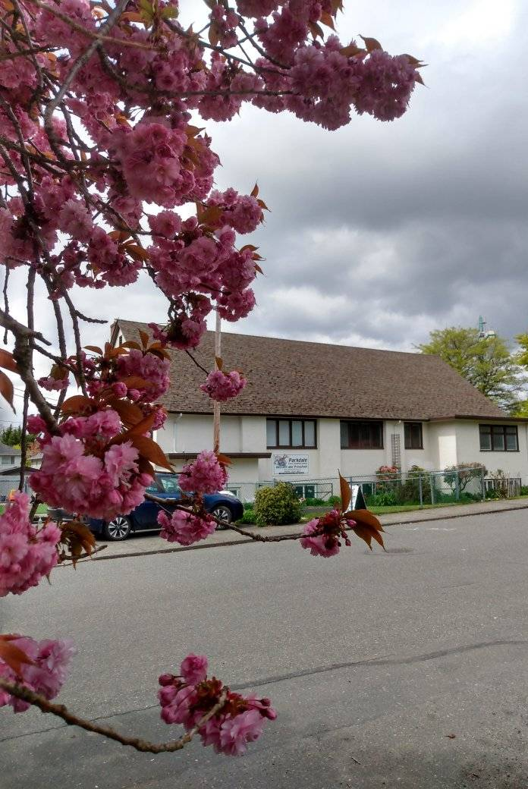
Welcome to Parkdale Church!
We’re so glad you came!
Please see the Bulletin
or parkdalechurch.ca for:
  Weekly gatherings
  Prayer items
  Other news
Or contact us at: parkdaleonline@gmail.com

Slide 3
Songs
Holy Forever
To God be the Glory
Cry of My Heart
Build My Life
Step by Step

Slide 4

Offering
Thank you to all
who contribute!
White drop-box near the coffee corner
Online giving via the website
Or by e-transfer to parkdalebookkeeper
@gmail.com

Slide 5

https://vimeo.com/1189519521/c472b4f86f?share=copy&fl=sv&fe=ci

Slide 6

EFCC 2026 Conference – Winnipeg

Slide 7
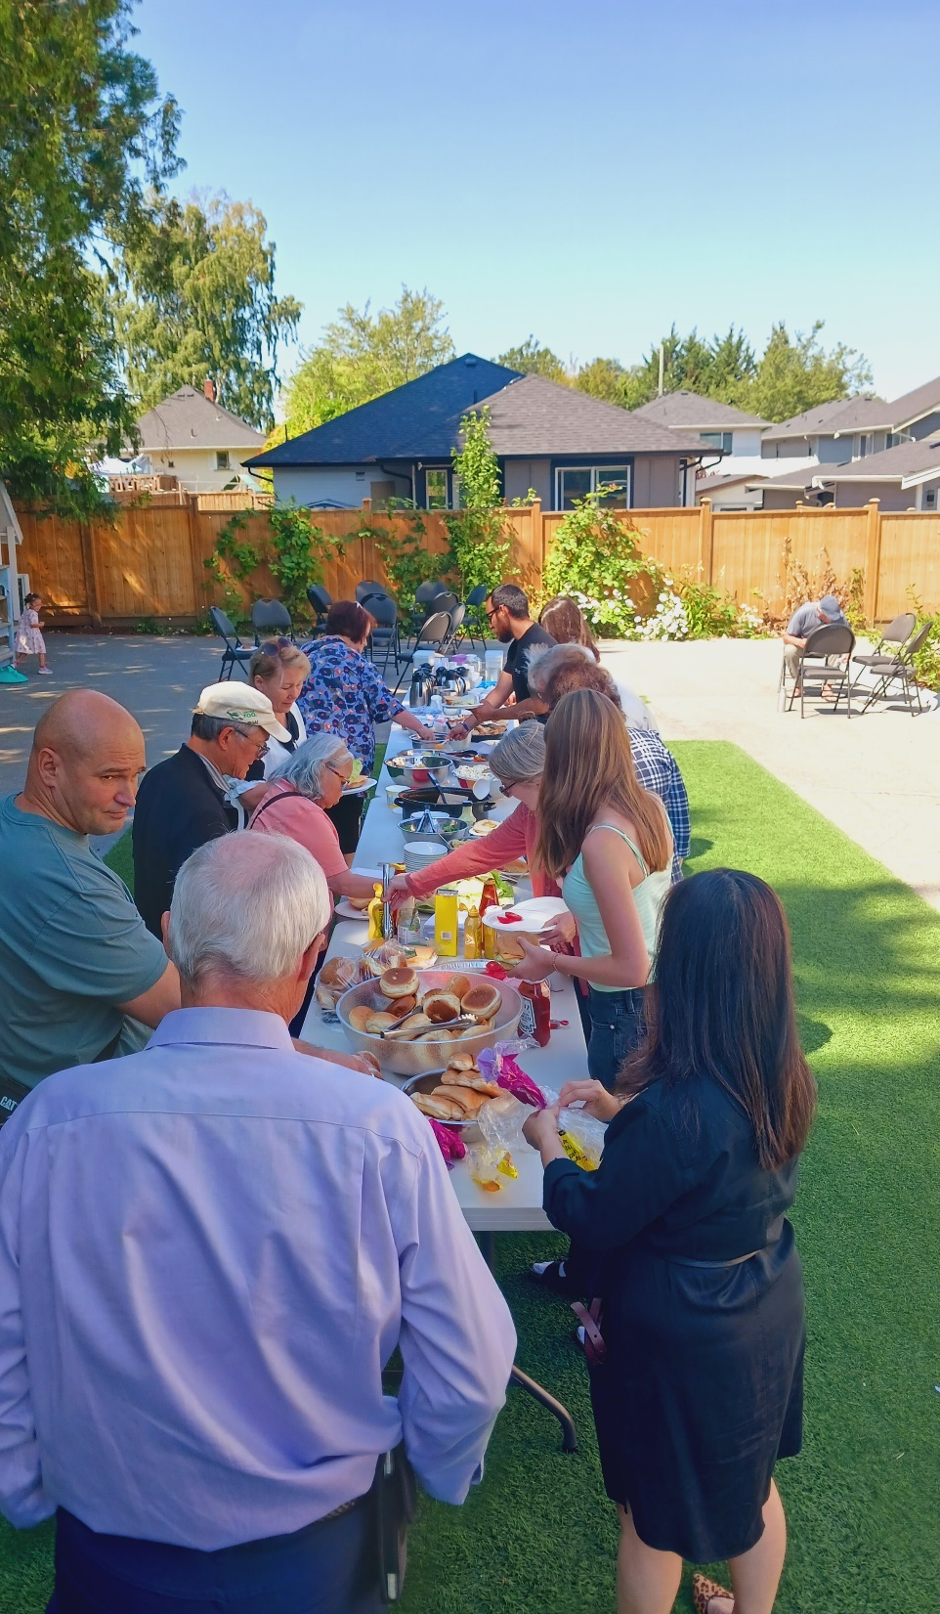
Parkdale News
Sunday, June 21
Father’s Day
Welcome members!
Sunday, June 28
Doug Hamm
Sunday, July 5
Evans Hundermark
BBQ & Commission

Slide 8
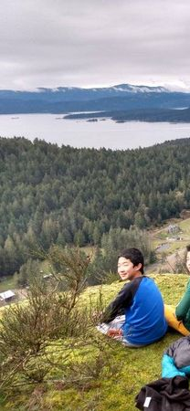
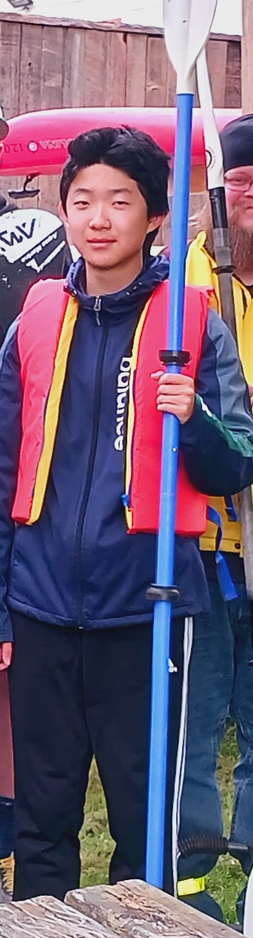
Graduation!
Congratulations, Danny!
And thanks for your years of service on the piano!

Slide 9
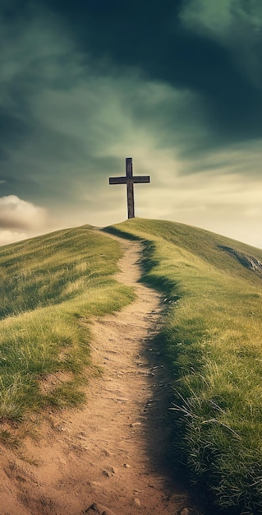

Welcome,
New Members!
Sharon Johnston
Timothy Yoon
Kate Hwang

Slide 10
Parkdale Membership Covenant
Having been brought by Divine grace
to embrace the Lord Jesus Christ
and to give up ourselves wholly to Him;
We do now solemnly and joyfully covenant with each other to live together in Him
with brotherly love, to His glory as our Lord.
We do, therefore, in His strength commit:

Slide 11
That we will exercise a mutual care,
as members one of another,
to promote the growth of the whole body
– in Christian knowledge, holiness and comfort
– to the end that we may stand perfect
and complete in all the will of God;
That to promote and secure this purpose,
we will endeavor to uphold the public worship
of God, and the ordinances of His house;
and to fellowship with each other therein,
not forsaking the assembling of ourselves together;

Slide 12
That we will cheerfully contribute of our property for the support of the poor,
for the support of missions
and for the maintenance of a faithful ministry
of the Gospel among us;
That we will take seriously the great duty
of training our children
and those under our care,
with a view to the service of Christ
and the enjoyment of everlasting life;

Slide 13
That we will walk cautiously in the world,
to the end that we may win souls for the Lord Jesus Christ.
We will endeavor to be a Christian example in speech, conduct, love, faith, and purity of life.
We will remember that God has not given us the spirit of fear, but of power, of love and of a sound mind;
that we are the light of the world and the salt of the earth, and that a city on a hill cannot be hid;

Slide 14
That we will be thoughtful and courteous
to one another, slow to take offense,
quick to forgive and to seek forgiveness;
That we will frequently encourage,
and if occasion shall require, admonish one another according to Matthew 18,
in the spirit of meekness
lest we also be tempted.
As in baptism we have been buried in Christ and raised again,
so there is on us a special obligation
to walk in newness of life;

Slide 15
And may the God of peace,
who brought again the Lord Jesus Christ from the dead,
the great Shepherd of the sheep,
through the blood of His everlasting covenant,
make us perfect in every good work
to do His will, working in us
that which is well-pleasing in His sight,
through Jesus Christ, to Whom be glory forever and ever. Amen.

Slide 16


Slide 17

Kids’ Minute
& Sunday
School

Slide 18
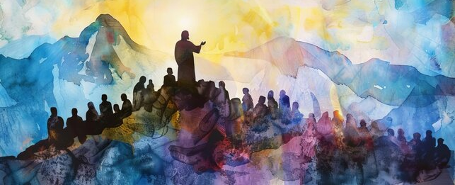
Gospel of Matthew:
Your Kingdom Come
Matthew 21:28-32
Children of
the Kingdom

Slide 19
Matthew 7:21 – Those in the kingdom
do the Father’s will
Matthew 12:50 – Jesus’s family
do the Father’s will
James 1:22, 2:14 – Faith leads to action

Slide 20
21:28-31– Parable of the 2 Sons
– which one did what the Father asked?
32 – Who is entering the kingdom?
– those with humble faith
2 more parables – reinforce action vs. words

Slide 21
Which brother are you?
Which have you been?
Which will you be?

Slide 22
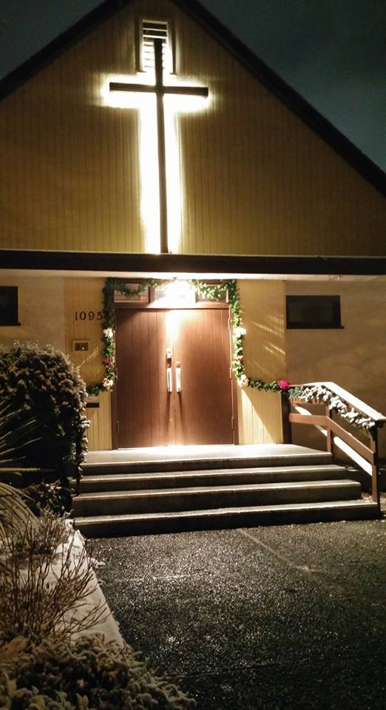
We’re so glad you joined us today!
Please join us
for refreshments
& fellowship!
See the bulletin
for more info,
or contact us at parkdaleonline@gmail.com

