Slide 1

July 05, 2026

Slide 2
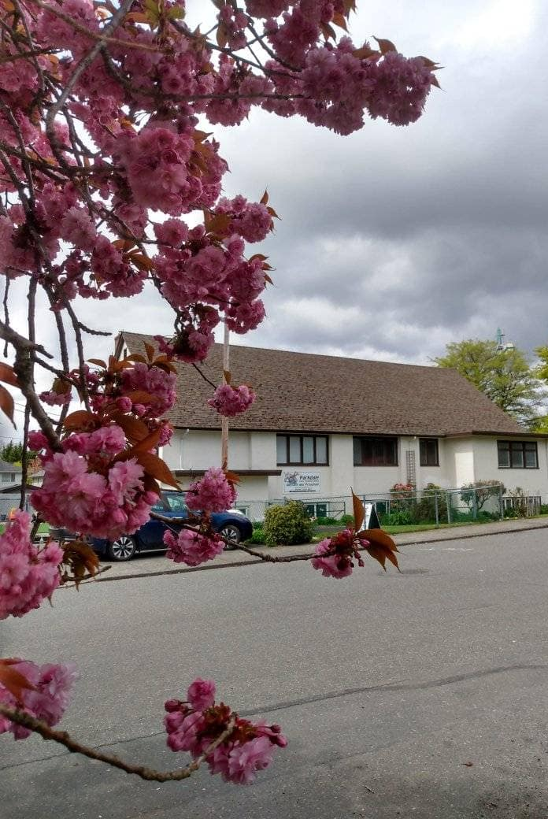
Welcome to Parkdale Church!
We’re so glad you came!
Please see the Bulletin
or parkdalechurch.ca for:
  Weekly gatherings
  Prayer items
  Other news
Or contact us at: parkdaleonline@gmail.com

Slide 3
Songs
Great is Thy Faithfulness (C) https://youtu.be/ErwiBz1QA4o?si=cbV5W-tOdWQLzlzx
You Shine (C) https://youtu.be/-nyhTCNk5Zs?si=O1c5MbKxT_NMJP23
Great are You Lord (E) https://youtu.be/3jCnAAeEJSQ?si=_18rQWt003yCvHXY
Battle Belongs (G) https://youtu.be/johgSkNj3-A?si=6TdOWTobhg8GVo-H
One Thing Remains (E) https://youtu.be/6_KXsMCJgBQ?si=qNDQsjKc0xrbz0Rl
Show Us Christ (A) https://youtu.be/uLIi5SAVMRw?si=XrzFVefzIMXFcztp

Slide 4

Offering
Thank you to all
who contribute!
White drop-box near the coffee corner
Online giving via the website
Or by e-transfer to parkdalebookkeeper
@gmail.com

Slide 5

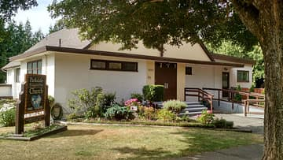
Volunteers needed
COBS Ministry
Saturday, Aug 1st and 8th
Speak with Andrea or email parkdaleonline@gmail.com
1
Garden Volunteers
Help water church plants
(2x a week)
Speak with Ed Robertson

Slide 6
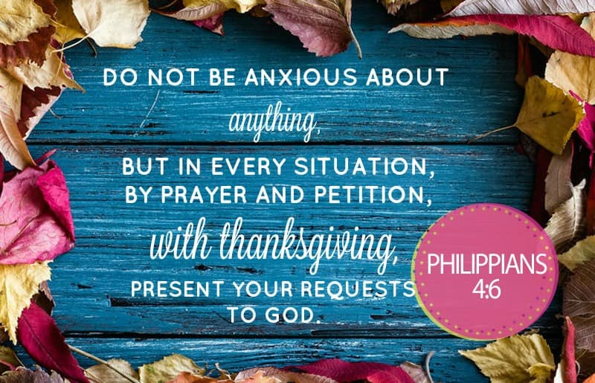

Slide 7
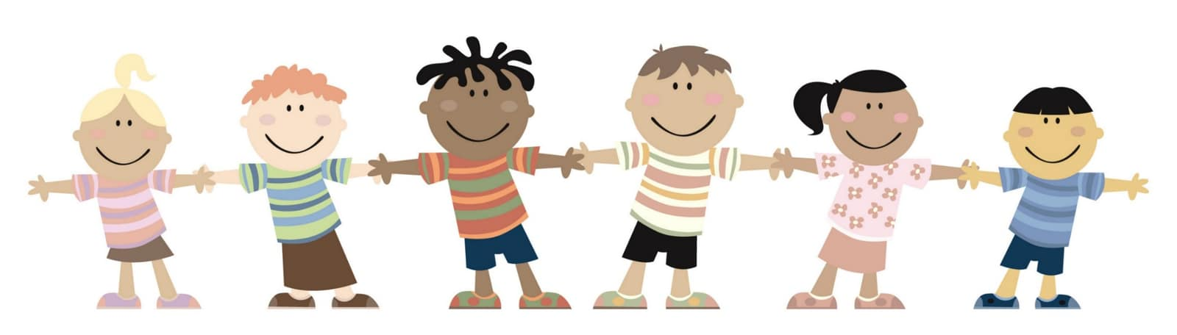
Kids’ Minute
& Sunday
School

Slide 8
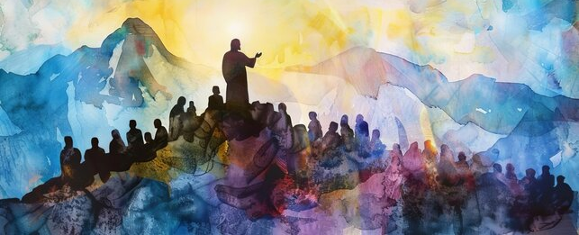
Joshua 1:1-17
“Where do we grow from here”
Guest Speaker:
Evans Hundermark.

Slide 9



Slide 10
1 Corinthians 11:23-26
The Lord Jesus, on the night
He was betrayed, took bread,
and when He had given thanks,
He broke it and said,
“This is My body, which is for you; do this in remembrance of Me.”
In the same way, after supper
He took the cup, saying,
“This cup is the new covenant in My blood; do this, whenever you drink it, in remembrance of Me.”
For whenever you eat this bread and drink this cup, you proclaim
the Lord’s death until He comes.

Slide 11
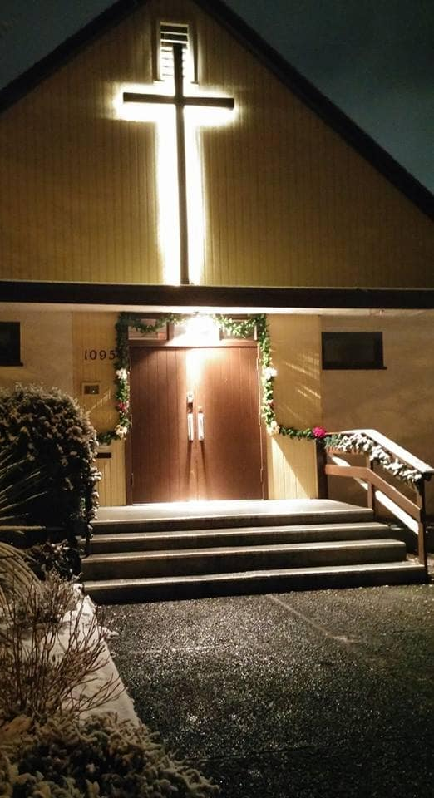
We’re so glad you joined us today!
Please join us
for refreshments
& fellowship!
See the bulletin
for more info,
or contact us at parkdaleonline@gmail.com

