Slide 1

July 12, 2026

Slide 2
Songs
Holy Holy Holy - CCLI Song # 1156
How Great Thou Art - CCLI Song # 14181
Build My Life - CCLI Song # 7070345
We Fall Down - CCLI Song # 2437367
The Servant King - CCLI Song # 78897 (Response song after sermon)

Slide 3

Upcoming
@ Parkdale!
Sunday, _____
Potluck after
the service

Slide 4

Parkdale News
COBS Ministry
Saturday, Aug 1st and 8th
Speak with Andrea or email parkdaleonline@gmail.com

Slide 5
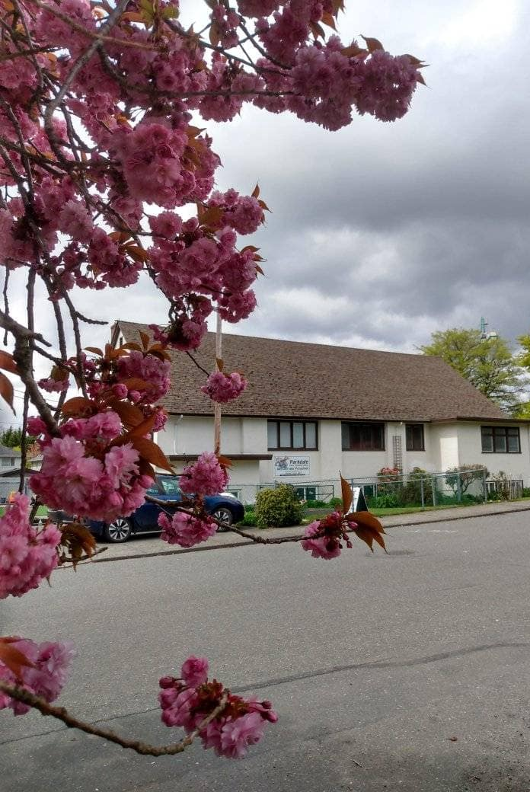
Welcome to Parkdale Church!
We’re so glad you came!
Please see the Bulletin
or parkdalechurch.ca for:
  Weekly gatherings
  Prayer items
  Other news
Or contact us at: parkdaleonline@gmail.com

Slide 6


Slide 7

Offering
Thank you to all
who contribute!
White drop-box near the coffee corner
Online giving via the website
Or by e-transfer to parkdalebookkeeper
@gmail.com

Slide 8

Kids’ Minute
& Sunday
School

Slide 9
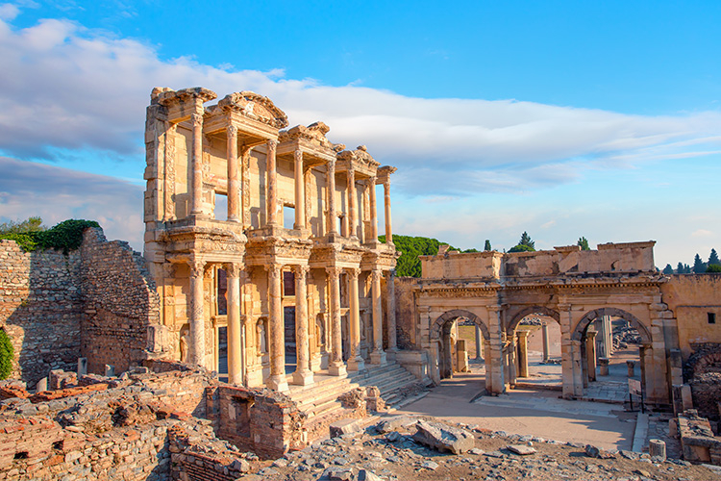
Ordinary Becomes Extraordinary
ACTS 19:1–20
Paul's Work in Ephesus
“So the word of the Lord spread widely and grew in power.”

Slide 10
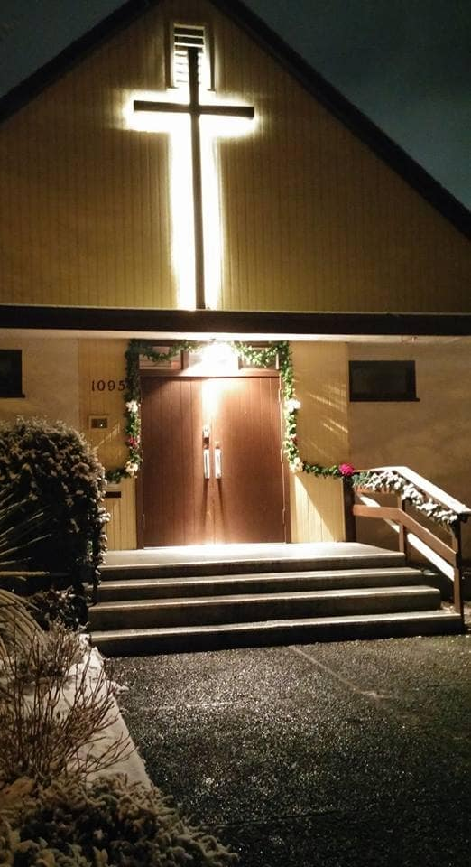
We’re so glad you joined us today!
Please join us
for refreshments
& fellowship!
See the bulletin
for more info,
or contact us at parkdaleonline@gmail.com

