Slide 1

July 19, 2026

Slide 2
Songs
Come as You Are
Yet Not I But Through Christ in Me
Living Hope
In Christ Alone
Build My Life

Slide 3
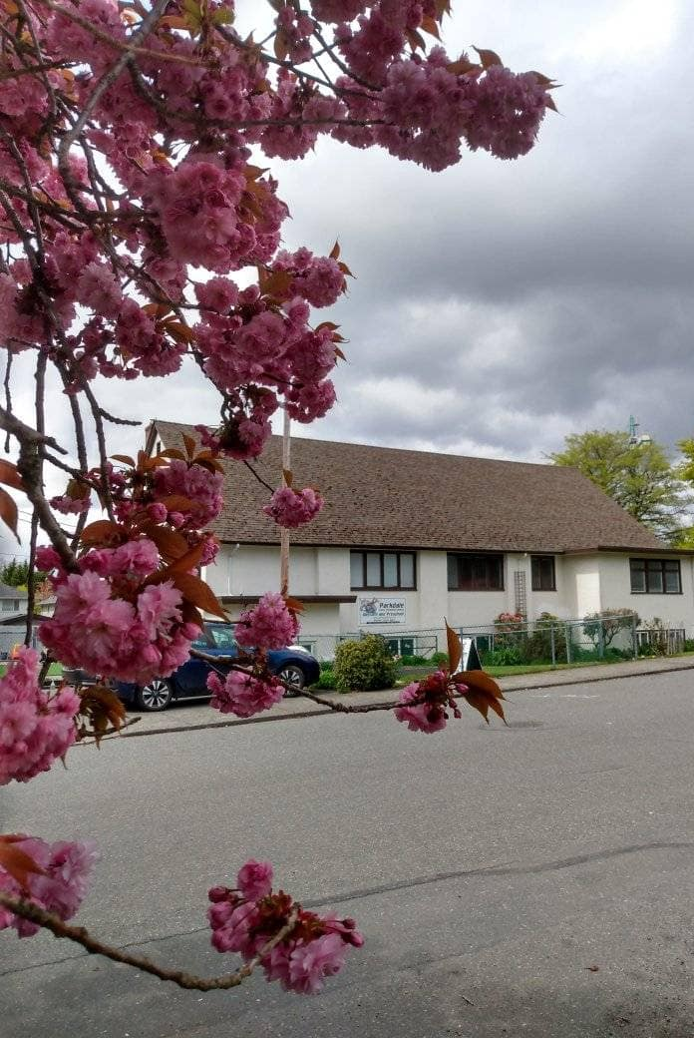
Welcome to Parkdale Church!
We’re so glad you came!
Please see the Bulletin
or parkdalechurch.ca for:
  Weekly gatherings
  Prayer items
  Other news
Or contact us at: parkdaleonline@gmail.com

Slide 4

Upcoming
@ Parkdale!
Sunday, July 26
Darin Reimer
Snack and Yak Potluck
Saturday, August 1st
Volunteers needed to pick up bread

Slide 5


Slide 6

Offering
Thank you to all
who contribute!
White drop-box near the coffee corner
Online giving via the website
Or by e-transfer to parkdalebookkeeper
@gmail.com

Slide 7

Kids’ Minute
& Sunday
School

Slide 8

In Christ:
The Letter to the Ephesians
Adopted and Authorized:
Ephesians 1: 1-14

Slide 9

“Now What?”
The Doctrine of Adoption and Our Lives Beyond Salvation

Slide 10
In Christ:
The Letter to the Ephesians
Adopted and Authorized:
Ephesians 1: 1-14

Slide 11
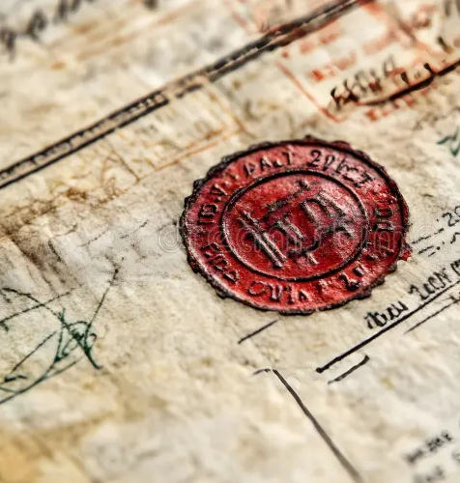
Sealed:
The Holy spirit as the authorizer of our identity

Slide 12
In Christ:
The Letter to the Ephesians
Adopted and Authorized:
Ephesians 1: 1-14

Slide 13
1 Corinthians 11:23-26
The Lord Jesus, on the night
He was betrayed, took bread,
and when He had given thanks,
He broke it and said,
“This is My body, which is for you; do this in remembrance of Me.”
In the same way, after supper
He took the cup, saying,
“This cup is the new covenant in My blood; do this, whenever you drink it, in remembrance of Me.”
For whenever you eat this bread and drink this cup, you proclaim
the Lord’s death until He comes.

Slide 14
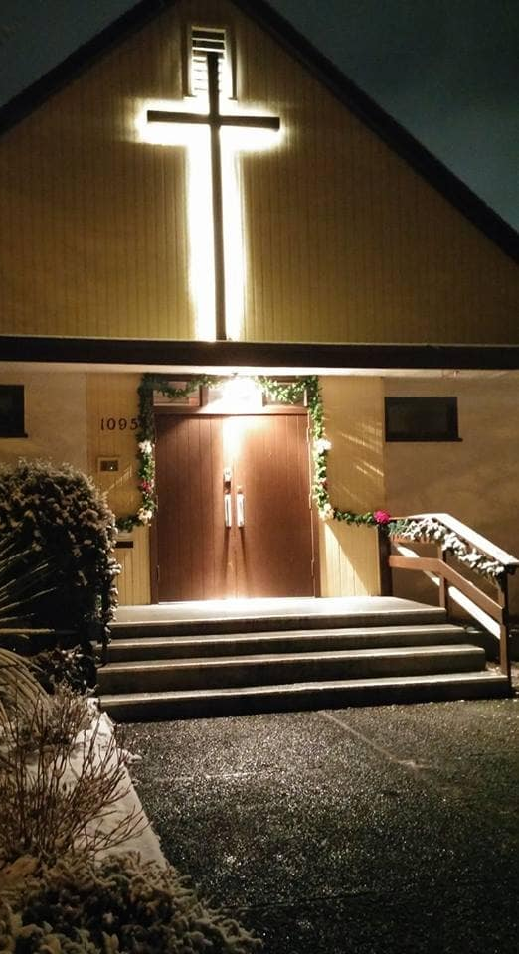
We’re so glad you joined us today!
Please join us
for refreshments
& fellowship!
See the bulletin
for more info,
or contact us at parkdaleonline@gmail.com

