Slide 1

July 26, 2026

Slide 2
Songs
By Faith
Lord I Need You
Holy Holy Holy
Living Hope
Days of Elijah

Slide 3
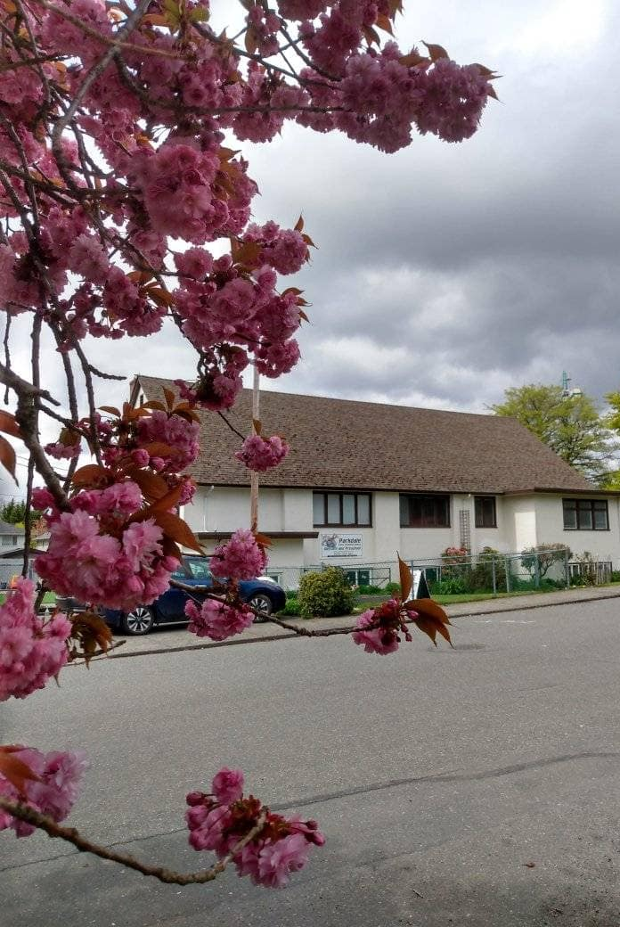
Welcome to Parkdale Church!
We’re so glad you came!
Please see the Bulletin
or parkdalechurch.ca for:
  Weekly gatherings
  Prayer items
  Other news
Or contact us at: parkdaleonline@gmail.com

Slide 4

Announcement
@Parkdale!
Volunteers needed to pick up bread Saturday, August 8th
Coffee Ministry Volunteers Needed!

Slide 5


Slide 6

Offering
Thank you to all
who contribute!
White drop-box near the coffee corner
Online giving via the website
Or by e-transfer to parkdalebookkeeper
@gmail.com

Slide 7

Kids’ Minute
& Sunday
School

Slide 8

Faith Heroes
Hebrews 11:32–40

Slide 9
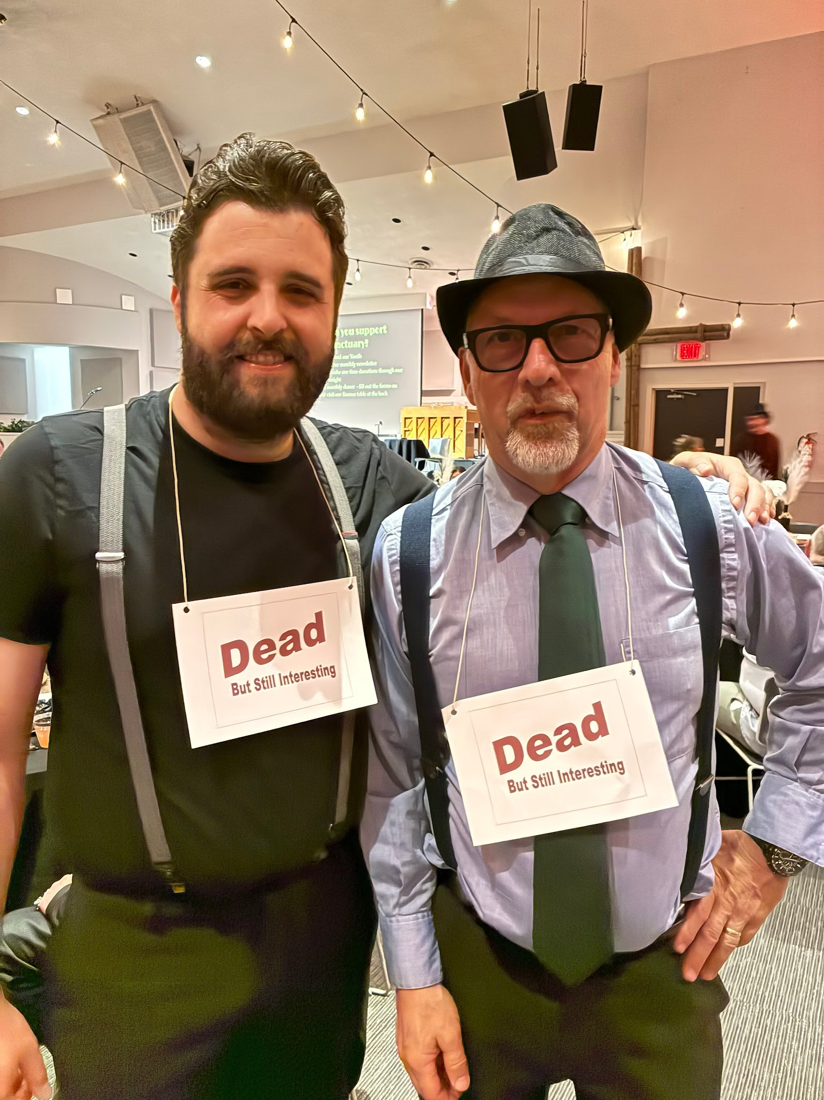

Slide 10


Slide 11
Two lists of faith heroes
Weakness turned to strength
Death turned to life
Peter escapes prison
David is victorious over armies
widow of Zarephath, the Shunammite woman
Persecution resulting in death
Faith that results in greater hardship and even death
John the Baptist beheaded
Jonathan dies in battle, alone
Widow with 7 sons

Slide 12
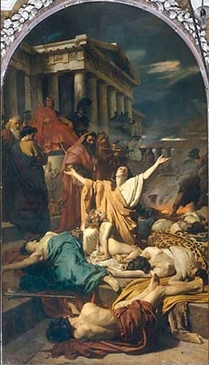

Slide 13
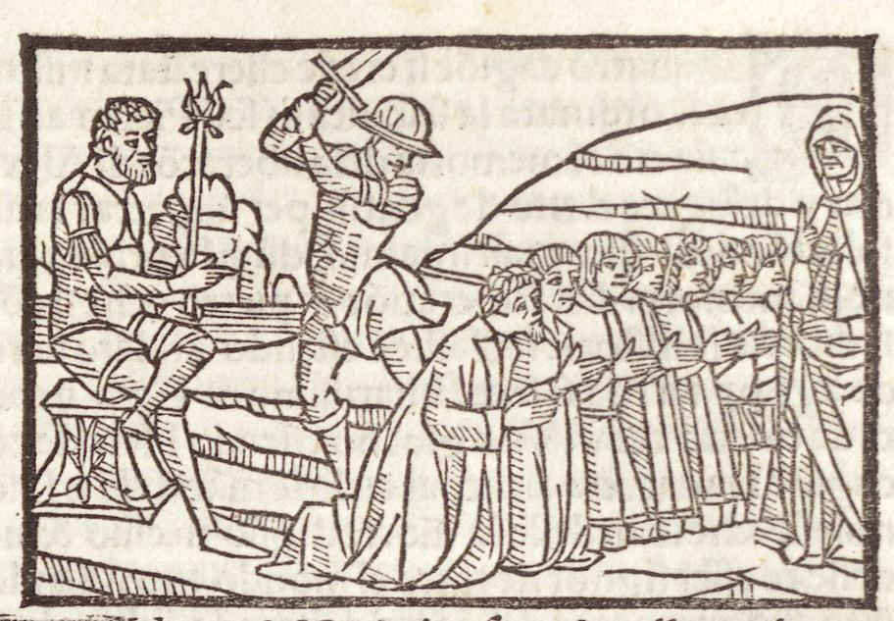

Slide 14
What does success look like in the Christian worldview?
Jesus wounds remind us of a greater purpose behind Christian suffering
Every sorrow, every hardship will make your eventual joy and reward greater.

Slide 15
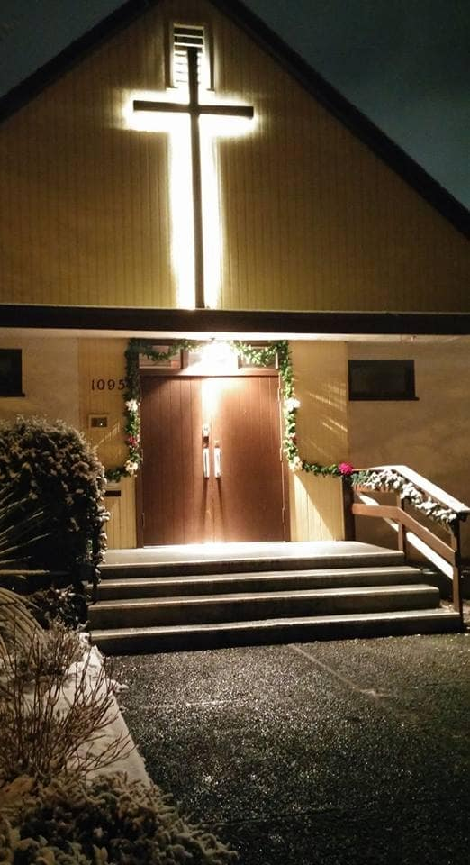
We’re so glad you joined us today!
Please join us
for refreshments
& fellowship!
See the bulletin
for more info,
or contact us at parkdaleonline@gmail.com

