Slide 1

August 02, 2026

Slide 2
Songs
Here I am to Worship
Open the Eyes of My Heart
How Great is Our God
Holy Forever
Might to Save

Slide 3
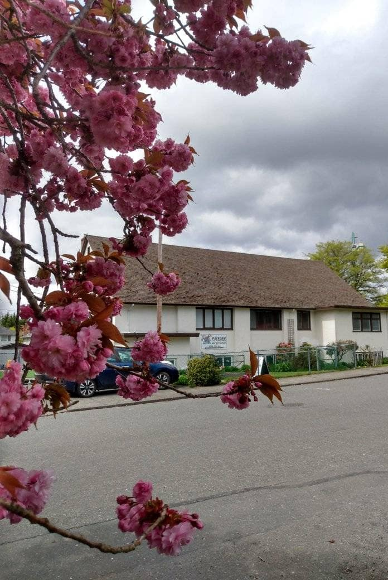
Welcome to Parkdale Church!
We’re so glad you came!
Please see the Bulletin
or parkdalechurch.ca for:
  Weekly gatherings
  Prayer items
  Other news
Or contact us at: parkdaleonline@gmail.com

Slide 4

Upcoming
@ Parkdale!
Sunday, Aug 23
Snack and Yak potluck
Everyone is invited!

Slide 5
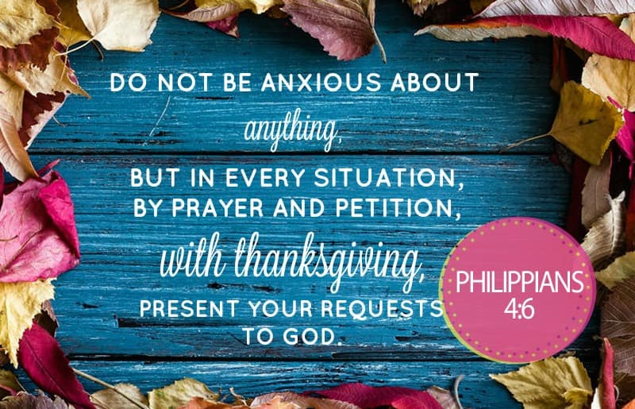

Slide 6

Offering
Thank you to all
who contribute!
White drop-box near the coffee corner
Online giving via the website
Or by e-transfer to parkdalebookkeeper
@gmail.com

Slide 7

Kids’ Minute
& Sunday
School

Slide 8

In Christ:
The Letter to the Ephesians
The Hope of Your Calling:
Ephesians 1: 15-23

Slide 9

Coming into Focus
Wisdom and Revelation to Perceive Our Hope and Calling

Slide 10

The Greatness of His Power At Work In You

Slide 11
1 Corinthians 11:23-26
The Lord Jesus, on the night
He was betrayed, took bread,
and when He had given thanks,
He broke it and said,
“This is My body, which is for you; do this in remembrance of Me.”
In the same way, after supper
He took the cup, saying,
“This cup is the new covenant in My blood; do this, whenever you drink it, in remembrance of Me.”
For whenever you eat this bread and drink this cup, you proclaim
the Lord’s death until He comes.

Slide 12
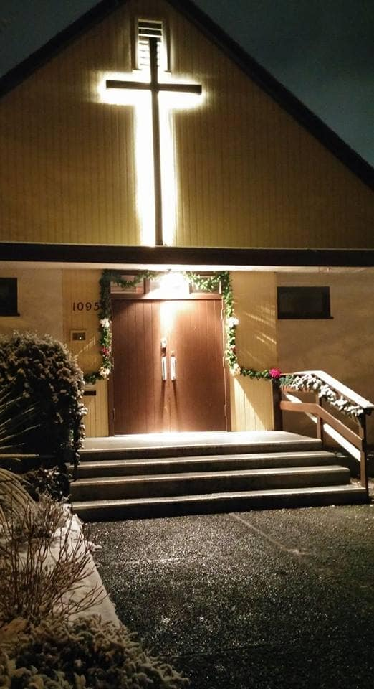
We’re so glad you joined us today!
Please join us
for refreshments
& fellowship!
See the bulletin
for more info,
or contact us at parkdaleonline@gmail.com

