Slide 1

August 09, 2026

Slide 2
Songs
Mighty to save
I could sing of your love forever
This is amazing grace
Grace greater than our sins
Cornerstone

Slide 3
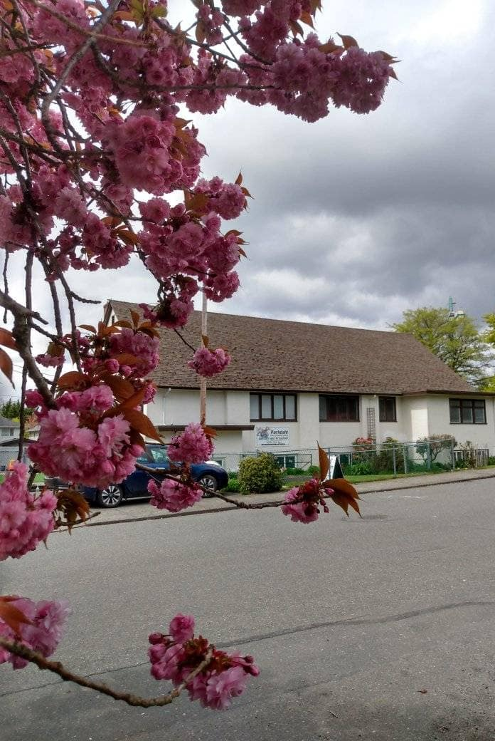
Welcome to Parkdale Church!
We’re so glad you came!
Please see the Bulletin
or parkdalechurch.ca for:
  Weekly gatherings
  Prayer items
  Other news
Or contact us at: parkdaleonline@gmail.com

Slide 4

Upcoming
@ Parkdale!
Sunday, Aug 23
Snack and Yak potluck
Everyone is invited!

Slide 5


Slide 6

Offering
Thank you to all
who contribute!
White drop-box near the coffee corner
Online giving via the website
Or by e-transfer to parkdalebookkeeper
@gmail.com

Slide 7

Kids’ Minute
& Sunday
School

Slide 8

In Christ:
The Letter to the Ephesians
Reoriented by Grace
Ephesians 2:1-10

Slide 9
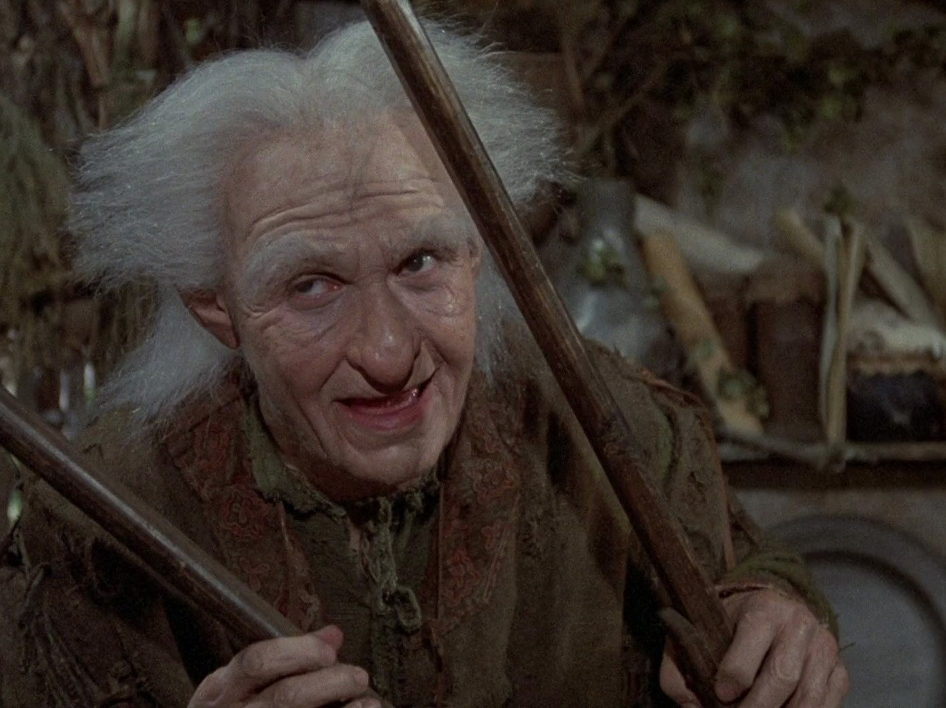
Only “Mostly Dead”?
The Death We Were Walking In Before Jesus

Slide 10
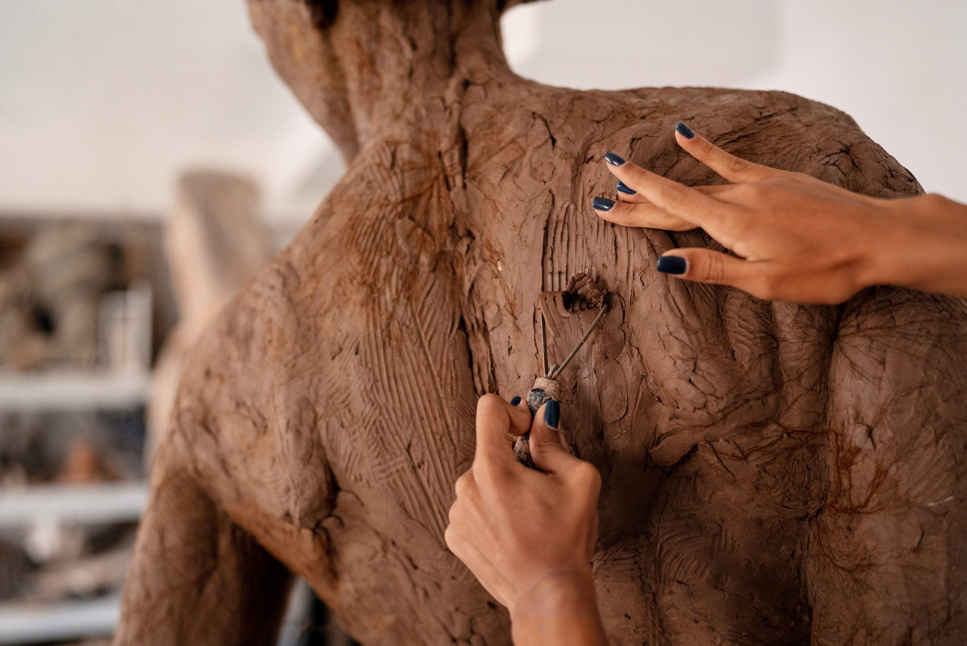
“God’s Masterpiece”
- What You and I Were Created For

Slide 11
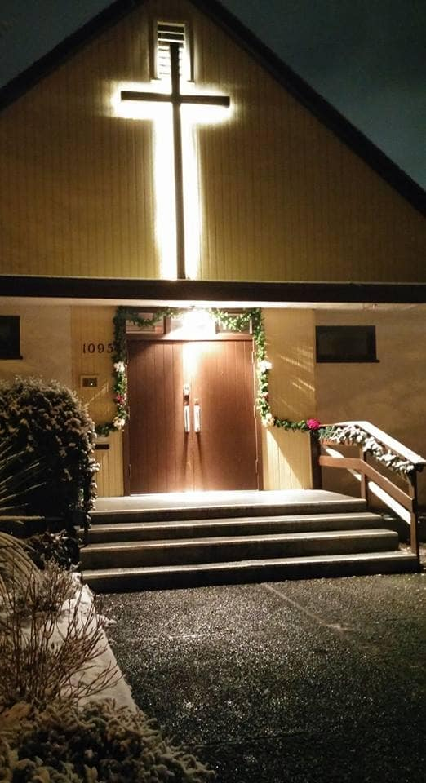
We’re so glad you joined us today!
Please join us
for refreshments
& fellowship!
See the bulletin
for more info,
or contact us at parkdaleonline@gmail.com

