Slide 1

August 16, 2026

Slide 2
Songs
In Christ Alone
Battle Belongs
Show Us Christ
No Longer Slaves
Cornerstone

Slide 3
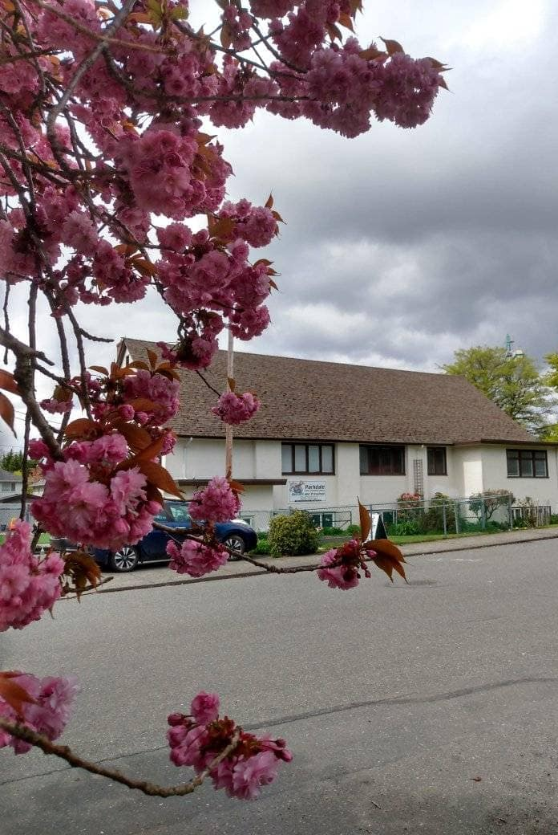
Welcome to Parkdale Church!
We’re so glad you came!
Please see the Bulletin
or parkdalechurch.ca for:
  Weekly gatherings
  Prayer items
  Other news
Or contact us at: parkdaleonline@gmail.com

Slide 4
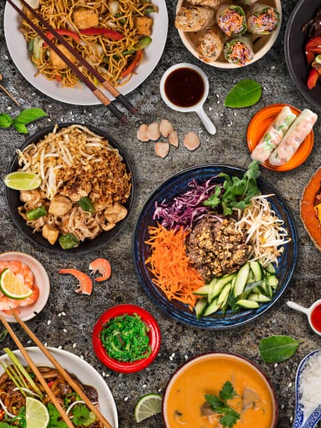
Upcoming
@ Parkdale!
Sunday, Aug 23
Snack and Yak potluck
Everyone is invited!

Slide 5


Slide 6

Offering
Thank you to all
who contribute!
White drop-box near the coffee corner
Online giving via the website
Or by e-transfer to parkdalebookkeeper
@gmail.com

Slide 7

Kids’ Minute
& Sunday
School

Slide 8

A Temple of Peaces
Eph. 2:11-22

Slide 9
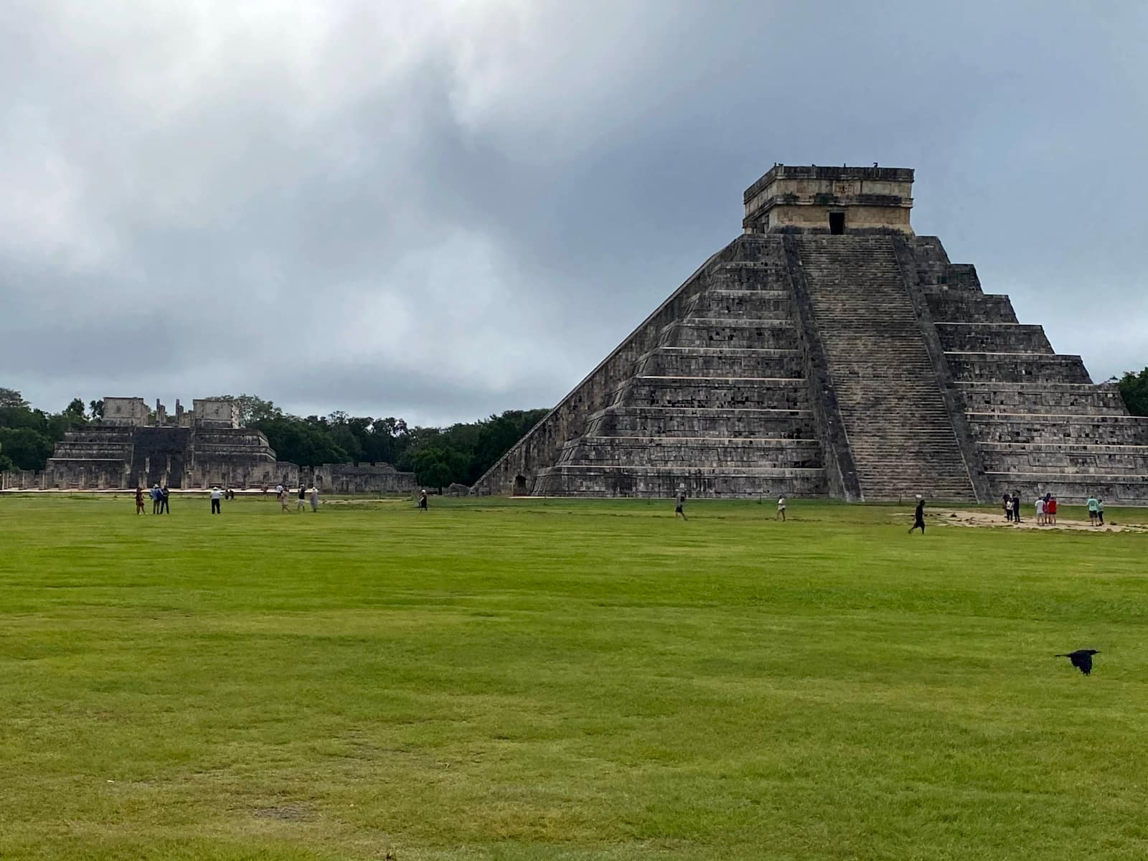

Slide 10
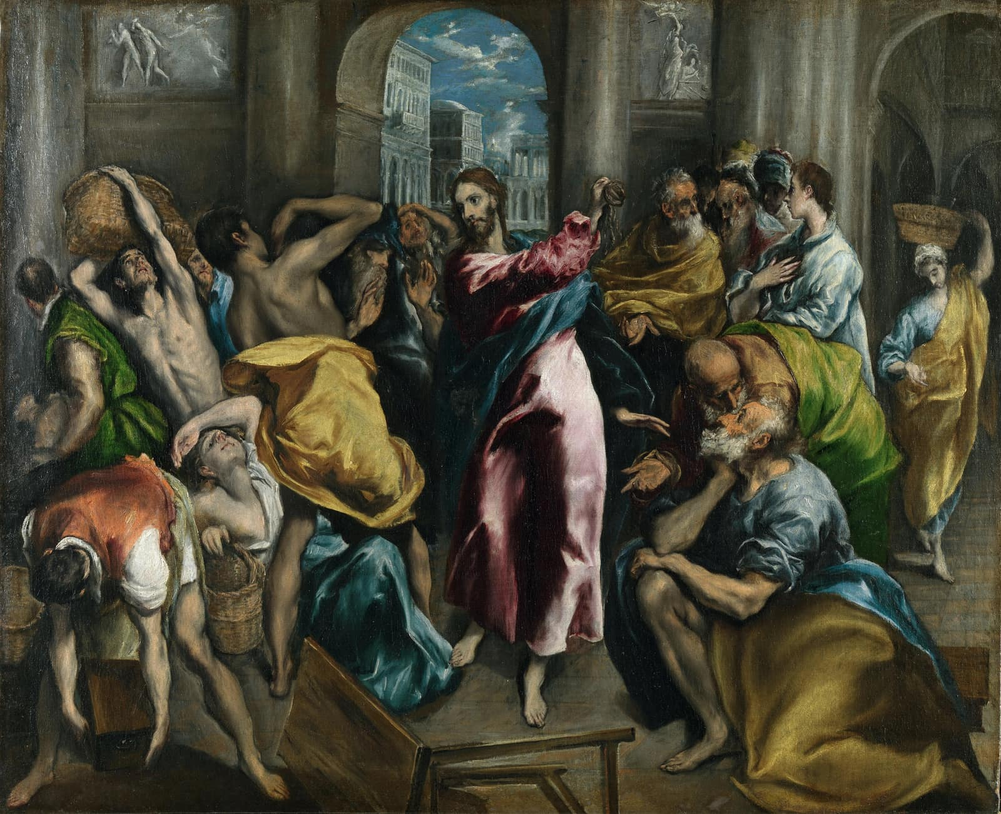

Slide 11
A house of prayer
for all nations
Isaiah 56:7

Slide 12
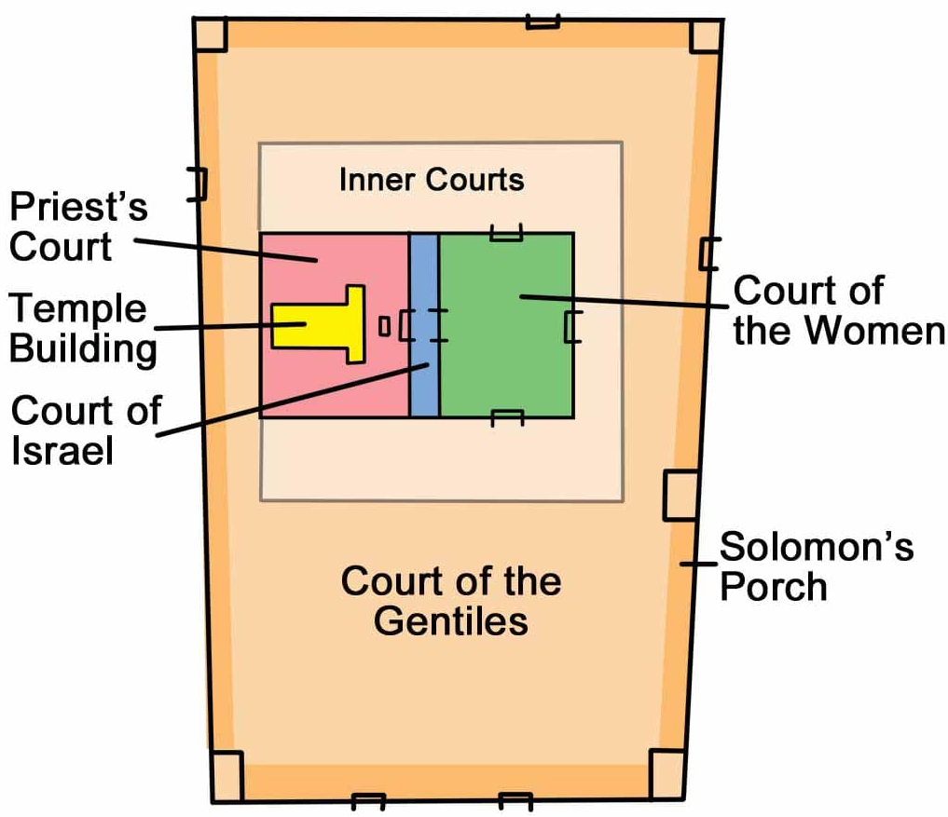

Slide 13
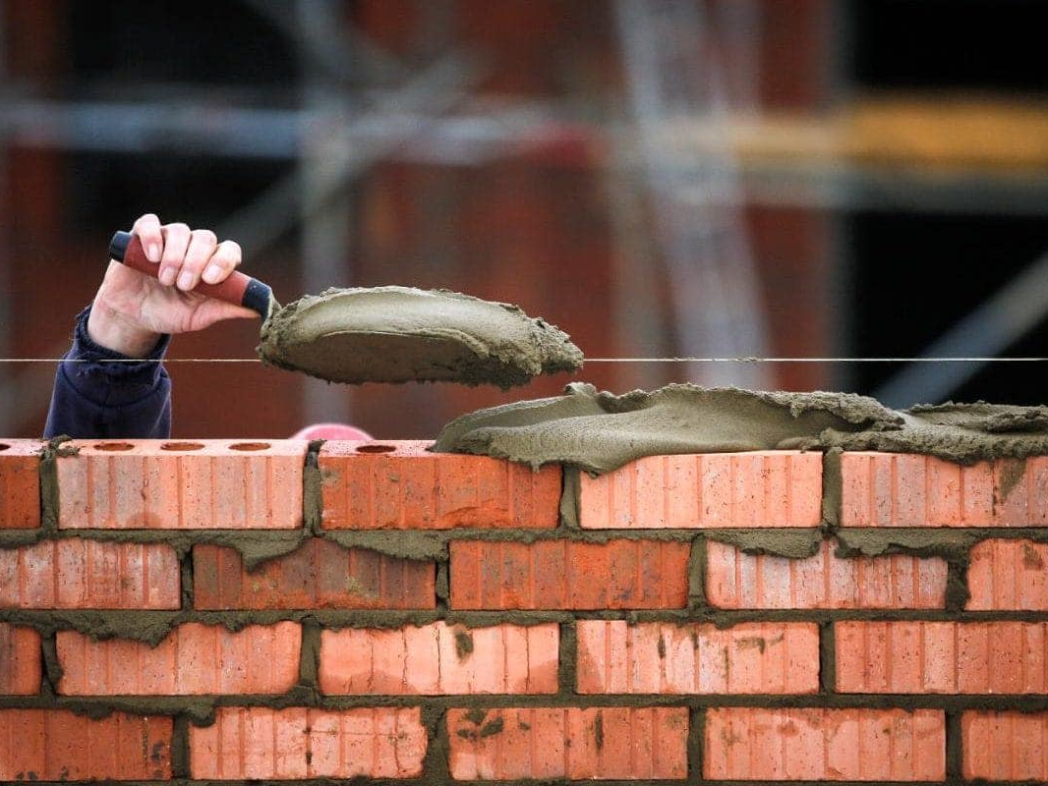

Slide 14

v. 11-13
Acts 19

Slide 15
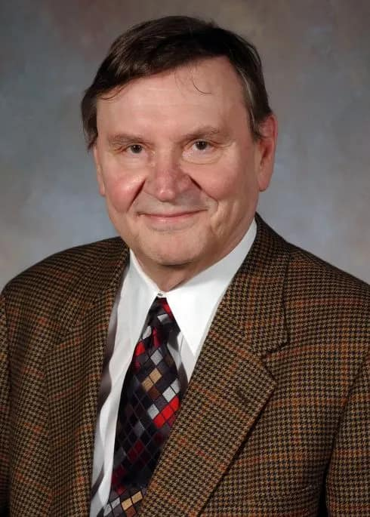


Slide 16
Who has the least access to the Good News today?

Slide 17

Christ’s Peace
v. 14-18

Slide 18
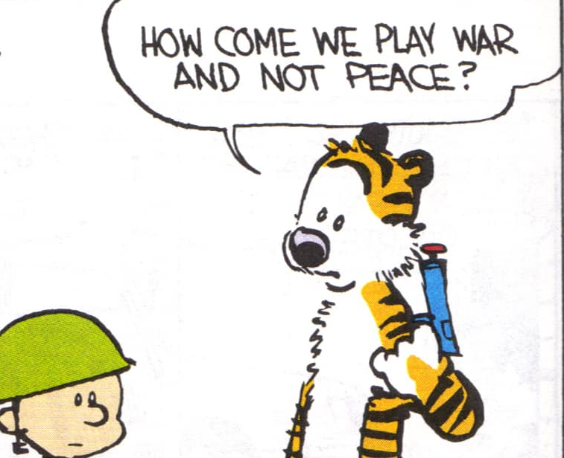
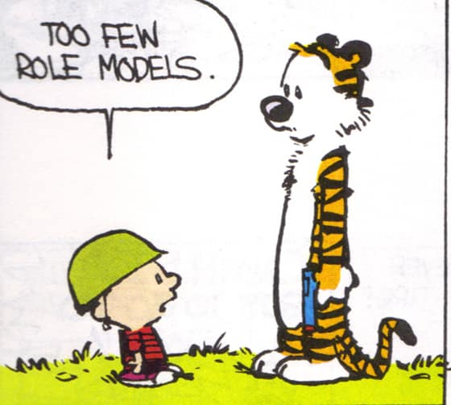

Slide 19
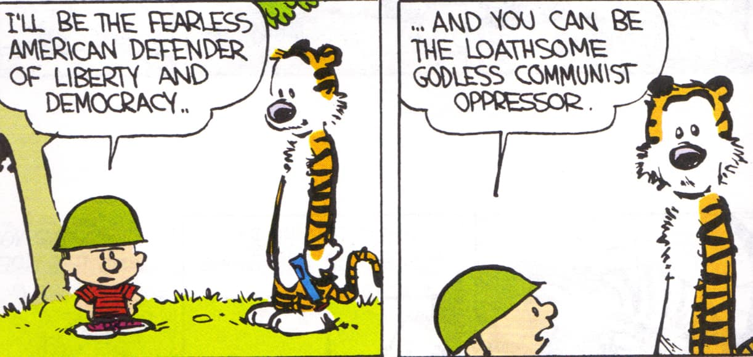

Slide 20
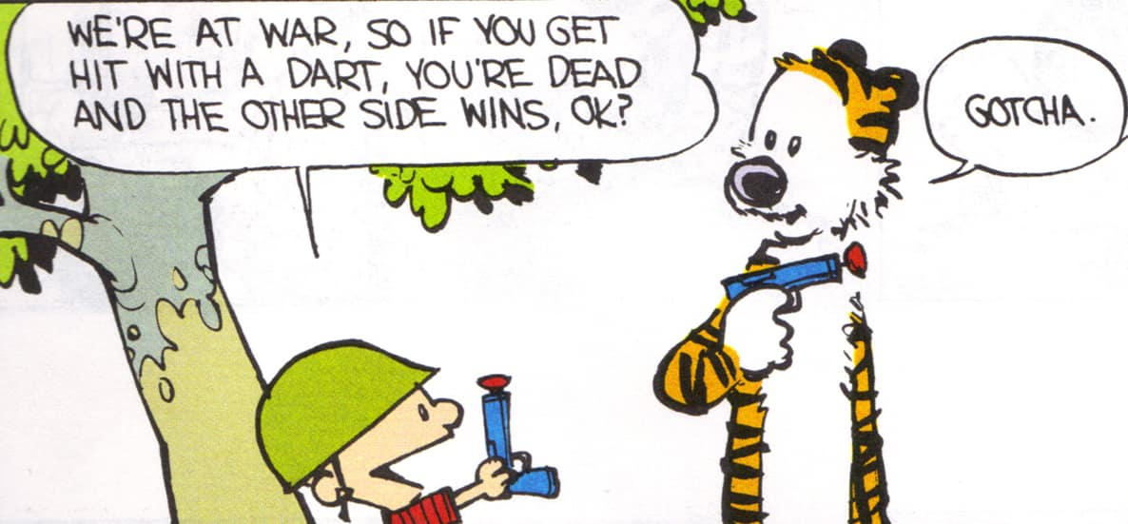


Slide 21
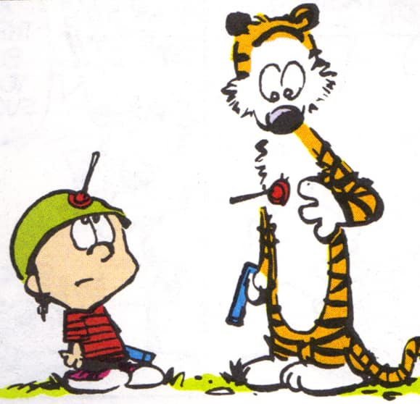
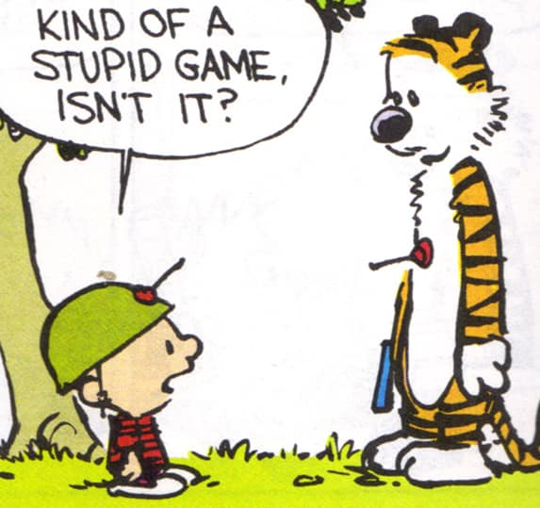

Slide 22


Slide 23
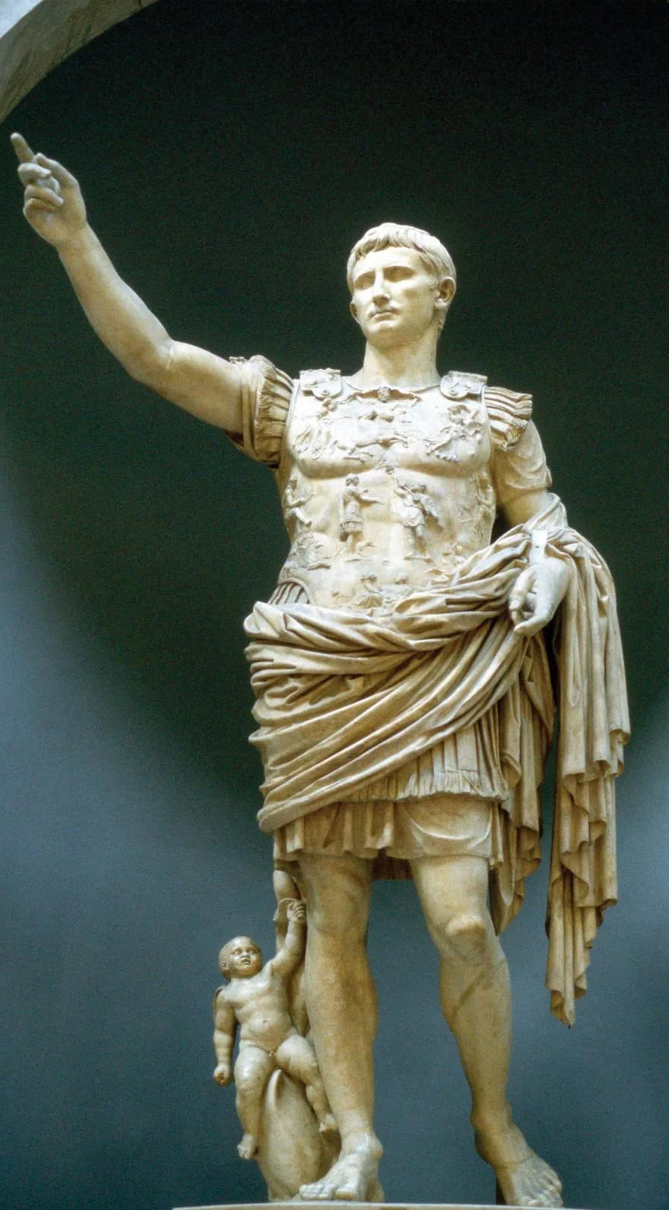
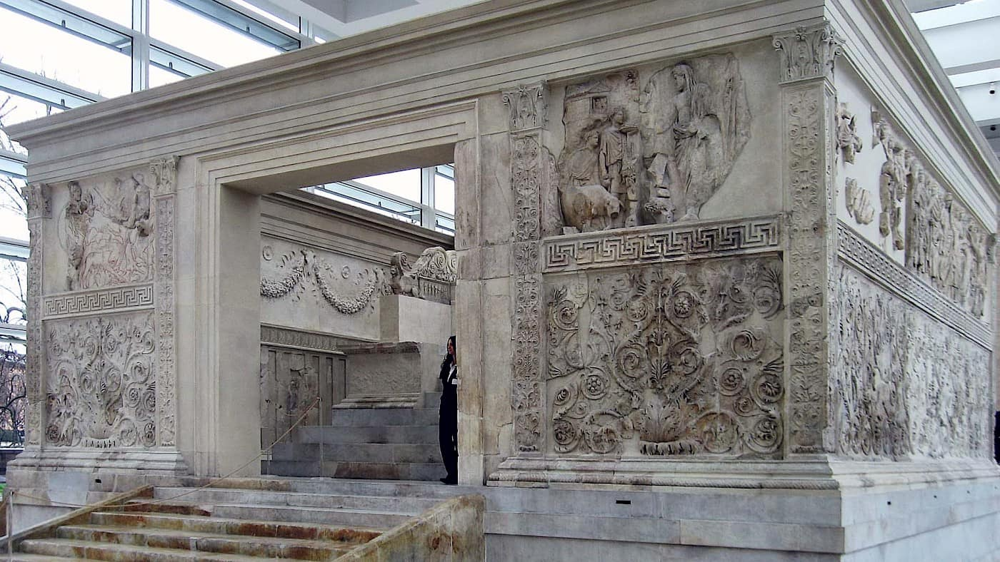

Slide 24
Peace I leave with you,
My peace I give you.
I do not give to you as the world gives. Don’t let your hearts be troubled and do not be afraid.
John 14:27 NIV

Slide 25
Now all of us can come to the Father through the Holy Spirit because of what Christ has done.
v. 18

Slide 26
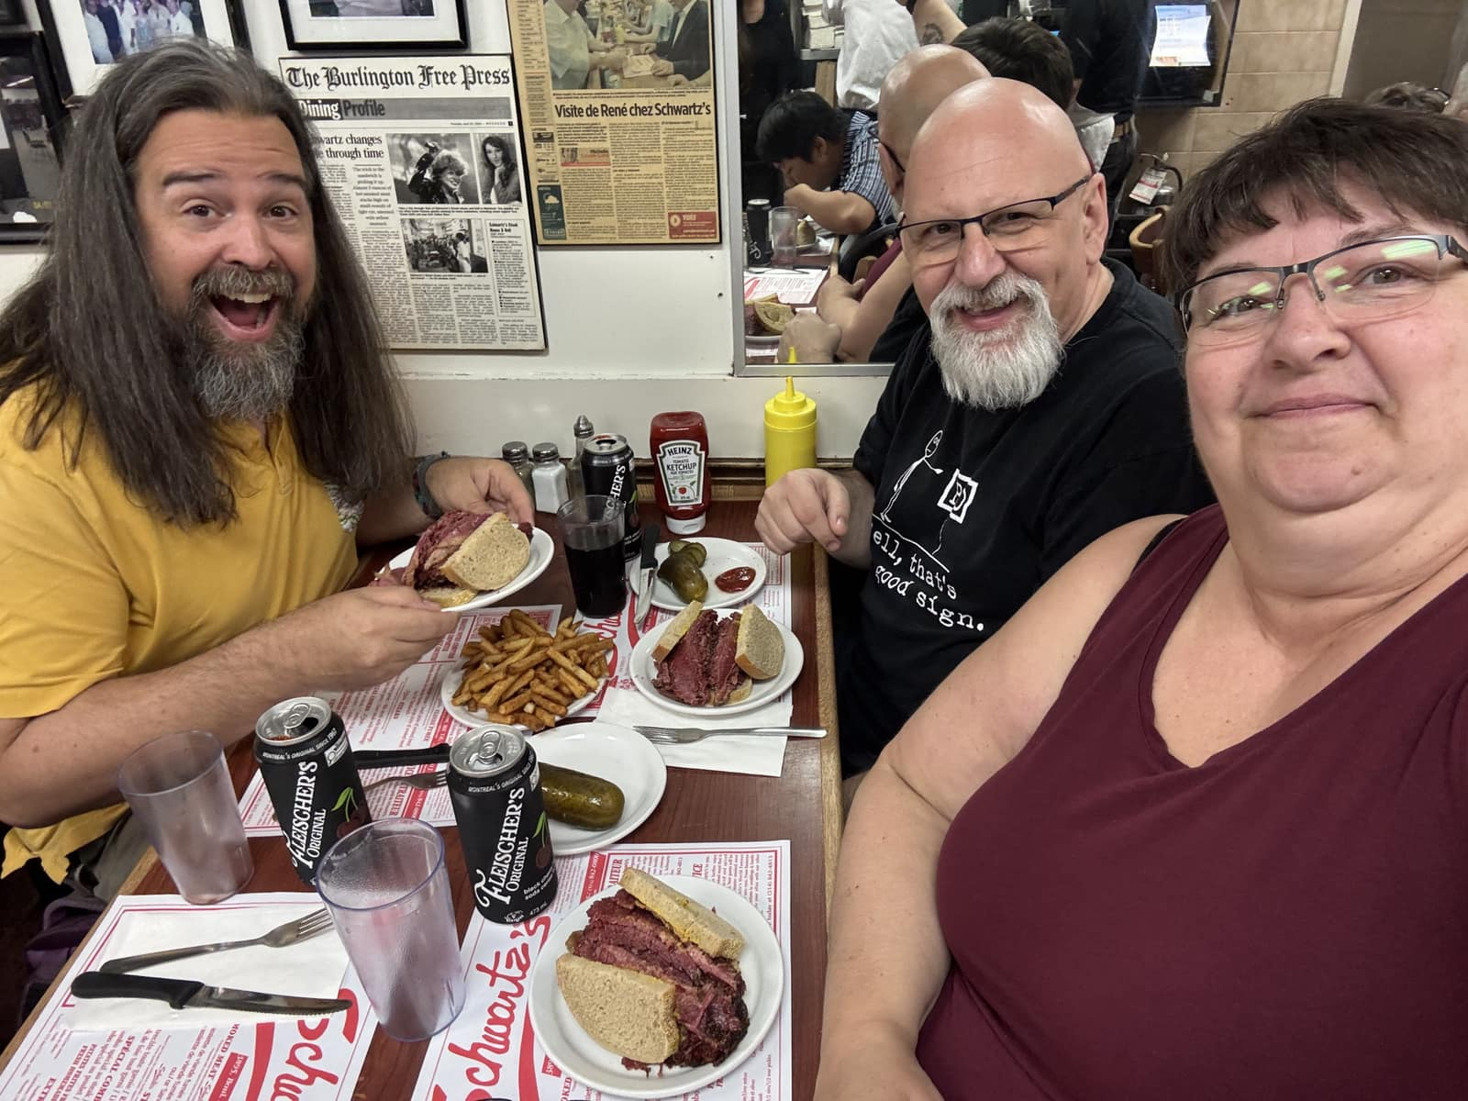
Expressions of Peace
v.19-22

Slide 27
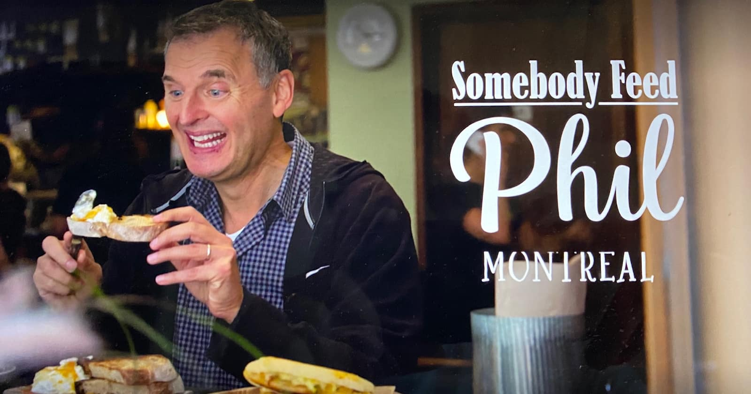

Slide 28
- No longer strangers and foreigners
Citizens - kingdom
God’s holy people
God’s family
Together, we are His house
Becoming a holy temple

Slide 30
Your love for one another will prove to the world that you are my disciples
John 13:35

Slide 31

A Temple
of Peaces

Slide 32
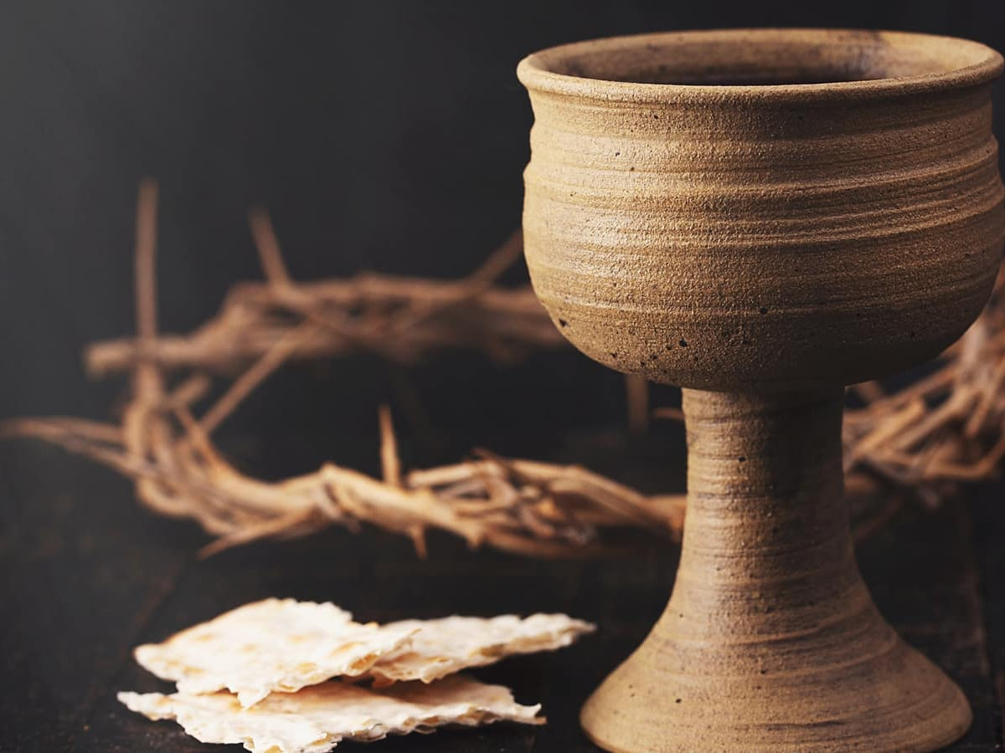

Slide 33
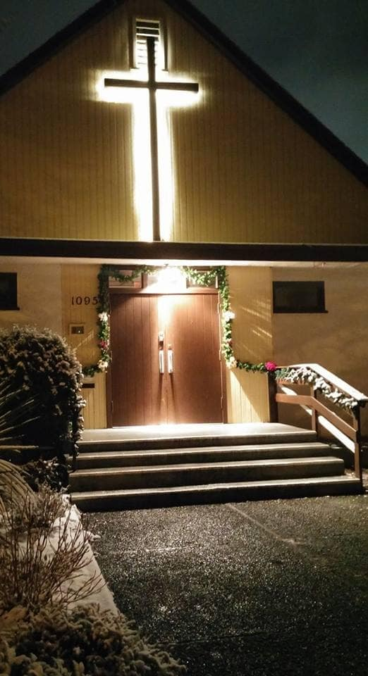
We’re so glad you joined us today!
Please join us
for refreshments
& fellowship!
See the bulletin
for more info,
or contact us at parkdaleonline@gmail.com

