Slide 1

August 23, 2026

Slide 2
Songs
Hope of the Nations (G)
King of Kings (D)
Great is Thy Faithfulness (C)
By Faith (A)
No Longer Slaves (C)

Slide 3
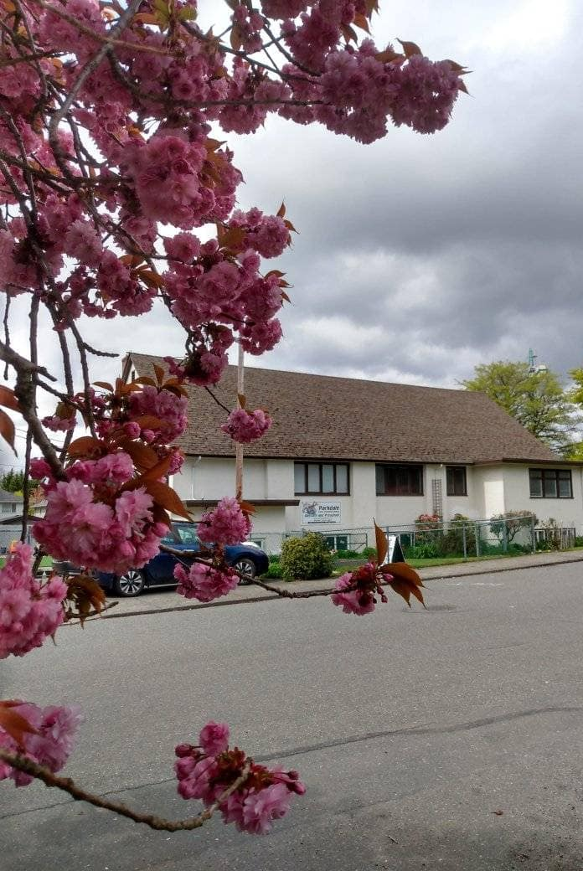
Welcome to Parkdale Church!
We’re so glad you came!
Please see the Bulletin
or parkdalechurch.ca for:
  Weekly gatherings
  Prayer items
  Other news
Or contact us at: parkdaleonline@gmail.com

Slide 4
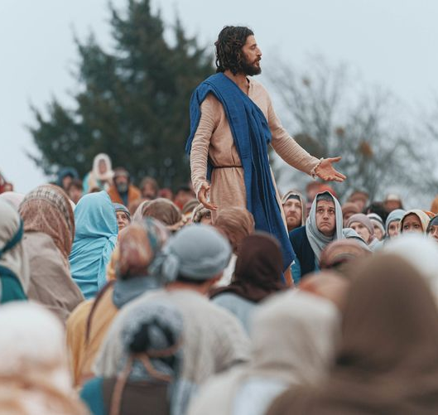
Parkdale Announcements!
Sunday School Helpers Needed No lesson prep needed, just help the teacher keep the room focused
Victoria BC Prays
Saturday, Sept. 5 · 4:00 PM
Front Lawn, BC Legislature

Slide 5
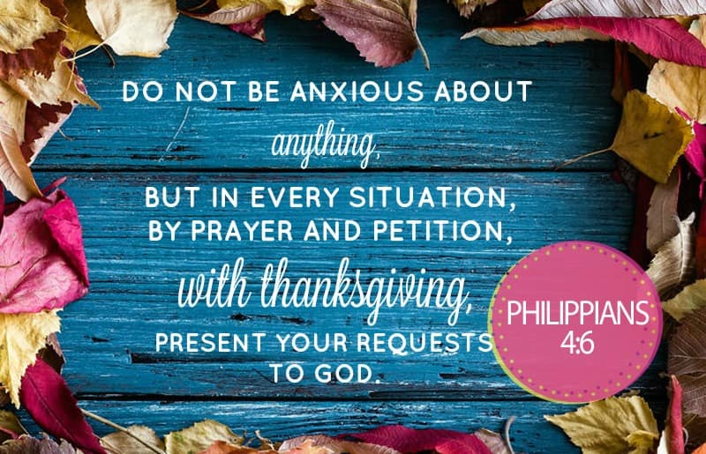

Slide 6

Offering
Thank you to all
who contribute!
White drop-box near the coffee corner
Online giving via the website
Or by e-transfer to parkdalebookkeeper
@gmail.com

Slide 7

Kids’ Minute
& Sunday
School

Slide 8


Slide 9


Slide 10


Slide 11


Slide 12
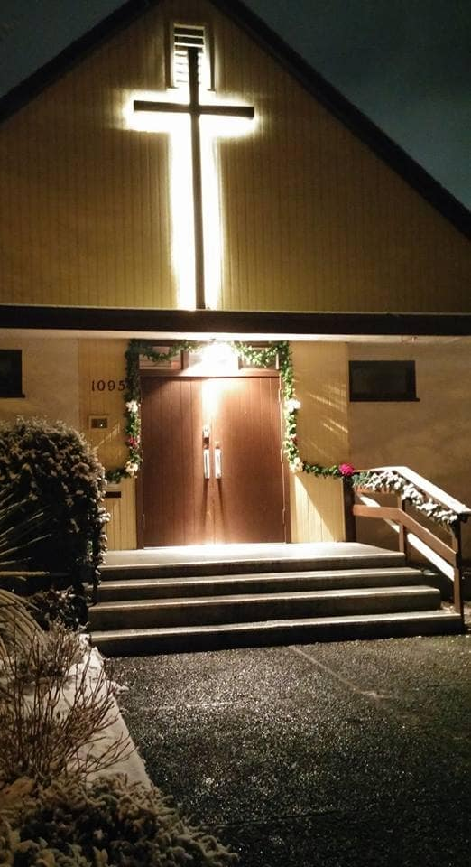
We’re so glad you joined us today!
Please join us
for refreshments
& fellowship!
See the bulletin
for more info,
or contact us at parkdaleonline@gmail.com

