Slide 1

August 30, 2026

Slide 2
Songs
You Are My King/ Amazing Love
Your Love O Lord
One Thing Remains
How Deep the Father's Love for Us
Build My Life

Slide 3
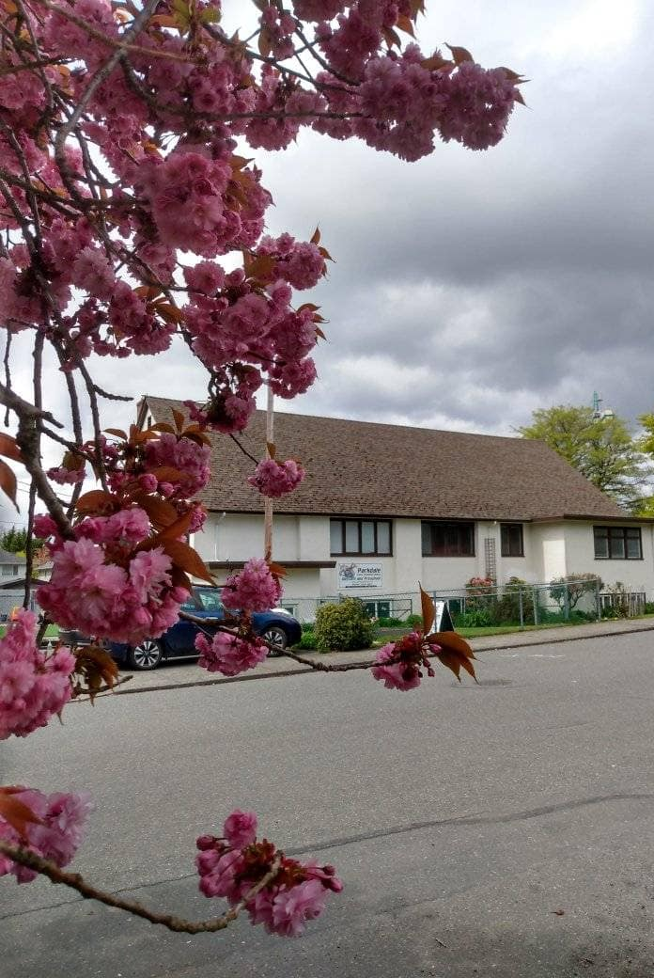
Welcome to Parkdale Church!
We’re so glad you came!
Please see the Bulletin
or parkdalechurch.ca for:
  Weekly gatherings
  Prayer items
  Other news
Or contact us at: parkdaleonline@gmail.com

Slide 4

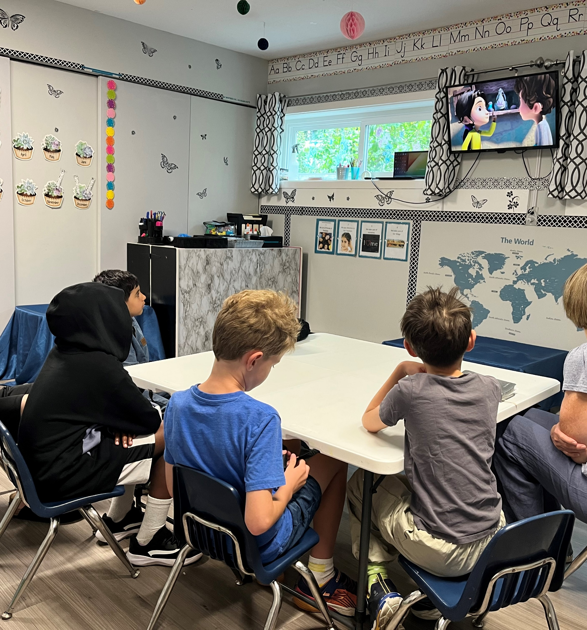
Sunday School Ministry
Looking for helpers!!
Regular classes begin: September 13
We invite kids to bring their Bibles

Slide 5


Slide 6

Offering
Thank you to all
who contribute!
White drop-box near the coffee corner
Online giving via the website
Or by e-transfer to parkdalebookkeeper
@gmail.com

Slide 7

Kids’ Minute
& Sunday
School

Slide 8
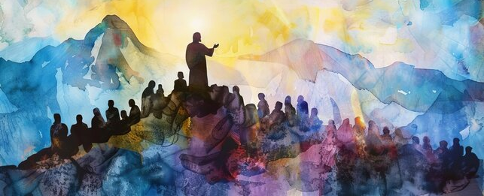
A Prayer for Experience
Ephesians 3:14–21

Slide 9
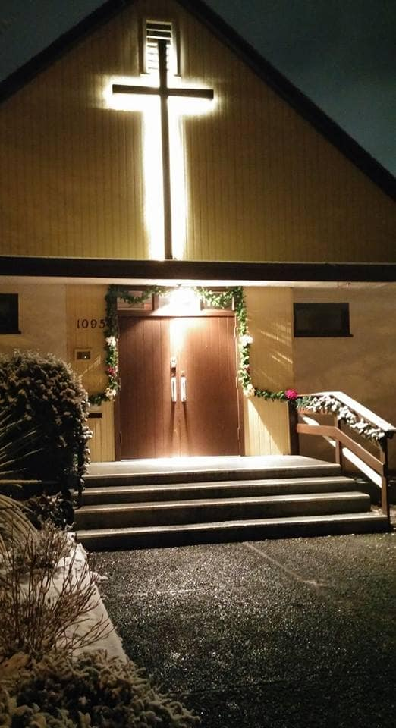
We’re so glad you joined us today!
Please join us
for refreshments
& fellowship!
See the bulletin
for more info,
or contact us at parkdaleonline@gmail.com

