Slide 1

September 06, 2026

Slide 2
Songs
How Great is our God (G)
What a Beautiful Name (D)
The Jesus Way (G)
Praise is Rising (G)
You Are My King/ Amazing Love (D):

Slide 3
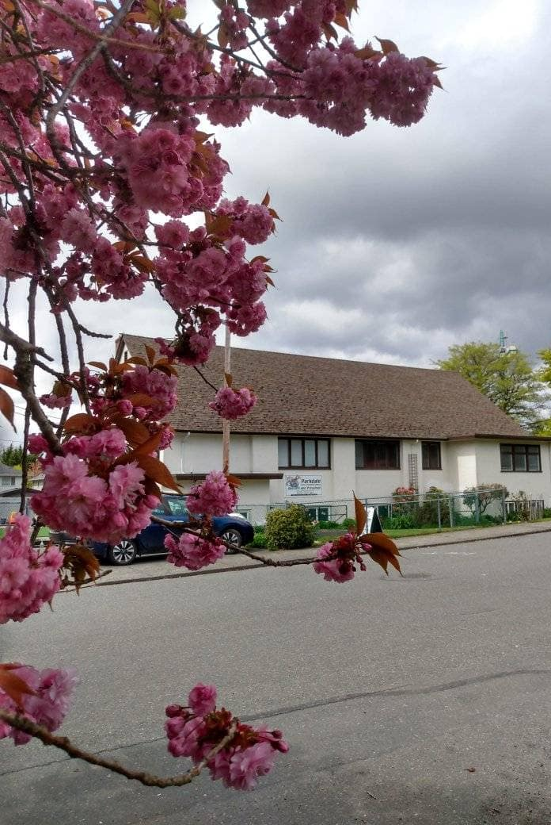
Welcome to Parkdale Church!
We’re so glad you came!
Please see the Bulletin
or parkdalechurch.ca for:
  Weekly gatherings
  Prayer items
  Other news
Or contact us at: parkdaleonline@gmail.com

Slide 4

Coming season @Parkdale
Youth group returns Sept. 11
Middle & high school welcome.
Full schedule on the board.
BBQ & Special Service Sept. 13
Crafting group returns Sept. 14
10 am, meets once a month.
Ladies Bible Study returns Sept. 21

Slide 5


Slide 6

Offering
Thank you to all
who contribute!
White drop-box near the coffee corner
Online giving via the website
Or by e-transfer to parkdalebookkeeper
@gmail.com

Slide 7

Kids’ Minute
& Sunday
School

Slide 8


Slide 9


Slide 10


Slide 11


Slide 12


Slide 13
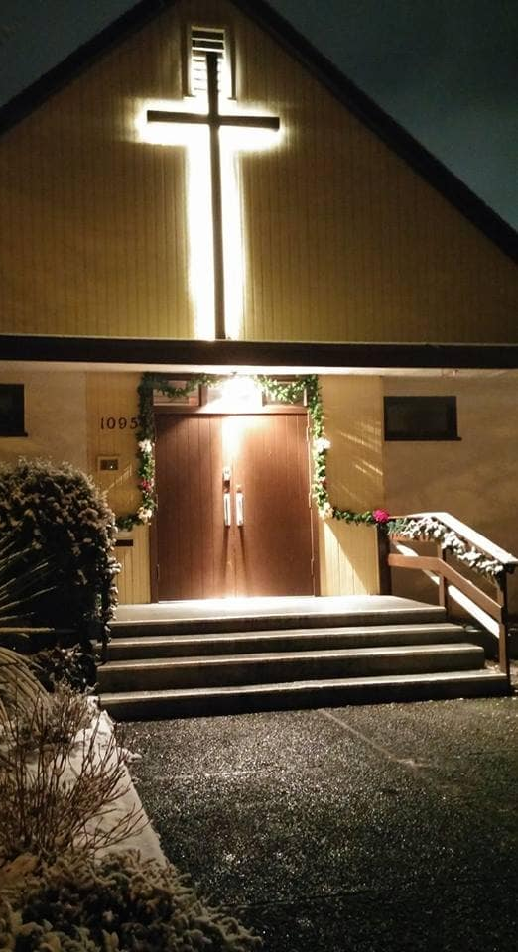
We’re so glad you joined us today!
Please join us
for refreshments
& fellowship!
See the bulletin
for more info,
or contact us at parkdaleonline@gmail.com

