Slide 1

September 13, 2026

Slide 2
Songs
Yet Not I but through Christ in me
Your Grace is Enough
Be Thou My Vision
Waymaker
Goodness of God

Slide 3
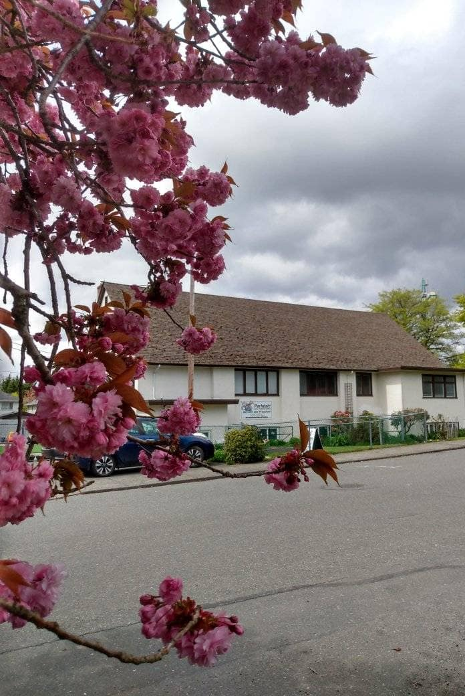
Welcome to Parkdale Church!
We’re so glad you came!
Please see the Bulletin
or parkdalechurch.ca for:
  Weekly gatherings
  Prayer items
  Other news
Or contact us at: parkdaleonline@gmail.com

Slide 4

Updates @Parkdale
BBQ & Special Service Sept. 13

Slide 5

Offering
Thank you to all
who contribute!
White drop-box near the coffee corner
Online giving via the website
Or by e-transfer to parkdalebookkeeper
@gmail.com

Slide 6


Slide 7

Kids’ Minute
& Sunday
School

Slide 8
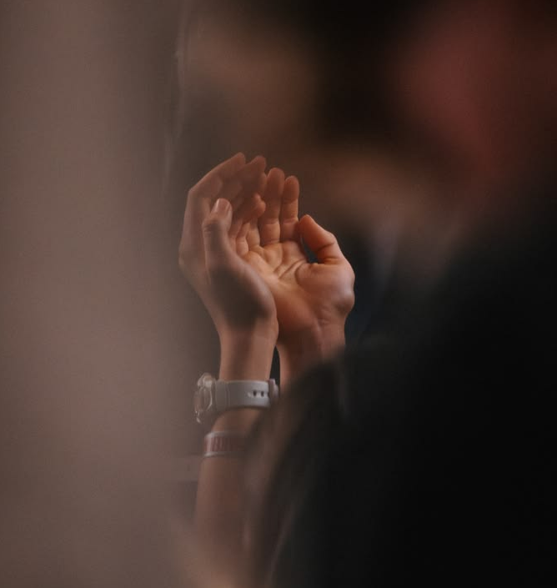
PARKDALE PRAYER SERVICE

Slide 9

Prayer for our Congregation.
Ephesians 3:14-19
For this reason I kneel before the Father, from whom every family^{[a]} in heaven and on earth derives its name. I pray that out of his glorious riches he may strengthen you with power through his Spirit in your inner being, so that Christ may dwell in your hearts through faith. And I pray that you, being rooted and established in love, may have power, together with all the Lord’s holy people, to grasp how wide and long and high and deep is the love of Christ, and to know this love that surpasses knowledge—that you may be filled to the measure of all the fullness of God.

Slide 10

Prayer for our New Lead Pastor
2Timothy 2:1-15
[…] Remember Jesus Christ, raised from the dead, descended from David. This is my gospel, for which I am suffering even to the point of being chained like a criminal. But God’s word is not chained. Therefore, I endure everything for the sake of the elect, that they too may obtain the salvation that is in Christ Jesus, with eternal glory.

Slide 11
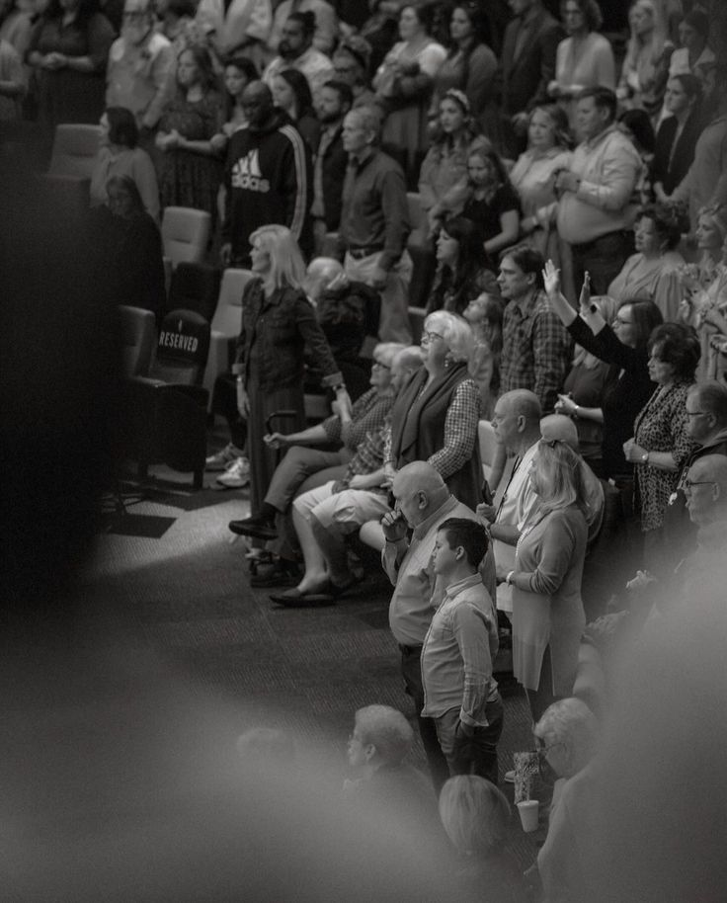
Prayer for our Pastoral Search Committee.
James 1:5-6
If any of you lacks wisdom, you should ask God, who gives generously to all without finding fault, and it will be given to you. But when you ask, you must believe and not doubt, because the one who doubts is like a wave of the sea, blown and tossed by the wind.

Slide 12
PARKDALE PRAYER SERVICE

Slide 13
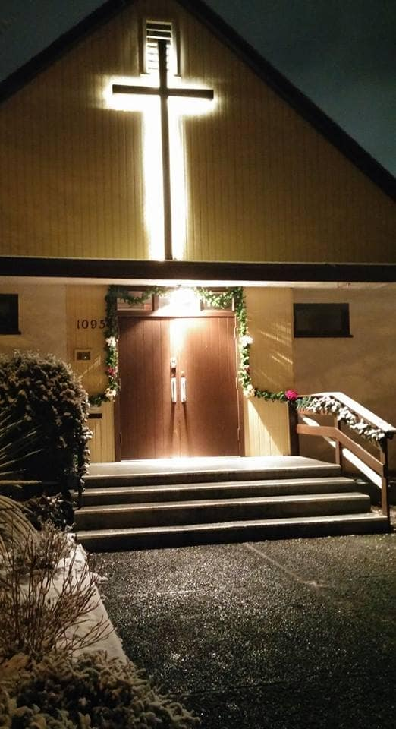
We’re so glad you joined us today!
Please join us
for refreshments
& fellowship!
See the bulletin
for more info,
or contact us at parkdaleonline@gmail.com

