Slide 1

September 27, 2026

Slide 2
Songs
Build My Life
The Lord's Prayer
Take My Life
Lord I lift Your Name On High
King of Kings

Slide 3
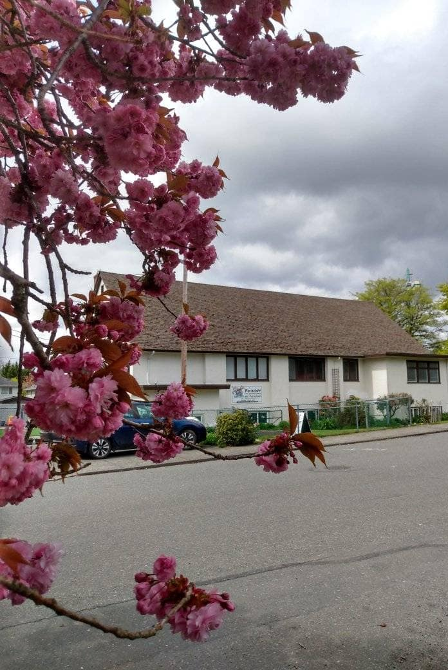
Welcome to Parkdale Church!
We’re so glad you came!
Please see the Bulletin
or parkdalechurch.ca for:
  Weekly gatherings
  Prayer items
  Other news
Or contact us at: parkdaleonline@gmail.com

Slide 4

Updates @Parkdale
Operation Christmas Child
is here!
Please support this hands-on ministry
by filling as many shoeboxes as you feel led to in your heart.

Slide 5

Offering
Thank you to all
who contribute!
White drop-box near the coffee corner
Online giving via the website
Or by e-transfer to parkdalebookkeeper
@gmail.com

Slide 6
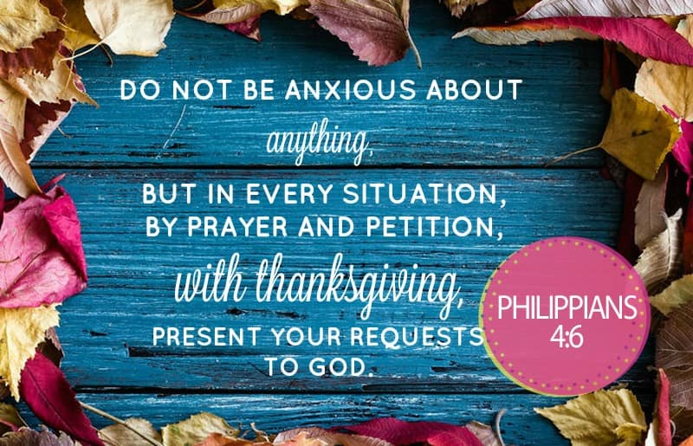

Slide 7
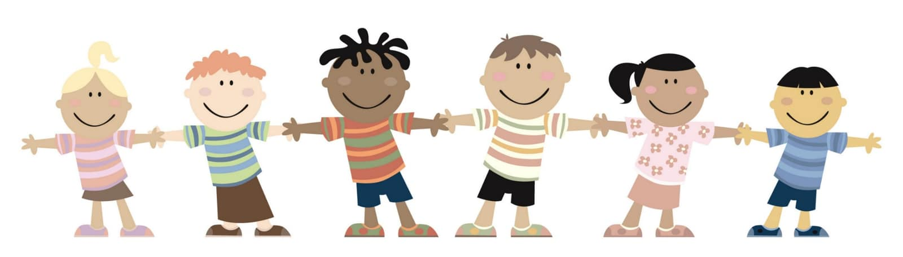
Kids’ Minute
& Sunday
School

Slide 8
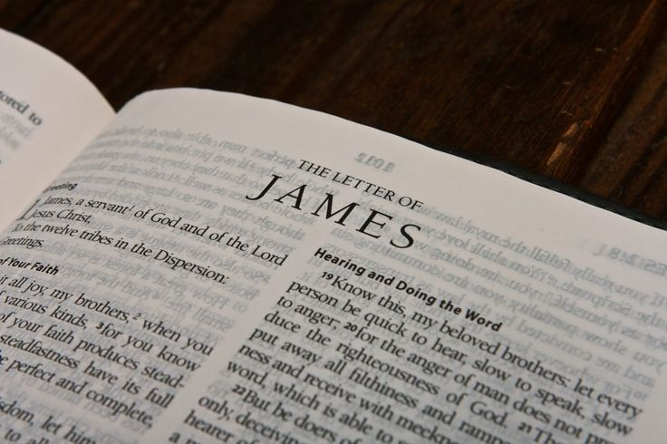
Today’s Speaker
Derek Robertson
“The Un-Dichotomy of the Christian Faith”

Slide 9

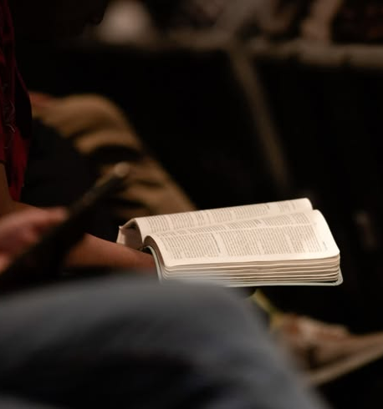
James 1: 19-20
“My dear brothers and sisters, take note of this: Everyone should be quick to listen, slow to speak and slow to become angry, because human anger does not produce the righteousness that God desires.” […]

Slide 10
James 2: 25-26
[…] “In the same way, was not even Rahab the prostitute considered righteous for what she did when she gave lodging to the spies and sent them off in a different direction? As the body without the spirit is dead, so faith without deeds is dead.”

Slide 11
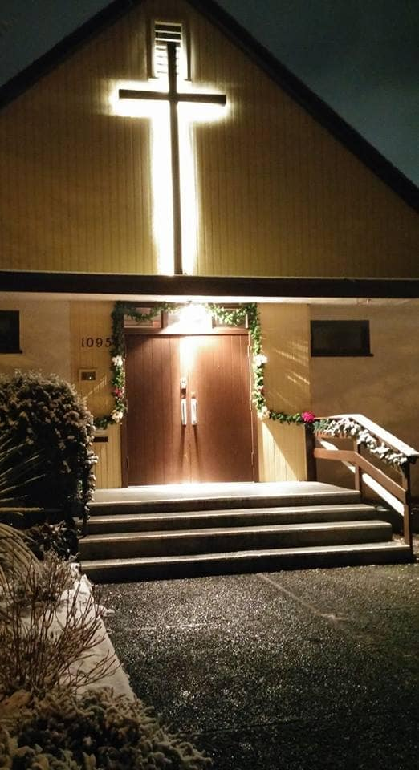
We’re so glad you joined us today!
Please join us
for refreshments
& fellowship!
See the bulletin
for more info,
or contact us at parkdaleonline@gmail.com

