Slide 1

October 04, 2026

Slide 2
Songs
Be Thou My Vision - CCLI Song # 7056332
Here I am to Worship - CCLI Song # 3266032
Hymn of the Holy Spirit - CCLI Song # 7113814 / First verse, couple times.
Response Song
God I Look to You - CCLI Song # 5858163

Slide 3
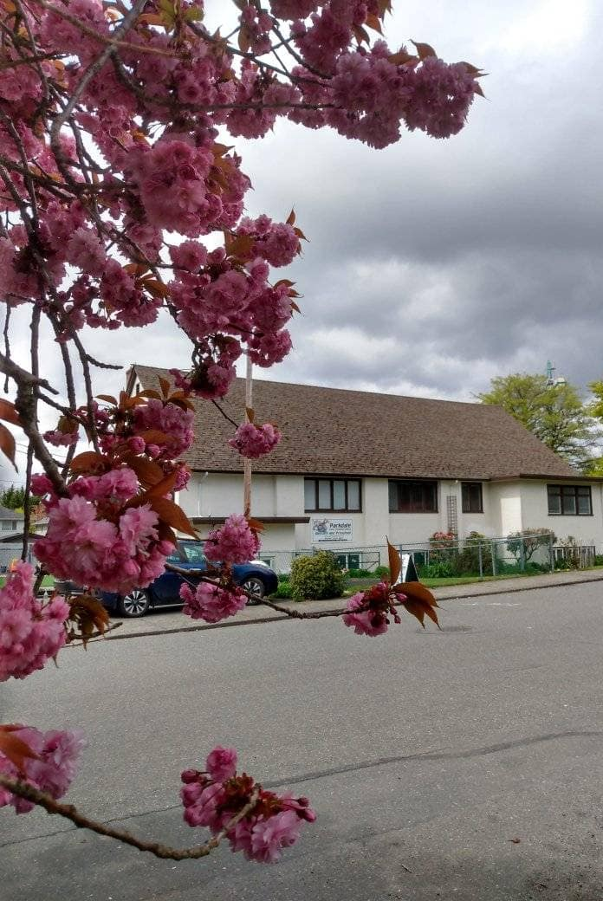
Welcome to Parkdale Church!
We’re so glad you came!
Please see the Bulletin
or parkdalechurch.ca for:
  Weekly gatherings
  Prayer items
  Other news
Or contact us at: parkdaleonline@gmail.com

Slide 4
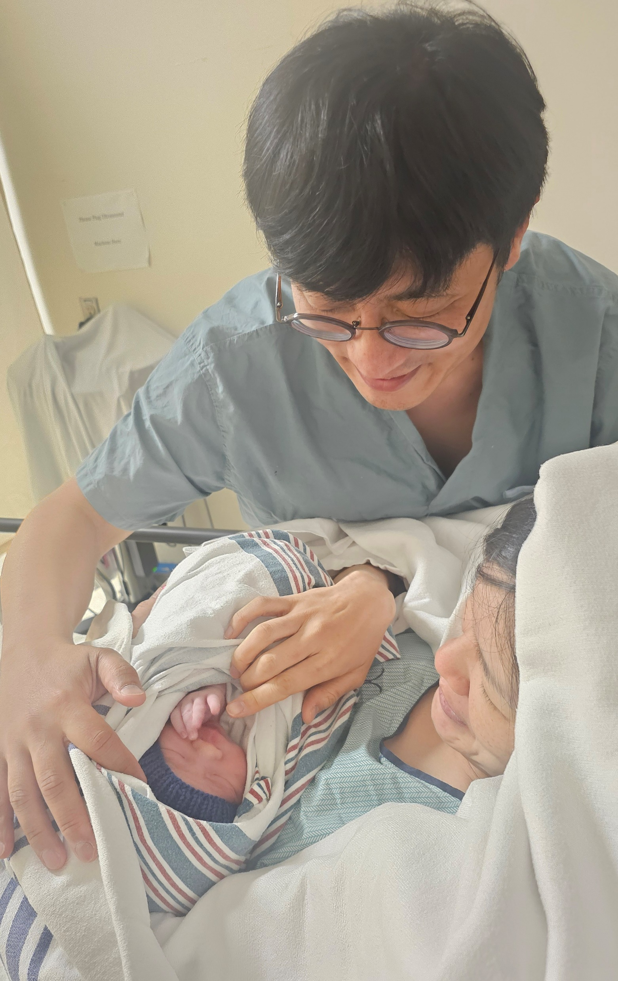
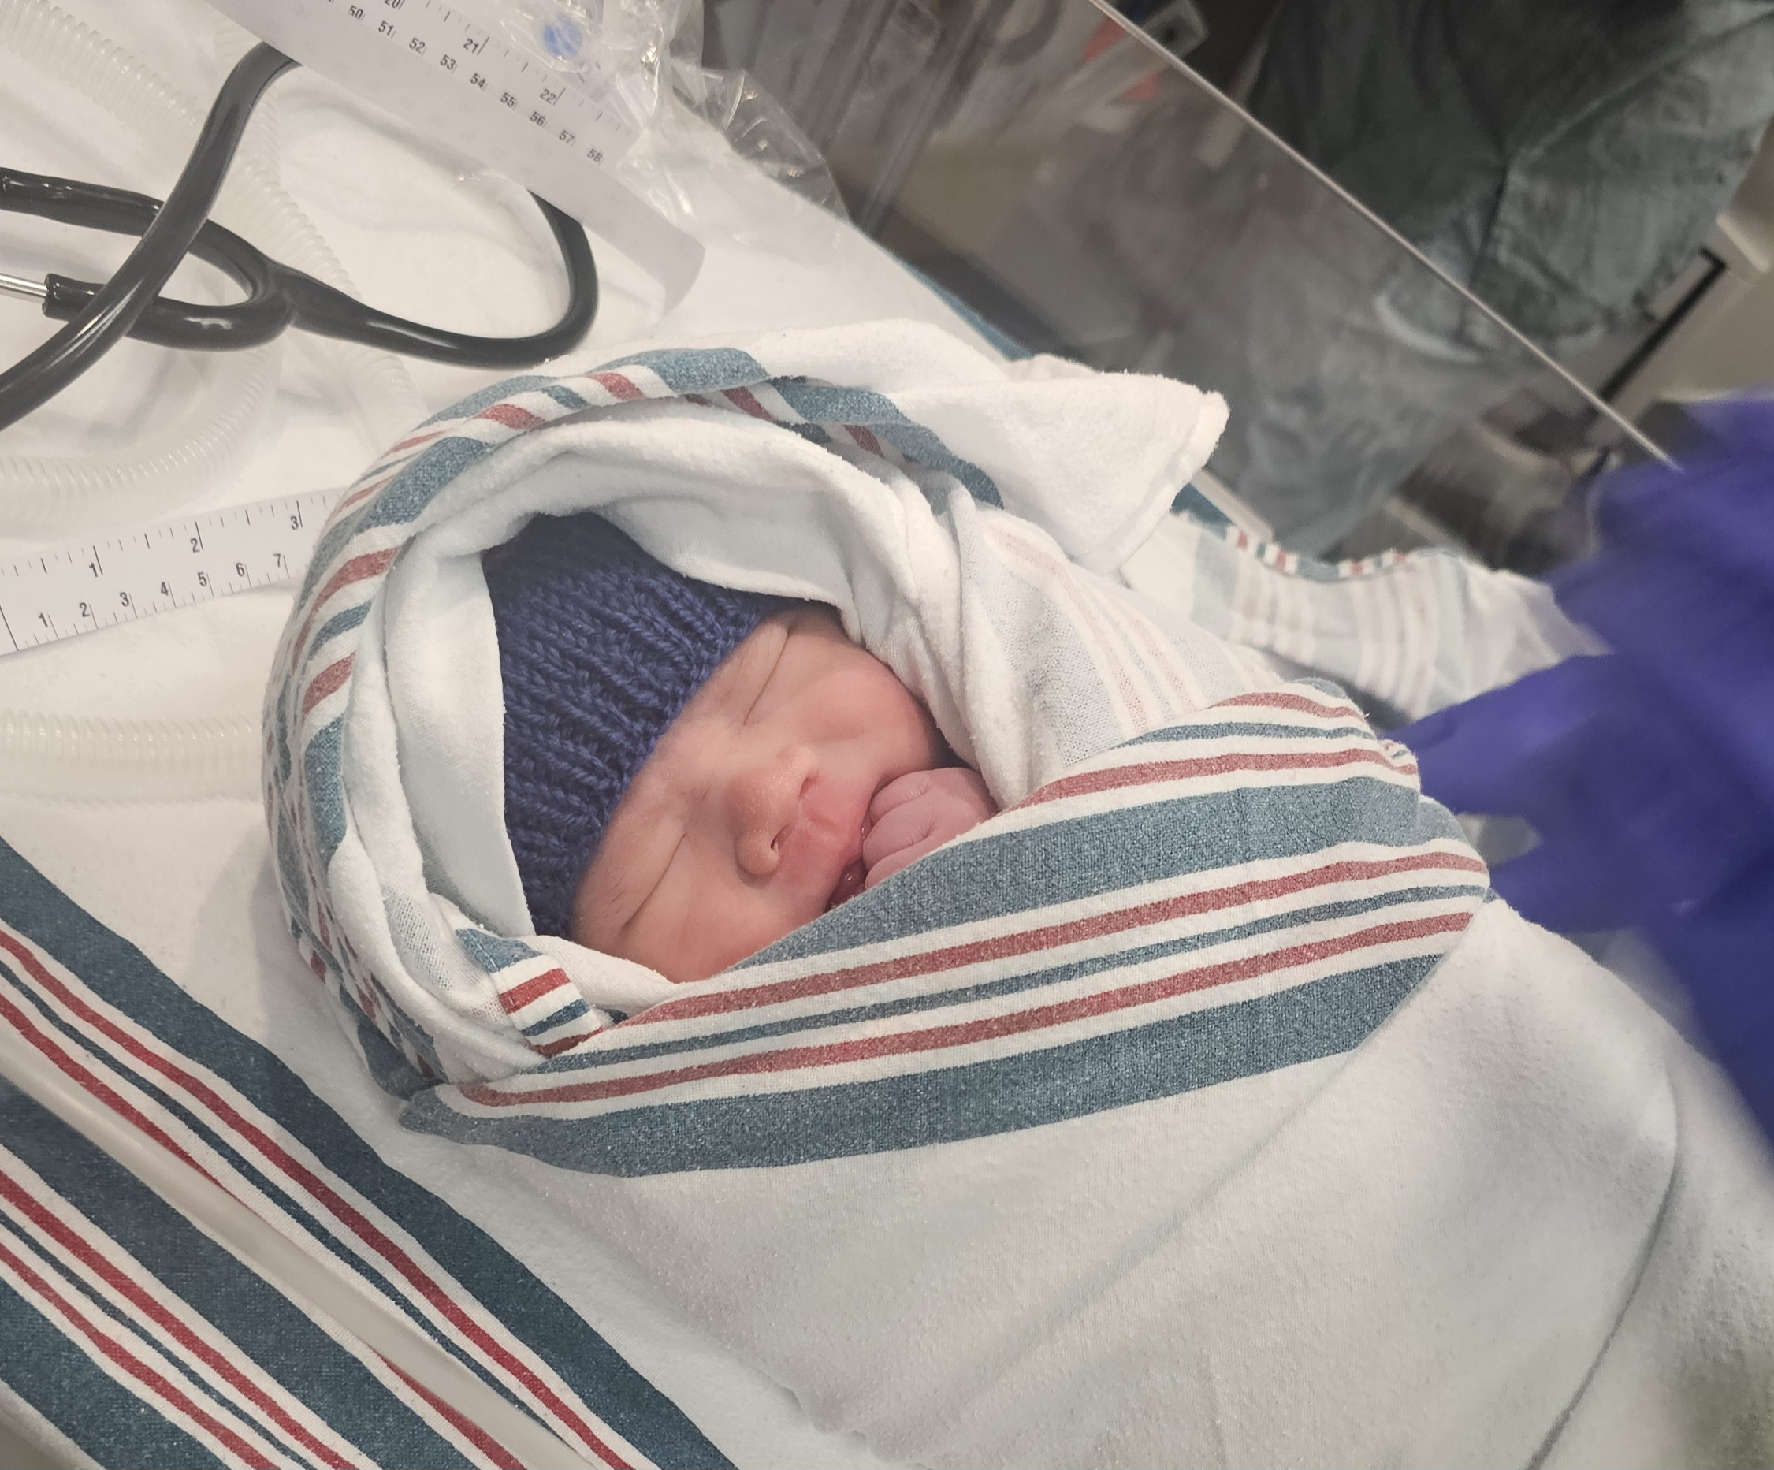
Welcome Baby William
“Hey everyone,
Thanks to all your prayers and blessings, baby William came into the world on September 30th
Kate is recovering well after a successful C-section. We had such a peaceful delivery, surrounded by the blessings of so many Christian staff members here.”
~Tim
Baby Shower - Sun, Nov. 1st

Slide 5

Offering
Thank you to all
who contribute!
White drop-box near the coffee corner
Online giving via the website
Or by e-transfer to parkdalebookkeeper
@gmail.com

Slide 6
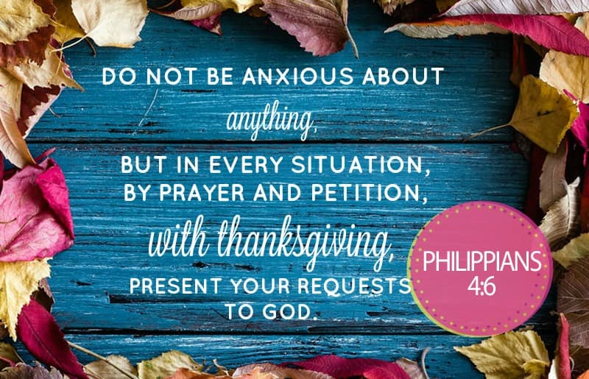

Slide 7
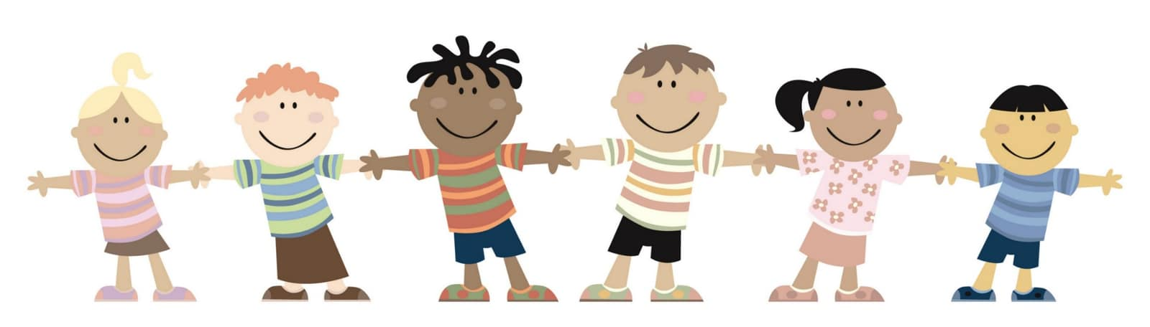
Kids’ Minute
& Sunday
School

Slide 8


Slide 9


Slide 10
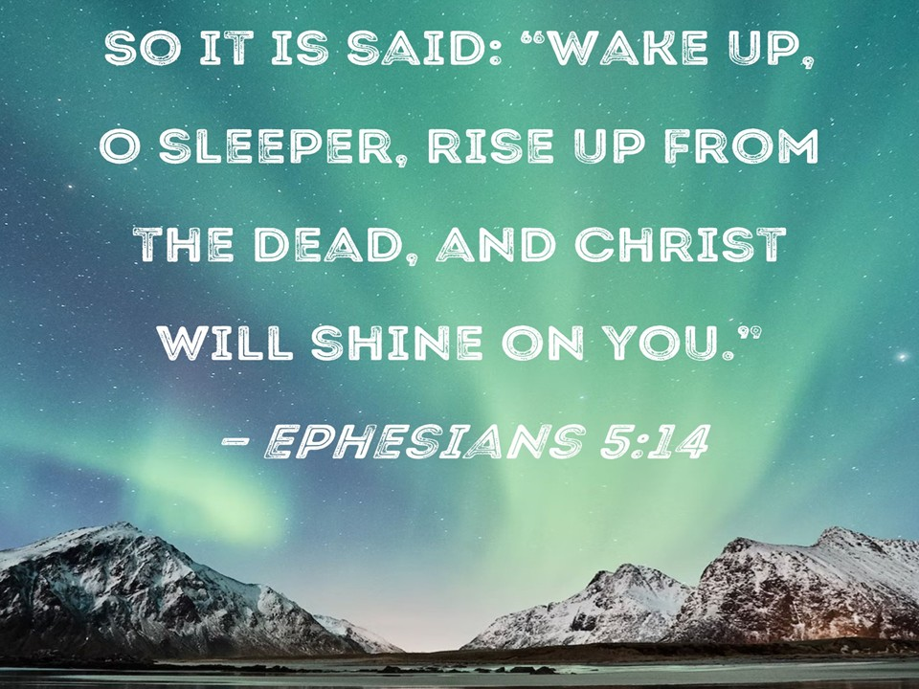

Slide 11
1 Corinthians 11:23-26
The Lord Jesus, on the night
He was betrayed, took bread,
and when He had given thanks,
He broke it and said,
“This is My body, which is for you; do this in remembrance of Me.”
In the same way, after supper
He took the cup, saying,
“This cup is the new covenant in My blood; do this, whenever you drink it, in remembrance of Me.”
For whenever you eat this bread and drink this cup, you proclaim
the Lord’s death until He comes.

Slide 12
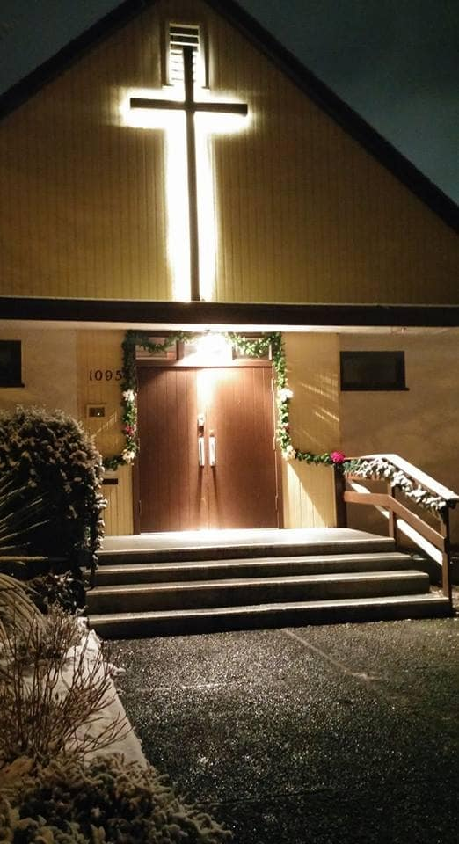
We’re so glad you joined us today!
Please join us
for refreshments
& fellowship!
See the bulletin
for more info,
or contact us at parkdaleonline@gmail.com

