Slide 1

October 11, 2026

Slide 2
Songs
God of Wonders
How Great Thou Art
Oh How Good It Is
Battle Belongs
Jesus Messiah

Slide 3
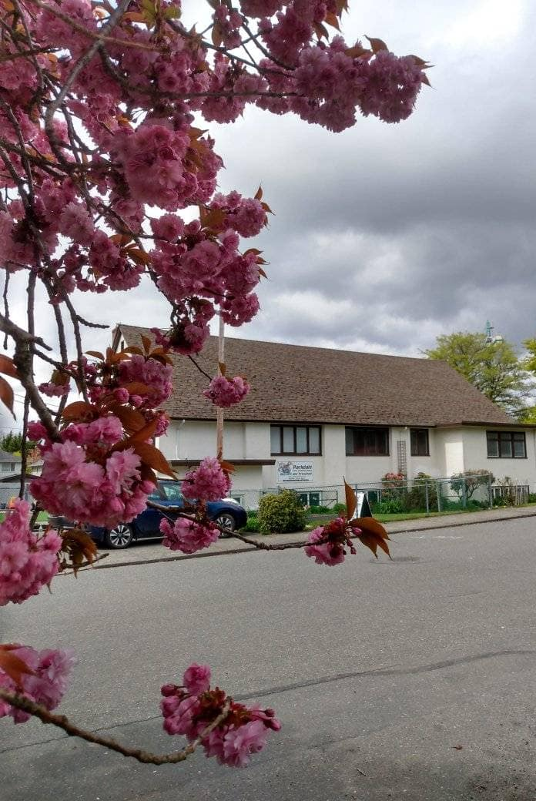
Welcome to Parkdale Church!
We’re so glad you came!
Please see the Bulletin
or parkdalechurch.ca for:
  Weekly gatherings
  Prayer items
  Other news
Or contact us at: parkdaleonline@gmail.com

Slide 4

Offering
Thank you to all
who contribute!
White drop-box near the coffee corner
Online giving via the website
Or by e-transfer to parkdalebookkeeper
@gmail.com

Slide 5


Slide 6

Kids’ Minute
& Sunday
School

Slide 7


Slide 8


Slide 9
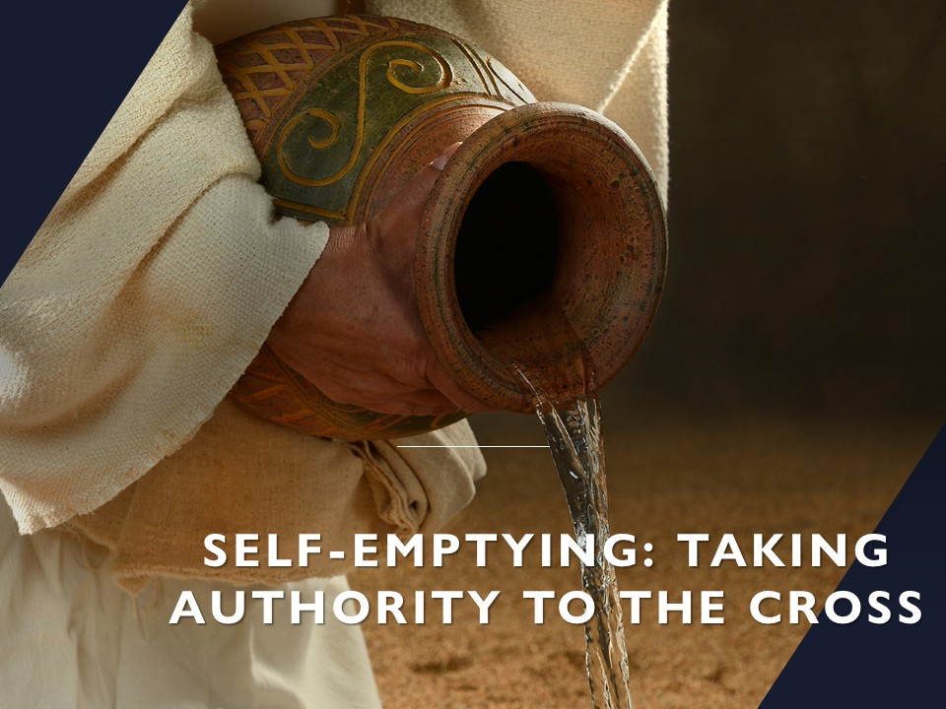

Slide 10
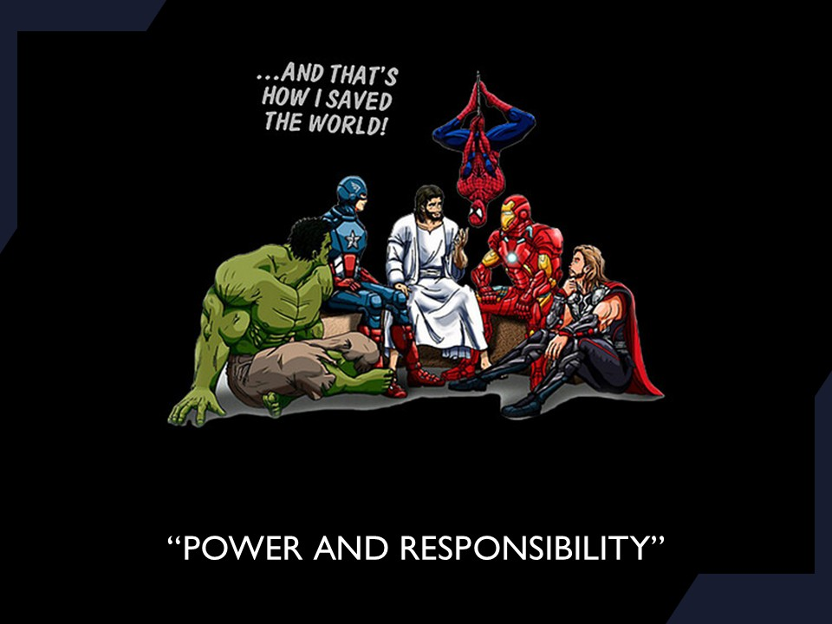

Slide 11
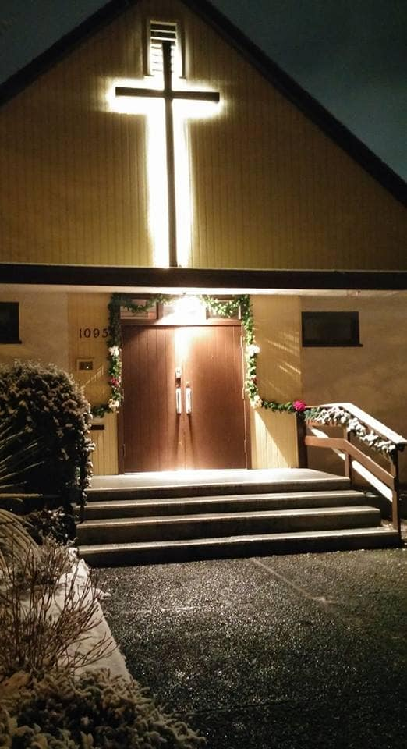
We’re so glad you joined us today!
Please join us
for refreshments
& fellowship!
See the bulletin
for more info,
or contact us at parkdaleonline@gmail.com

