Slide 1

October 25, 2026

Slide 2
Songs
Come, Now is the Time
No longer Slaves
Come Thou Fount
Mighty to Save
Who Am I

Slide 3
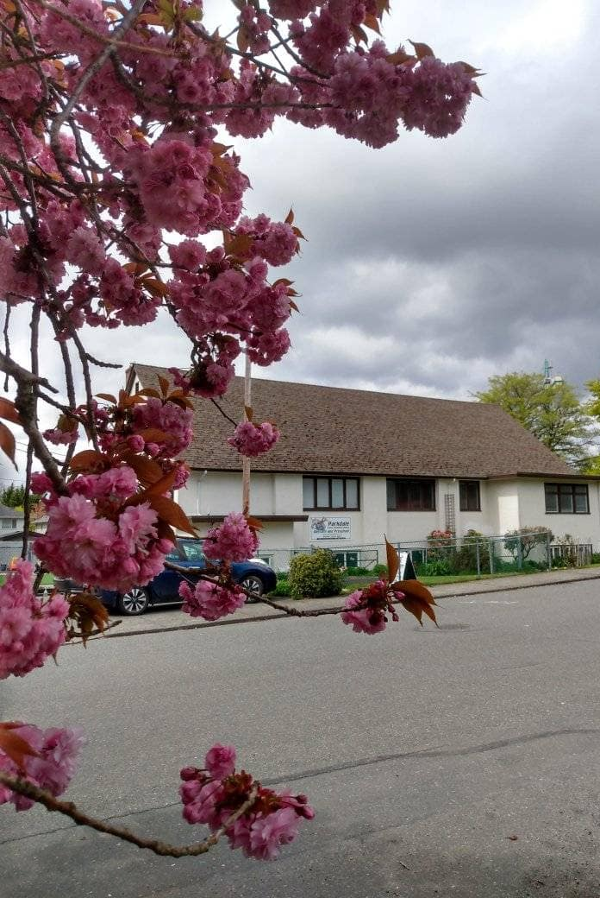
Welcome to Parkdale Church!
We’re so glad you came!
Please see the Bulletin
or parkdalechurch.ca for:
  Weekly gatherings
  Prayer items
  Other news
Or contact us at: parkdaleonline@gmail.com

Slide 4
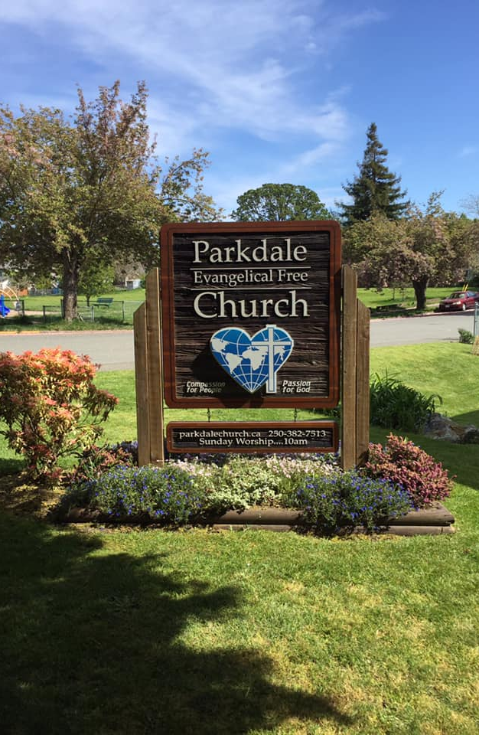
Coming events!
Congregational Meeting
November 15th
Sunday nights
Prayer Meetings
Date and time to be confirmed

Slide 5

Offering
Thank you to all
who contribute!
White drop-box near the coffee corner
Online giving via the website
Or by e-transfer to parkdalebookkeeper
@gmail.com

Slide 6
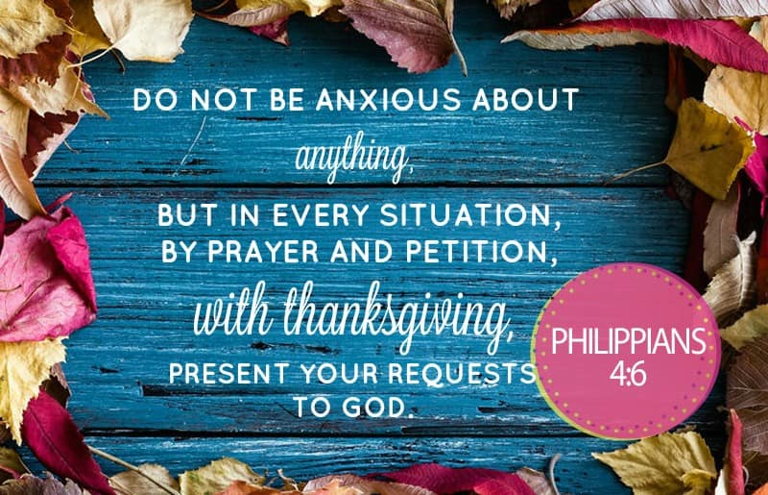

Slide 7

Kids’ Minute
& Sunday
School

Slide 8


Slide 9
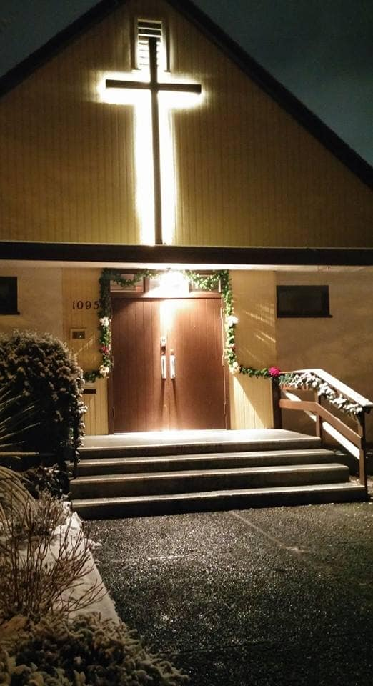
We’re so glad you joined us today!
Please join us
for refreshments
& fellowship!
See the bulletin
for more info,
or contact us at parkdaleonline@gmail.com

