Slide 1

November 1, 2026

Slide 2
Songs
All Who Are Thirsty
Holy Forever
Beautiful One
Who Am I
Oh How Good It Is

Slide 3
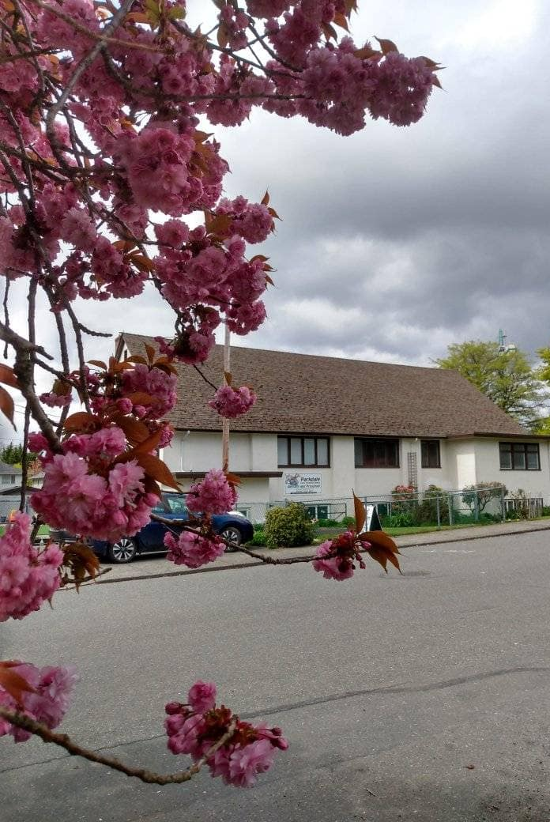
Welcome to Parkdale Church!
We’re so glad you came!
Please see the Bulletin
or parkdalechurch.ca for:
  Weekly gatherings
  Prayer items
  Other news
Or contact us at: parkdaleonline@gmail.com

Slide 4

Coming events!
Congregational Meeting
November 15th
Sunday nights
Prayer Meetings
Date and time to be confirmed

Slide 5

Offering
Thank you to all
who contribute!
White drop-box near the coffee corner
Online giving via the website
Or by e-transfer to parkdalebookkeeper
@gmail.com

Slide 6
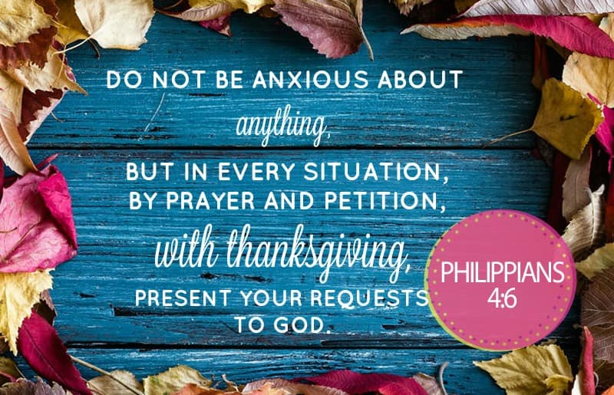

Slide 7
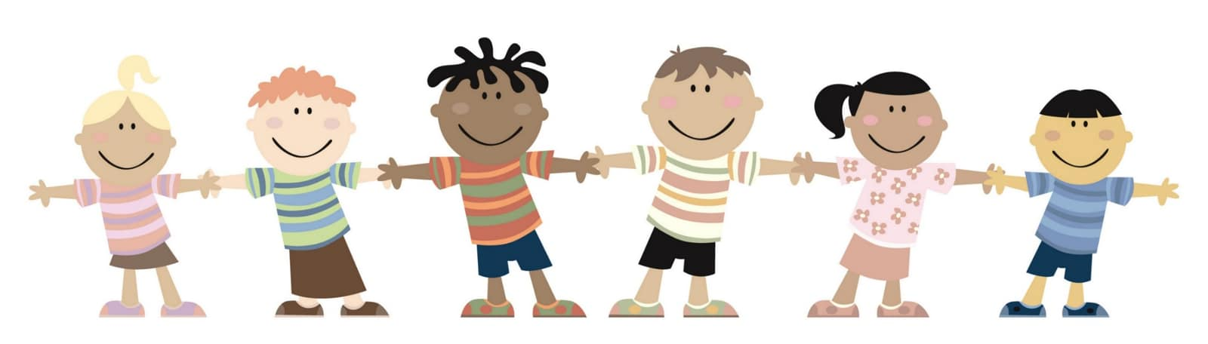
Kids’ Minute
& Sunday
School

Slide 8
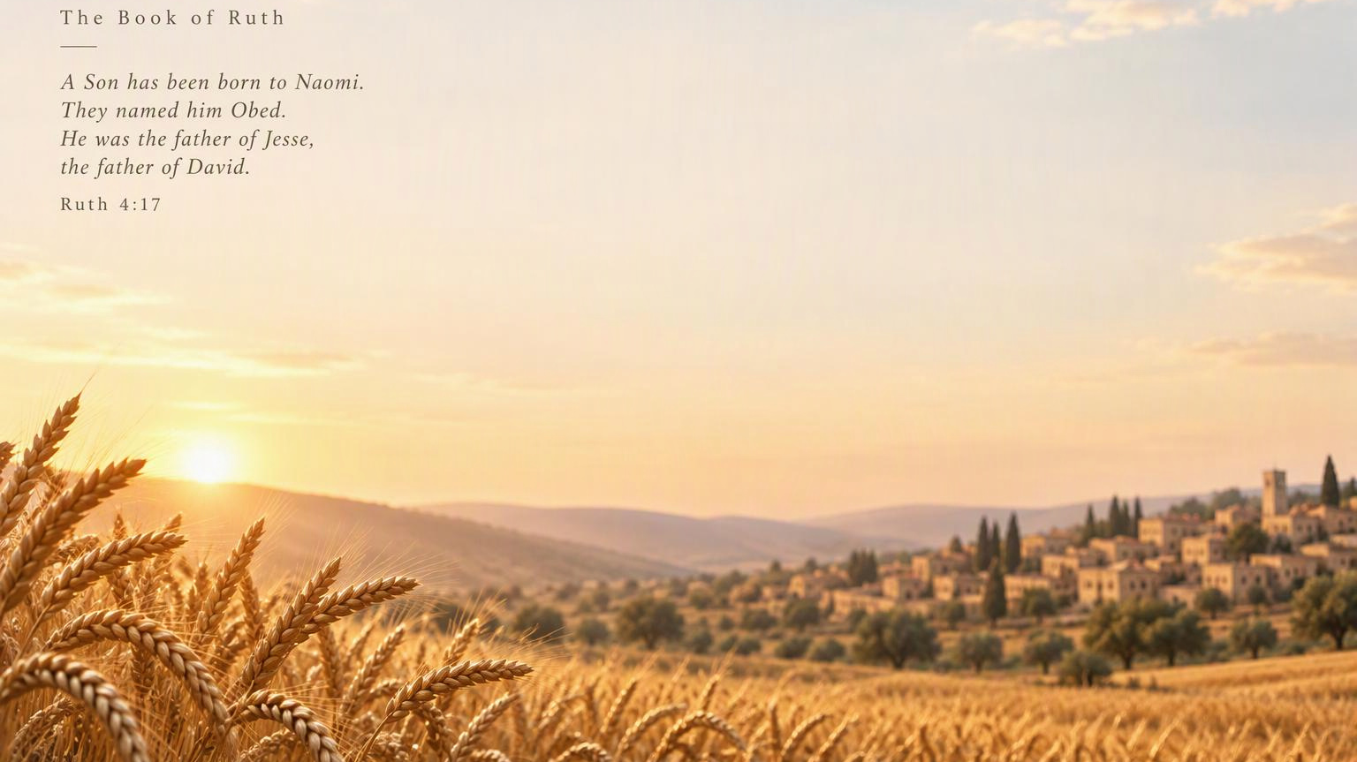
Until A Son was Sent to Us
Timothy S. Yoon

Slide 9
SERMON INTRO
The Recurring Pattern of Divine Providence:
Sending a Child
When God’s people reach an impasse, providence often enters the story through a child.
ISAAC
MOSES
SAMUEL
JESUS
PROMISE
DELIVERANCE
RENEWAL
SALVATION
Genesis 21:1–3
Exodus 2:1–10
1 Samuel 1:19–20
Luke 2:6–11
God’s next great work often begins
in a form the world overlooks.
Scripture arc · Genesis 21 · Exodus 2 · 1 Samuel 1 · Luke 2

Slide 10
RESPONSIVE READING
01 / 05
Ruth 4:1–4
English Standard Version · responsive reading
LEADER
1
CONGREGATION
2
Now Boaz had gone up to the gate and sat down there. And behold, the redeemer, of whom Boaz had spoken, came by. So Boaz said, “Turn aside, friend; sit down here.” And he turned aside and sat down.
And he took ten men of the elders of the city and said, “Sit down here.” So they sat down.
LEADER
3
CONGREGATION
4
So I thought I would tell you of it and say, “Buy it in the presence of those sitting here and in the presence of the elders of my people.” If you will redeem it, redeem it. But if you will not, tell me, that I may know, for there is no one besides you to redeem it, and I come after you.” And he said, “I will redeem it.”
Then he said to the redeemer, “Naomi, who has come back from the country of Moab, is selling the parcel of land that belonged to our relative Elimelech.”
Leader: odd verses · Congregation: even verses
Ruth 4 · ESV text supplied by the user

Slide 11
RESPONSIVE READING
02 / 05
Ruth 4:5–8
English Standard Version · responsive reading
LEADER
5
CONGREGATION
6
Then Boaz said, “The day you buy the field from the hand of Naomi, you also acquire Ruth the Moabite, the widow of the dead, in order to perpetuate the name of the dead in his inheritance.”
Then the redeemer said, “I cannot redeem it for myself, lest I impair my own inheritance. Take my right of redemption yourself, for I cannot redeem it.”
LEADER
7
CONGREGATION
8
Now this was the custom in former times in Israel concerning redeeming and exchanging: to confirm a transaction, the one drew off his sandal and gave it to the other, and this was the manner of attesting in Israel.
So when the redeemer said to Boaz, “Buy it for yourself,” he drew off his sandal.
Leader: odd verses · Congregation: even verses
Ruth 4 · ESV text supplied by the user

Slide 12
RESPONSIVE READING
03 / 05
Ruth 4:9–12
English Standard Version · responsive reading
LEADER
9
CONGREGATION
10
Then Boaz said to the elders and all the people, “You are witnesses this day that I have bought from the hand of Naomi all that belonged to Elimelech and all that belonged to Chilion and to Mahlon.”
Also Ruth the Moabite, the widow of Mahlon, I have bought to be my wife, to perpetuate the name of the dead in his inheritance, that the name of the dead may not be cut off from among his brothers and from the gate of his native place. You are witnesses this day.”
LEADER
11
CONGREGATION
12
Then all the people who were at the gate and the elders said, “We are witnesses. May the Lord make the woman, who is coming into your house, like Rachel and Leah, who together built up the house of Israel. May you act worthily in Ephrathah and be renowned in Bethlehem,”
“and may your house be like the house of Perez, whom Tamar bore to Judah, because of the offspring that the Lord will give you by this young woman.”
Leader: odd verses · Congregation: even verses
Ruth 4 · ESV text supplied by the user

Slide 13
RESPONSIVE READING
04 / 05
Ruth 4:13–16
English Standard Version · responsive reading
LEADER
13
CONGREGATION
14
So Boaz took Ruth, and she became his wife. And he went in to her, and the Lord gave her conception, and she bore a son.
Then the women said to Naomi, “Blessed be the Lord, who has not left you this day without a redeemer, and may his name be renowned in Israel!”
LEADER
15
CONGREGATION
16
“He shall be to you a restorer of life and a nourisher of your old age, for your daughter-in-law who loves you, who is more to you than seven sons, has given birth to him.”
Then Naomi took the child and laid him on her lap and became his nurse.
Leader: odd verses · Congregation: even verses
Ruth 4 · ESV text supplied by the user

Slide 14
RESPONSIVE READING
05 / 05
Ruth 4:17
English Standard Version · responsive reading
Together · VERSE 17
And the women of the neighborhood gave him a name, saying, “A son has been born to Naomi.” They named him Obed. He was the father of Jesse, the father of David.
CONGREGATION
All God’s People Say
Amen!
The story closes with Obed—
father of Jesse, father of David.
Responsive reading concludes
Ruth 4 · ESV text supplied by the user

Slide 15
Until A Son was Sent to Us
Timothy S. Yoon

Slide 16
SERMON BODY · CORE KEYWORD 01
2 Core Keywords of the Book of Ruth
01
Redemption
Hebrew: גֹּאֵל · go’el
To reclaim what was lost—and restore
land, lineage, and future.
RECLAIM
RESTORE
RENEW
the inheritance
the family line
the future
Boaz acts as the willing kinsman-redeemer.
Ruth 4:9–10

Slide 17
SUPPORTING PASSAGE
The Law of Redemption
Leviticus 25:23–25 · ESV
23
“The land shall not be sold in perpetuity, for the land is mine. For you are strangers and sojourners with me.”
24
“And in all the country you possess, you shall allow a redemption of the land.”
25
“If your brother becomes poor and sells part of his property, then his nearest redeemer shall come and redeem what his brother has sold.”
Redemption protects what belongs to God—and restores what poverty has lost.
Legal background for Ruth 4

Slide 18
SUPPORTING PASSAGE
Preserving the Family Name
Deuteronomy 25:5–6 · ESV
5
“If brothers dwell together, and one of them dies and has no son, the wife of the dead man shall not be married outside the family to a stranger. Her husband’s brother shall go in to her and take her as his wife and perform the duty of a husband’s brother to her.”
6
“And the first son whom she bears shall succeed to the name of his dead brother, that his name may not be blotted out of Israel.”
The duty serves a purpose: the family name must continue.
Legal background for Ruth 4

Slide 19
SUPPORTING PASSAGE
Levirate Marriage
Deuteronomy 23:3–4 · ESV
3
“No Ammonite or Moabite may enter the assembly of the Lord. Even to the tenth generation, none of them may enter the assembly of the Lord forever,”
4
“because they did not meet you with bread and with water on the way, when you came out of Egypt, and because they hired against you Balaam the son of Beor from Pethor of Mesopotamia, to curse you.”
Ruth enters Israel’s story under the shadow of this exclusion.
Narrative tension in Ruth

Slide 20
SERMON BODY · CORE KEYWORD 02
2 Core Keywords of the Book of Ruth
02
Loving Kindness
Hebrew: חֶסֶד · hesed
Faithful and obedient love to the Word of God.
FAITHFUL
OBEDIENT
LOVE
steadfast in commitment
aligned with God’s Word
expressed in action
Hesed is love that remains faithful—and obeys.
Ruth · חֶסֶד

Slide 21
THE SPREAD OF HESED · 01
The Hesed of Ruth the Moabitess
Ruth 1:8 · ESV
8
“But Naomi said to her two daughters-in-law, ‘Go, return each of you to her mother’s house. May the Lord deal kindly with you, as you have dealt with the dead and with me.’”
“May the Lord deal kindly with you.”
Ruth 1:8

Slide 22
THE SPREAD OF HESED · 02
The Hesed of Ruth the Moabitess
Ruth 1:16–17 · ESV
16
“But Ruth said, ‘Do not urge me to leave you or to return from following you. For where you go I will go, and where you lodge I will lodge. Your people shall be my people, and your God my God.’”
17
“Where you die I will die, and there will I be buried. May the Lord do so to me and more also if anything but death parts me from you.”
Hesed chooses covenant faithfulness—even unto death.
Ruth 1:16–17

Slide 23
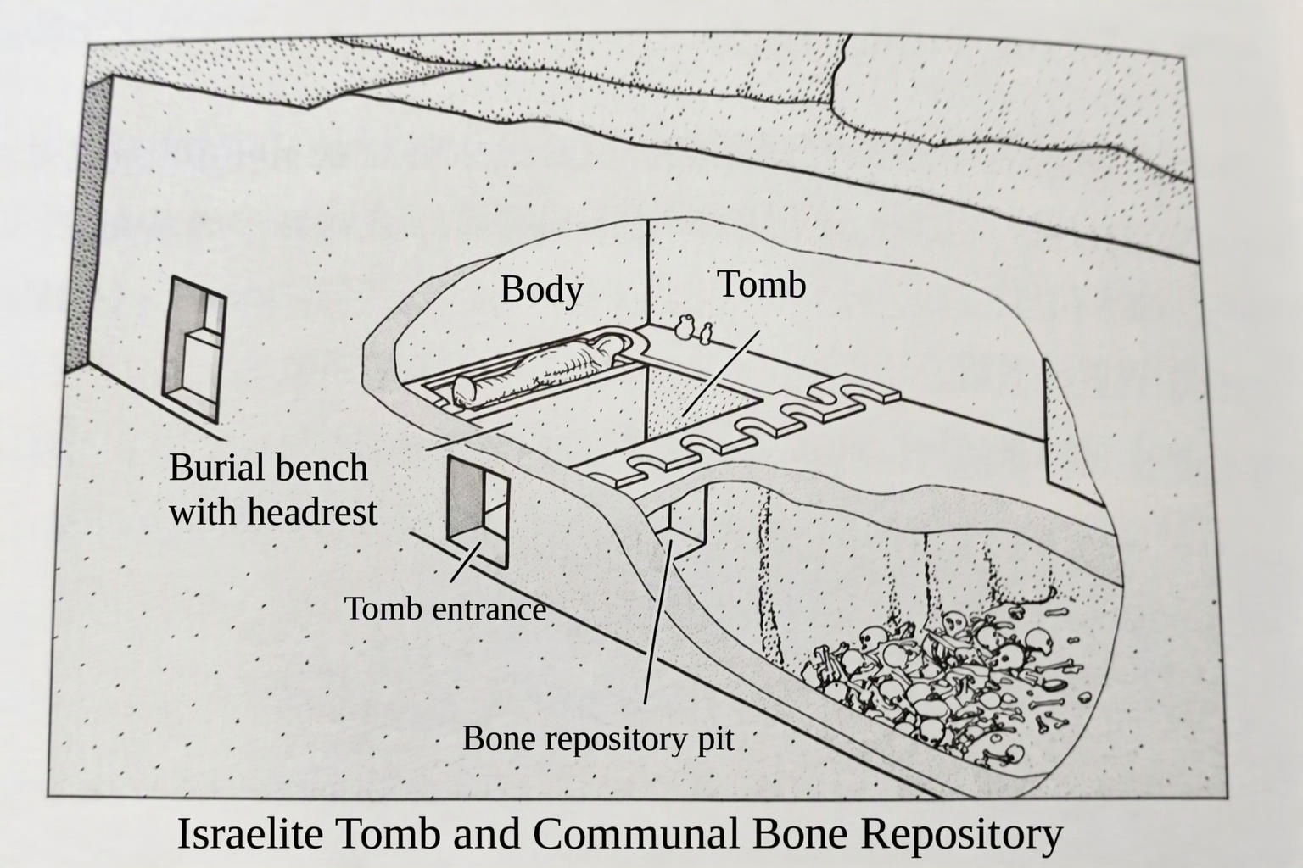
VISUAL REFERENCE · THE SPREAD OF HESED
The Hesed of Ruth the Moabitess
Ruth 1:17
RUTH’S COVENANT WORD
“Where you die
I will die,
and there will
I be buried.”
Hesed remains present
even at the grave.
Visual reference: Israelite tomb and communal bone repository
USER-PROVIDED IMAGE

Slide 24
THE SPREAD OF HESED · 03
The Hesed of Boaz, the Kinsman Redeemer
Ruth 2:20 · ESV
20
“And Naomi said to her daughter-in-law, ‘May he be blessed by the Lord, whose kindness has not forsaken the living or the dead!’ Naomi also said to her, ‘The man is a close relative of ours, one of our redeemers.’”
Cf. Ruth 4:9-10. Ginzberg. Legends of Bible p.518-9
“His kindness has not forsaken the living or the dead.”
Ruth 2:20

Slide 25
THE SPREAD OF HESED · 04
The Hesed of everyone in the Israeli community
Ruth 4:11–12 · ESV
11
“Then all the people who were at the gate and the elders said, ‘We are witnesses. May the Lord make the woman, who is coming into your house, like Rachel and Leah, who together built up the house of Israel. May you act worthily in Ephrathah and be renowned in Bethlehem,’”
12
“and may your house be like the house of Perez, whom Tamar bore to Judah, because of the offspring that the Lord will give you by this young woman.”
The community’s hesed bears witness—and speaks blessing.
Ruth 4:11–12

Slide 26
THE SPREAD OF HESED · 05
The Birth of Obed
Ruth 4:17 · ESV
17
“And the women of the neighborhood gave him a name, saying, ‘A son has been born to Naomi.’ They named him Obed. He was the father of Jesse, the father of David.”
A son is born—and the line leads to David.
Ruth 4:17

Slide 27
The Battle God Focuses on in the Age of the Judges
CONCLUSION · THE BOOK OF RUTH
A Battle to LIVE OUT HESED

Slide 28
HEBREW WORD STUDY · PSALMS 1–2
Meditate or Plot?
ONE ROOT · TWO DIRECTIONS
PSALM 1:2
THE SHARED ROOT
PSALM 2:1
MEDITATE
PLOT
הָגָה
יֶהְגֶּה · yehgeh
יֶהְגּוּ · yehgu
hāgâ · hagah
“but his delight is in the lawᵇ of the Lord,
and on his law he meditates day and night.”
“Why do the nations rageᵃ
and the peoples plot in vain?”
to murmur
to ponder
to rehearse
Object: God’s Torah
Direction: faithful delight
Object: emptiness
Direction: defiant resistance
The battle is not whether we meditate—but what our hearts rehearse.
Psalm 1:2 · Psalm 2:1
Hebrew forms: Bible Hub interlinear text analysis · Strong’s 1897

Slide 29
Until A Son was Sent to Us
Timothy S. Yoon

Slide 30
1 Corinthians 11:23-26
The Lord Jesus, on the night
He was betrayed, took bread,
and when He had given thanks,
He broke it and said,
“This is My body, which is for you; do this in remembrance of Me.”
In the same way, after supper
He took the cup, saying,
“This cup is the new covenant in My blood; do this, whenever you drink it, in remembrance of Me.”
For whenever you eat this bread and drink this cup, you proclaim
the Lord’s death until He comes.

Slide 31
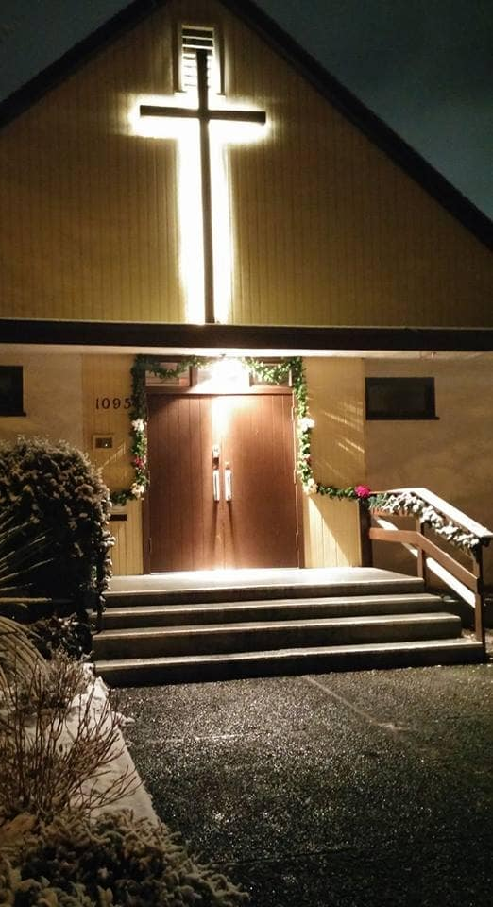
We’re so glad you joined us today!
Please join us
for refreshments
& fellowship!
See the bulletin
for more info,
or contact us at parkdaleonline@gmail.com

